Slide 1
Savonia UAS
19.2.2024
PEKKA REINIKAINEN
Specialist, Int’l Advocacy and Communication
Finnish Red Cross
European Union
Climate Pact Ambassador European Commission
DG Clima
WHERE IS
THE WORLD
GOING?

Slide 2
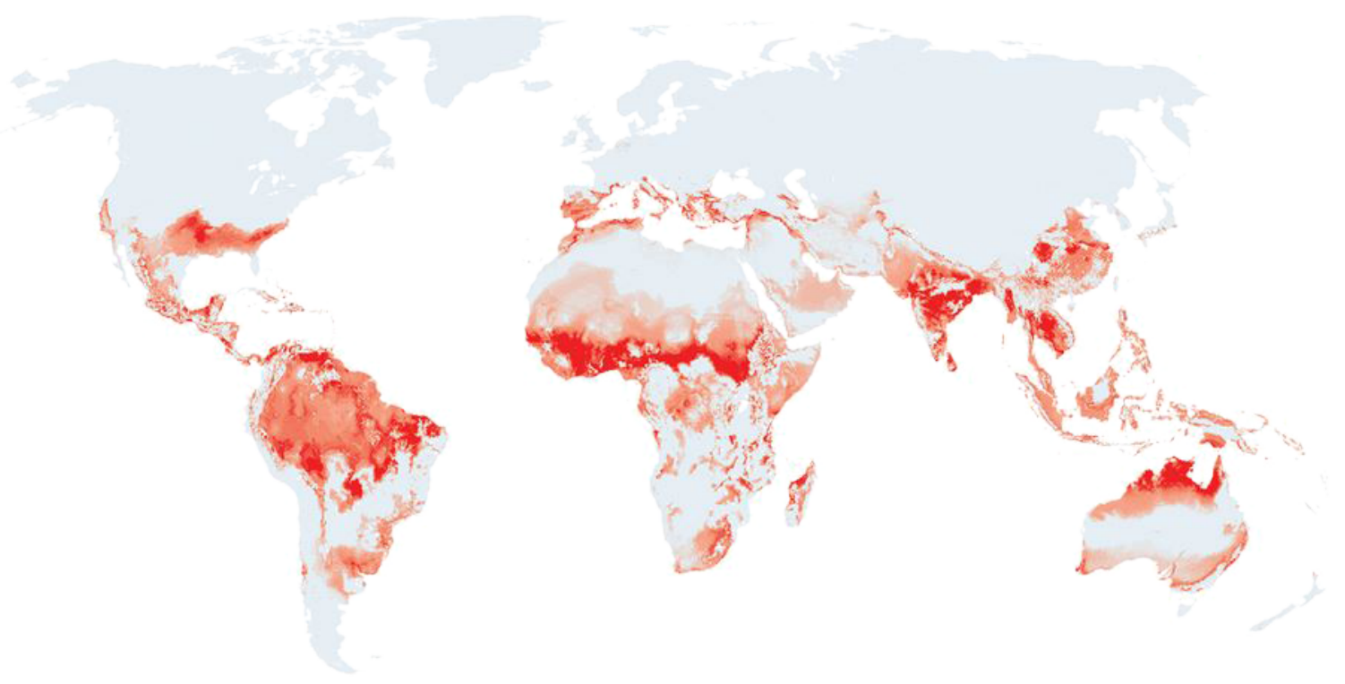
PREDICTION OF UNSUITABLE LIVING ENVIRONMENTS FOR HUMANS IN 2070
Temperature rise
in the fork
2⁰C - 2,5⁰C
compared to
pre-industrial
levels.
The forecast
is based on
predicted
temperatures
and rainfall
Living environments most unsuitable
for human habitation
Less suitable living environments
More suitable (no major changes) in historical perspective
Source: IPCC ARS ”Future of human climate niche”, by Chi Xu et al. 2020. Artwork based on the Economist.
Extracted from IFRC & UN OCHA ”Extreme heat; preparing for the heatwaves of the future – October 2022

Slide 3
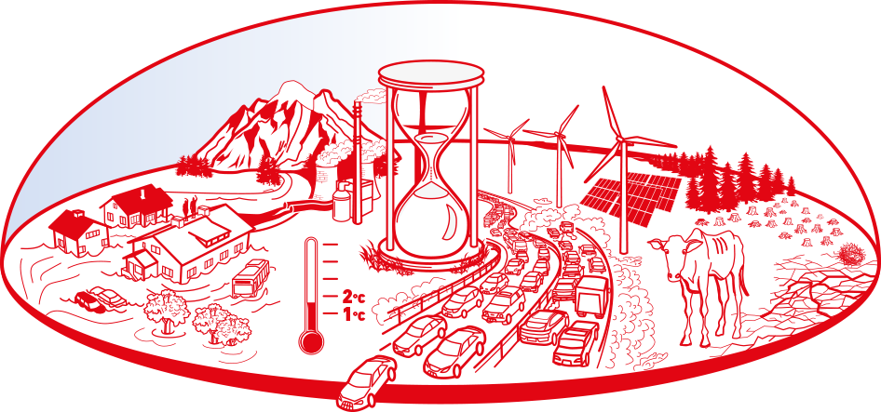
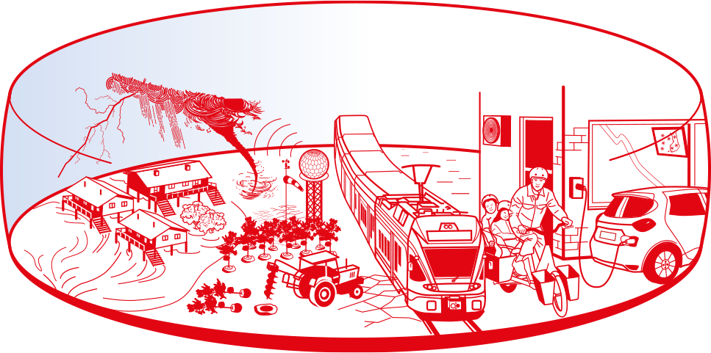
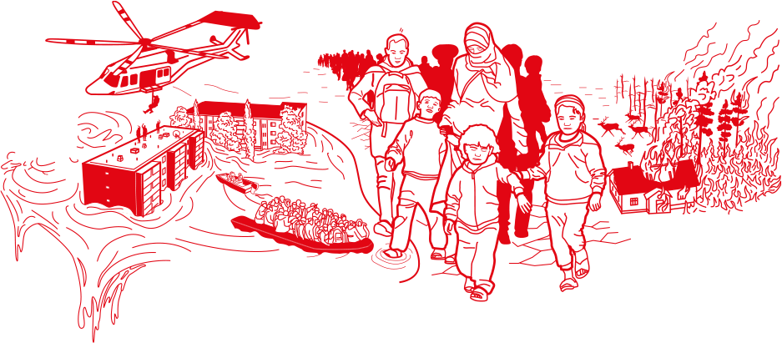
© Klimaburger-concept
Pekka Reinikainen
EU Climate Pact Ambassador
LEVEL ONE
what does the
thermometer
read?
LEVEL TWO
prevent
mitigate
adapt
CLIMA-
BURGER
1-2-3
LEVEL THREE
respond to
all kinds of
crises and
disasters
OVERSHOOT
CRITICCAL THRESHOLD
RISK: out-of-control humanitarian emergency
Graphics: JuJu Design Jussi Latvala

Slide 4
© Klimaburger-concepti:
Pekka Reinikainen
EU Climate Pact Ambassador
LEVEL ONE
what does the
thermometer
read?
LEVEL TWO
prevent
mitigate
adapt
CLIMA-
BURGER
1-2-3
LEVEL THREE
respond to
all kinds of
crises and
disasters
OVERSHOOT
CRITICCAL THRESHOLD
RISK: out-of-control humanitarian emergency
Graphics: JuJu Design Jussi Latvala

Slide 5
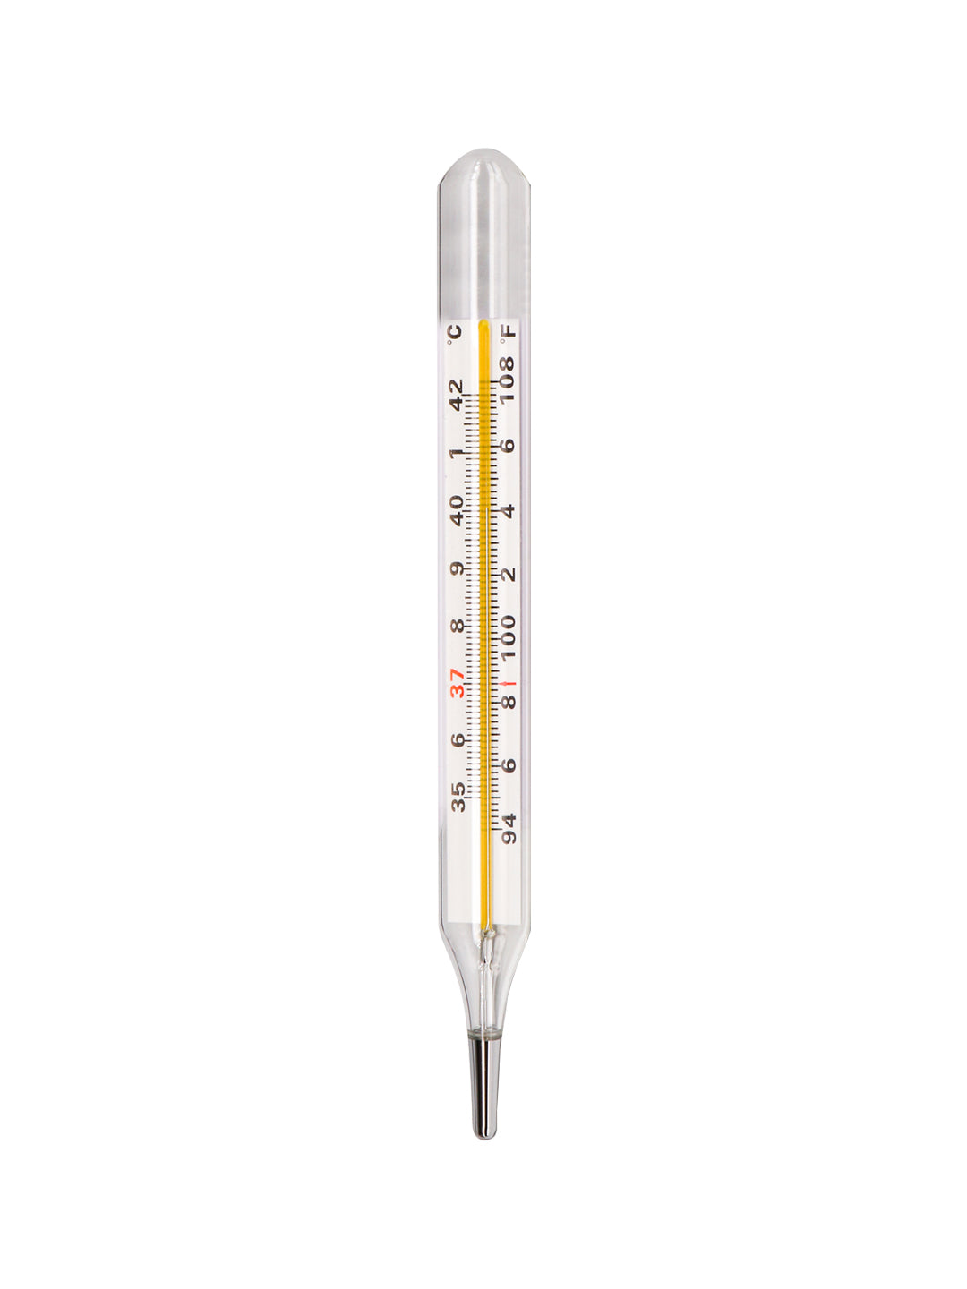
HOMO SAPIENS V. MOTHER EARTH
ENDLESS LOW INTENSITY INFLAMMATION WITH CONSEQUENCES
OR
NEVER-ENDING
SHUDDERS & QUIVERS AT
AROUND 39° C ?
+ 2,5
DEGREES
= 38,7°C
+ 1,5 DEGREES
= 37,7°C
”NORMAL”
TEMP
36,2°C

Slide 6
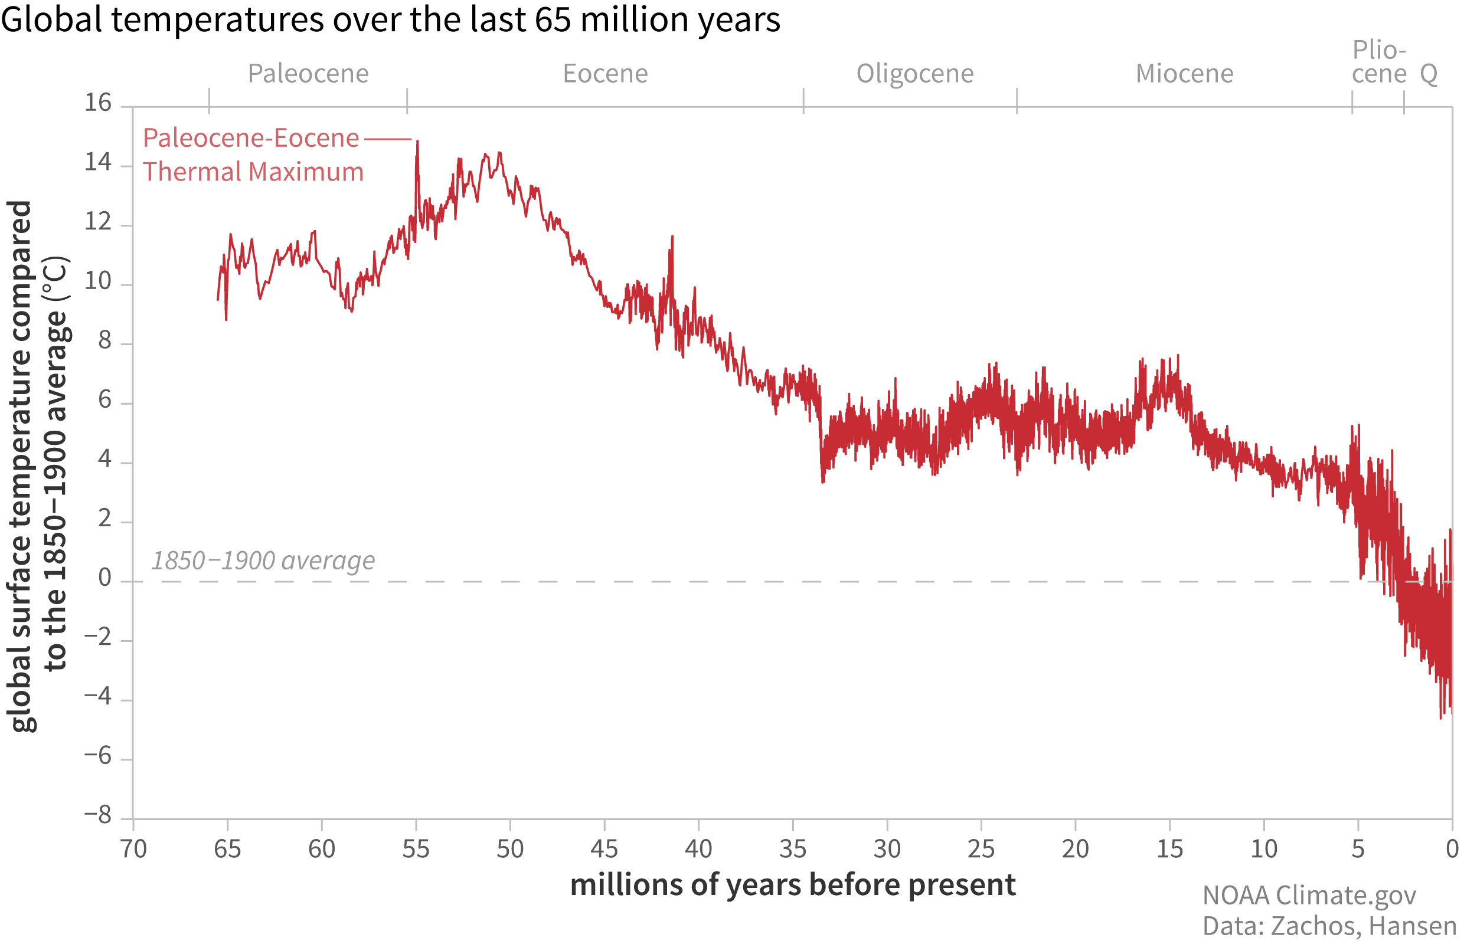
GLOBAL TEMPERATURES DURING
THE MOST RECENT 65 MILLION YEARS
Global surface temperature compared
To the 1850-1900 average (°C)
1850-1900 average for pre-industrial period
Millions of years prior to today

Slide 7
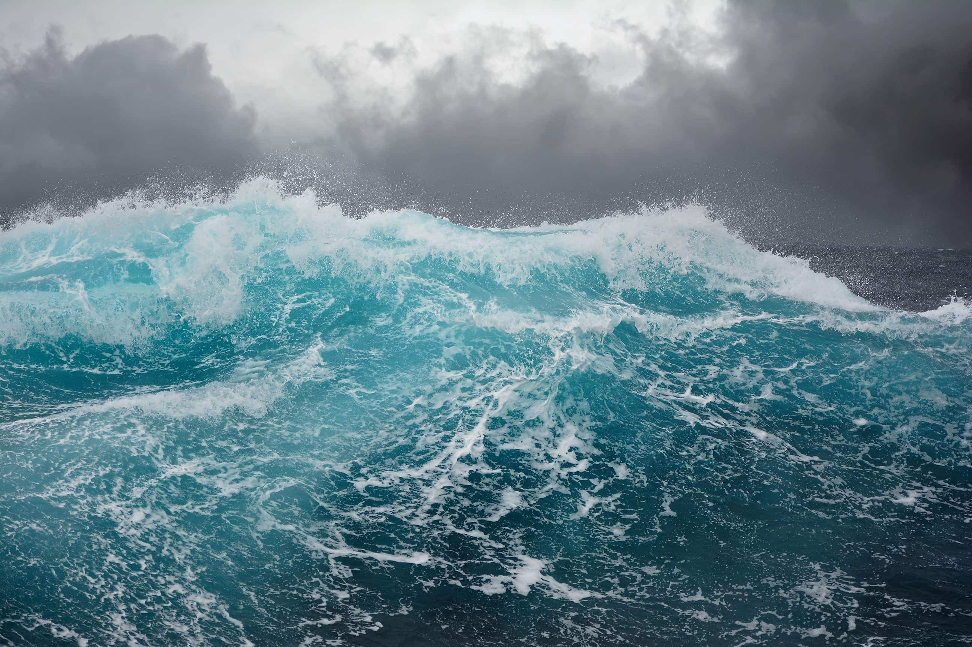
THE EARTH LAST EXPERIENCED A CO₂ LEVEL EQUIVALENT TO THE PRESENT 3-5 MILLION YEARS AGO. THE SEA LEVEL AT THE TIME WAS 10-20 METERS HIGHER THAN TODAY
WMO former SG Petteri Taalas 2018

Slide 8
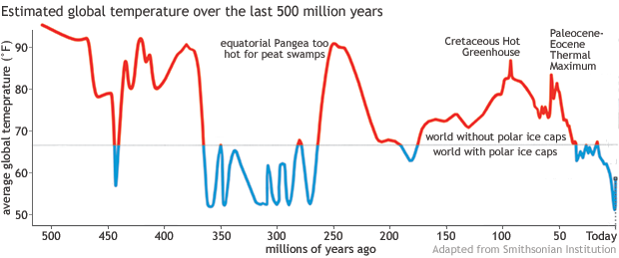
ESTIMATED GLOBAL AVERAGE TEMPERATURE
FOR THE PAST 500 MILLION YEARS
Average global temperature (⁰F)
World without
Polar ice caps
World with Polar ice caps
Today
Millions of years prior to today

Slide 9
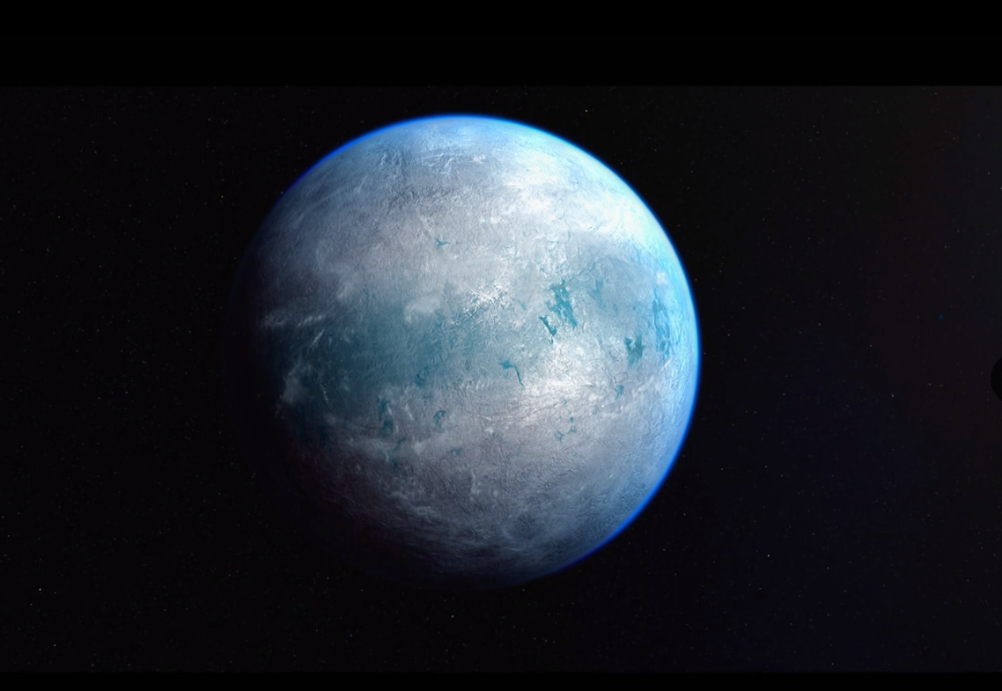
SNOWBALL
ALMOST A KILOMETRE OF ICE COVERING UP THE PLANET
717 MILLION YEARS AGO

Slide 10
THIS IS A FOSSIL OF A LEAF
FROM A TREE WHICH STOOD
IN A FOREST NEAR THE NORTH POLE
45 MILLION YEARS AGO

Slide 11
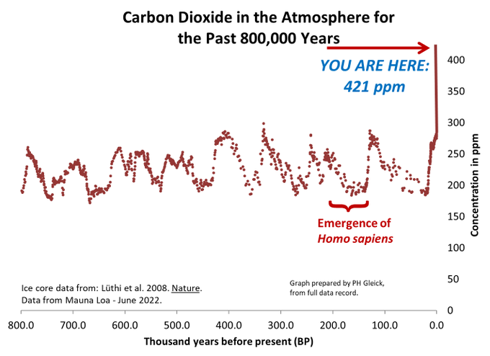
ATHMOSPHERIC CO²-CONCENTRATION
DURING THE PAST 800,000 YEARS
06/2022 The athmospheric CO²-concentration was 421,83 ppm
In 2021 the concentration was 419,90 ppm
Ten years ago the concentration was396,40 ppm
Athmospheric CO²concentration should not exceed 350,00 ppm
Situation 07/2023:
422,14 ppm
Athmospheric CO²-conentration (ppm)
Homo Sapiens
appears
on the scene
Measurement samples from permafrost Lüthi et al. 2008 Nature
Current values as monthly averages from the Mauna Loa measuring station
Thousands of years before modern times

Slide 12
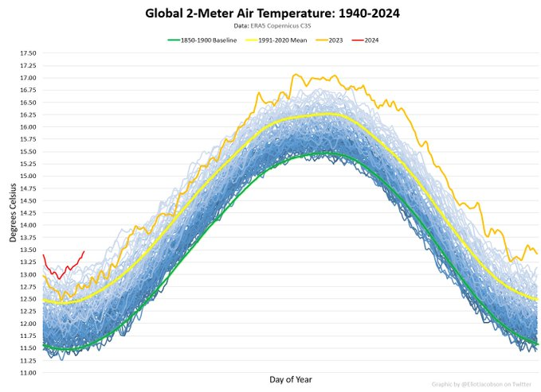
GLOBAL TEMPERATURE 1940-2024
MEASURED AT 2 METRE LEVEL
ENNUSTE
DATA: ERAS Copernicus
1850-1900 baseline
1991-2020 aver.
2023
2024
Degrees Celcius(°C)
Compared with period 1850-1900
Varmest January ever measured: +1,65°C
Warmest 31.1. ever: +1,93°C
Days of the year

Slide 13
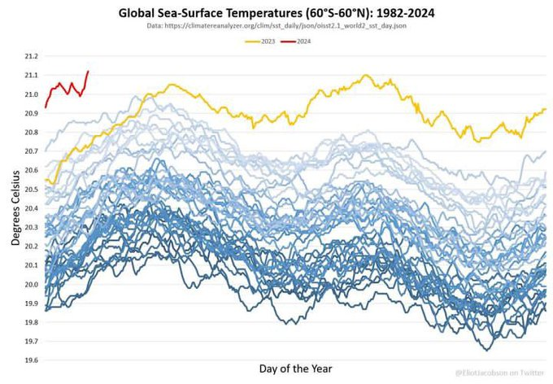
GLOBAL SEA SURFACE TEMPERATURE
1982-2024 (65⁰S – 60⁰N)
DATA: Climatereanalyzer.org
2023
2024
All other years
since 1982
Degrees Celcius (°C)
Days of the year

Slide 14
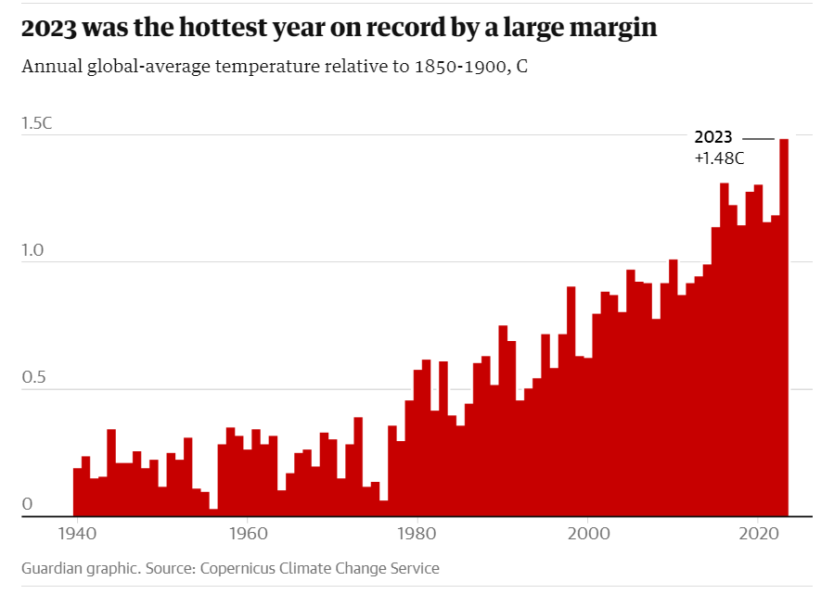
2023: HOTTEST GLOBE IN 120 000 YEARS
2023 was the hottest year in record by a large margin
2023:
1,48°C
Source: The Guardianin grafiikka. Data: EU, Copernicus Climate Change Service

Slide 15
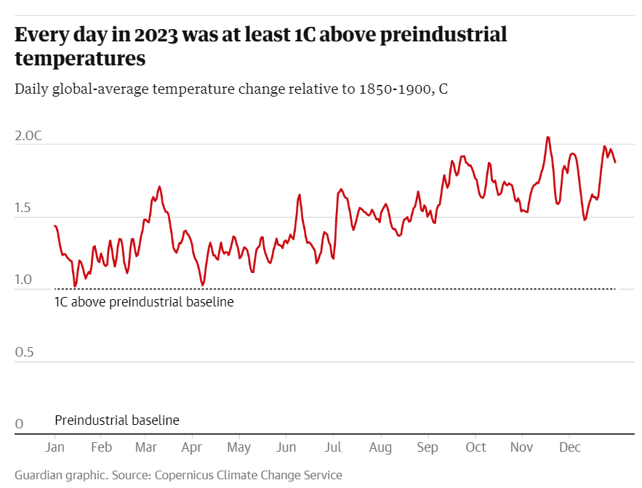
2023: EVERY SINGLE DAY ABOVE 1°C
HALF OVER 1,5°C TWO DAYS OVER 2,0°C
Daily global-average temperature change relative to 1850-1900 in°C
1,48°C
1°C above preindustrial baseline
Preindustrial baseline
Source: The Guardianin grafiikka. Data: EU, Copernicus Climate Change Service

Slide 16
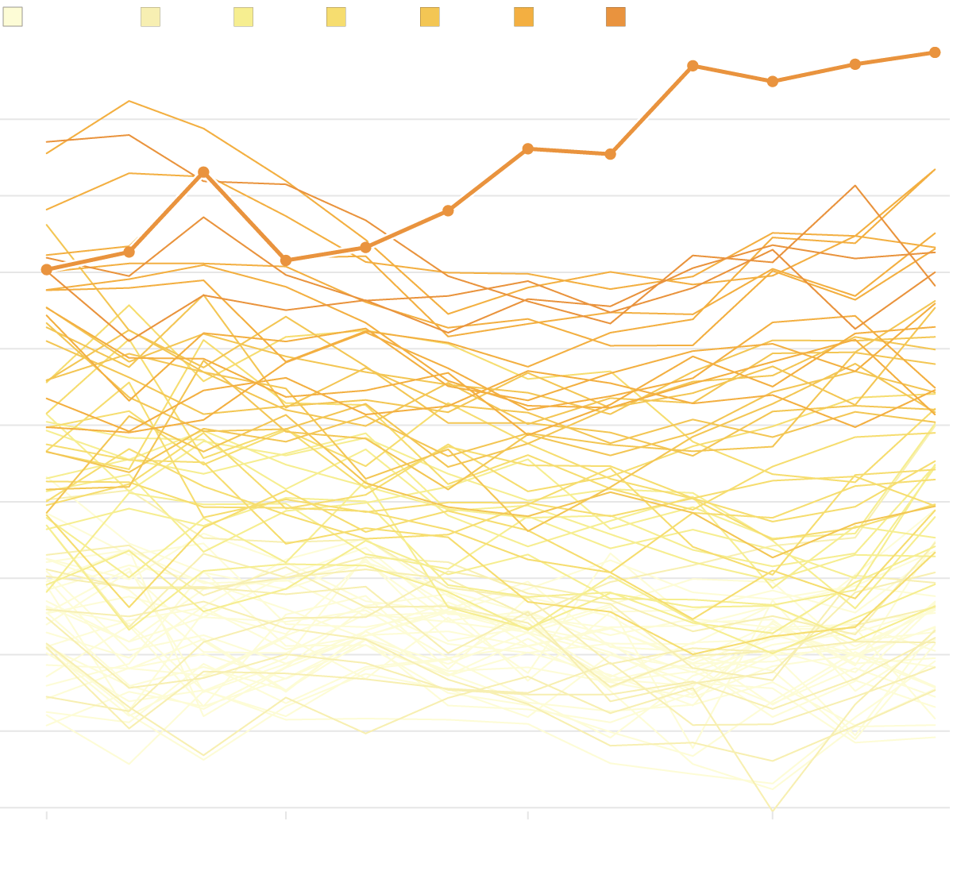
1940-1960 1970s 1980s 1990s 2000 2010s 2020s
november
december
september
+1,78°C
+1,6°C
+1,4°
+1.2°
+1,0°
+0,8°
+0,6°
+0,4°
+0.2°
0
−0.2°
year 2023
october
march
july
august
february
may
june
january
april
All other years
since 1940s
2023 MONTH-BY-MONTH
Source: Copernicus/ECMWF, Graphics:

Slide 17
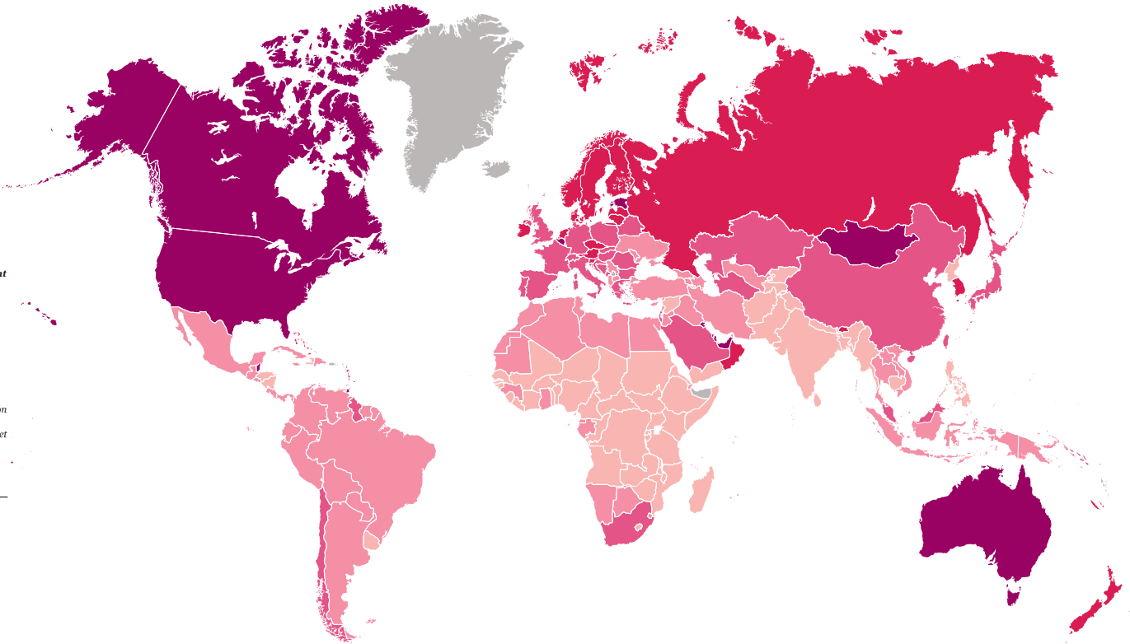
An individual's ecological footprint = the state's footprint divided by the population
In order for us to live within the limits of our planet's resources, humanity's ecological footprint should be smaller
than the Earth's biocapacity. Currently, this level is 1.6 global hectares (gha) per person. If a country's ecological
footprint is, for example, 6.4 gha, its inhabitants overshoot the earth’s capacity fourfold.
Additional informtion: data.footprintnetwork.org
Finland 31.3.2023
FINLAND
6,4 gha (2018)
per person.
That is x 5
overshoot
The world 2.8.2023
<1,7gha per person
1,7-3,4gha per person
3,4-5,1gha per person
5,1-6,7gha per person
>6,7gha per person
Unsufficient information
Source: Living Planet Report 2022, Building a Nature-Positive Society. WWF October 2022

Slide 18
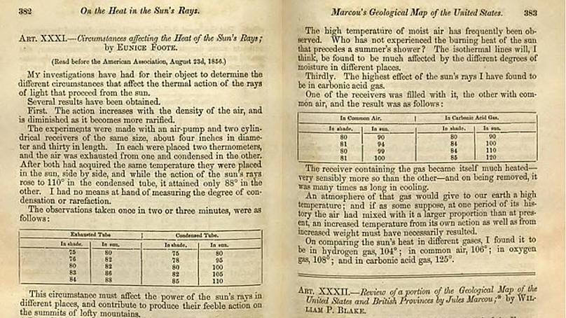
23.8.1856: CO² WARMS THE GLOBE
In 1856, 167 years ago, Eunice Newton Foote, a 37-year-old American, wrote a paper entitled "Circumstances affecting the Heat of the Sun's Rays", in which she scientifically proved for the first time that the presence of CO² gas in the atmosphere would lead to global warming. The paper was presented at the meeting of the American Association
for the Advancement of Science on August 23, 1856

Slide 19
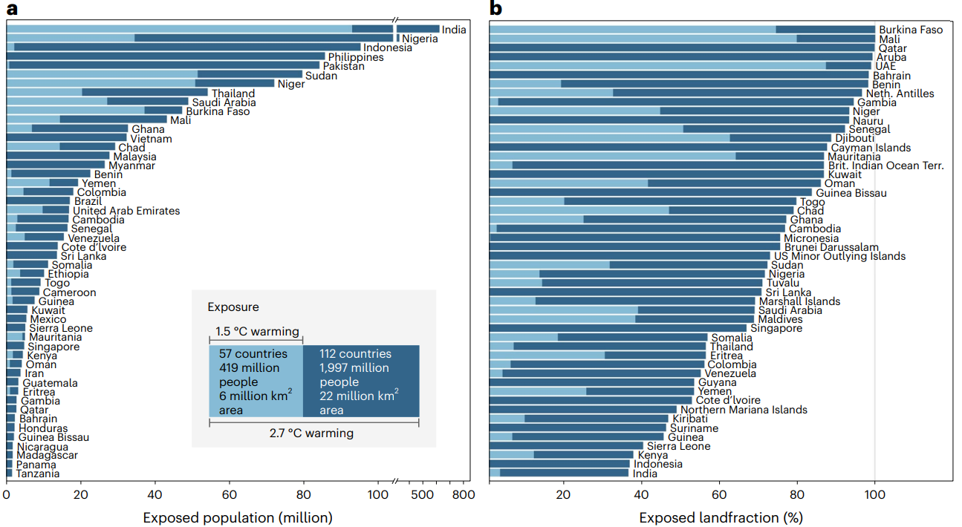
Determining the human cost
of climate change
A
Exposure
B
Exposed population (millions)
Exposed landfraction (%)
Country-specific exposure to extreme heat (29°C or more) after average temperature increases of either 1.5°C or 2.7°C Figure a) shows the number of exposed populations for the top 50 countries around 2070 in a world of 9.5 billion people. It should be noted that for the two most populous countries, India and Nigeria, the scale of the drawing is not sufficient. Figure b) shows the share of the land area exposed to climate extremes from the total area of the states for the top 50 countries. In both figures, the 1.5°C situation is indicated by a light blue color, and the 2.7°C situation by a dark blue color, both in the background and in the bars.
Source: Quantifying the human cost of global warming; Nature Sustainability 22 May 2023
Fig. 5 | Country-level exposure to unprecedented heat (MAT ≥29 °C) at 2.7 °C and 1.5 °C global warming in a world of 9.5 billion people (around 2070 under SSP2). a, Population exposed for the top 50 countries ranked under 2.7 °C global warming (dark blue) with exposure at 1.5 °C global warming overlaid (pale blue). Note the break in the x axis for the top two countries. b, Fraction of land area exposed for the top 50 countries (again ranked under 2.7 °C global warming with results for 1.5 °C global warming overlaid). The inset in a summarizes the total global exposure of countries, population and land area at the two levels of global warming, with results for all countries provided in Supplementary Data. UAE, United Arab Emirates; Neth. Antilles, Netherlands Antilles; Brit. Indian Ocean Terr., British Indian Ocean Territory.

Slide 20
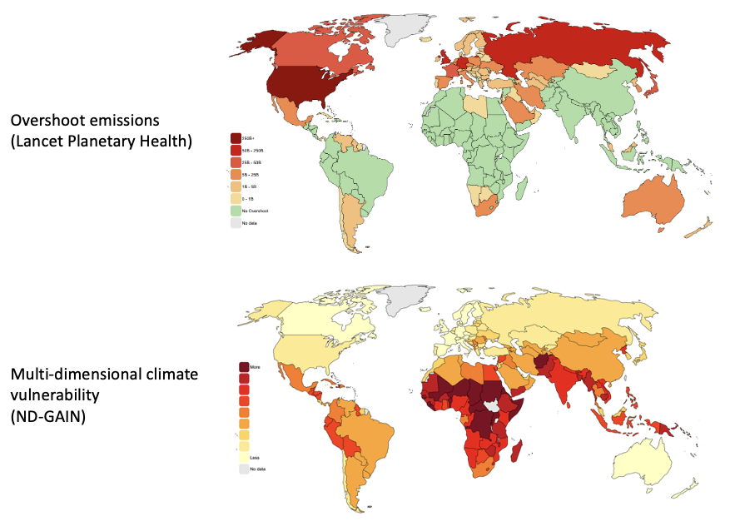
OVERSHOOT EMISSIONS
Source: Lancet Planetary Health
CLIMATE
VULNERABILITY
Source: ND-Gain

Slide 21
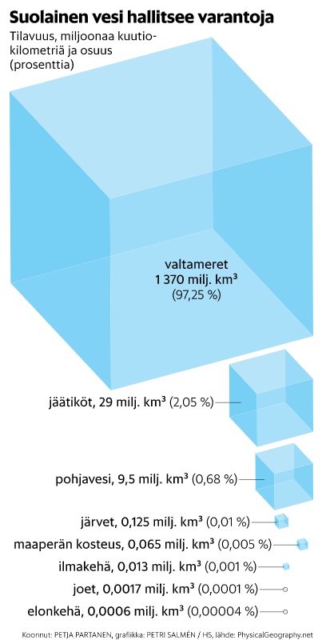
Salt water dominates the reserves
Volume, millions of cubic
kilometers and share
(in percent)
oceans
1,370 mm km³
(97,25%)
glaciers 29 mm km³ (2.05%)
water table 9.5 mm km³ (0.68%)
lakes 0.125 mm km³ (0.01%)
soil moisture 0.065 mm km³ (0,005%)
atmosphere 0.013 mm km³ (0,001%)
rivers 0.0017 mm km³ (0,0001%)
life cycle 0.0006 mm km³ (0,00004%)
THE WATERS OF THE WORLD
Source: PhysicalGeography.net, HS Petja Partanen, graphics: Petri Salmen

Slide 22
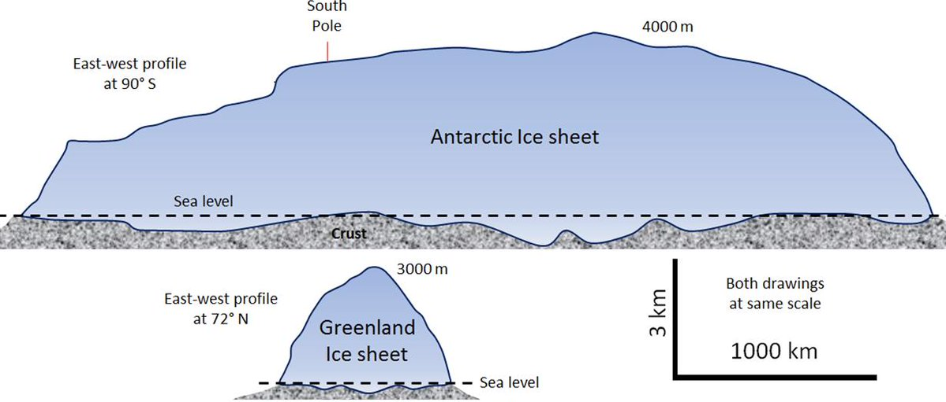
ICE MASSES of GREENLAND AND the ANTARCTIC
South Pole
4000 metres
East-west profile 90⁰South
Antarctic ice sheet
Sea level
Crust
3000 metres
Both drawings
At same scale
1000 kilometres
East-west profile 72⁰North
3 kilometres
Greenland
ice sheet
Sea level

Slide 23
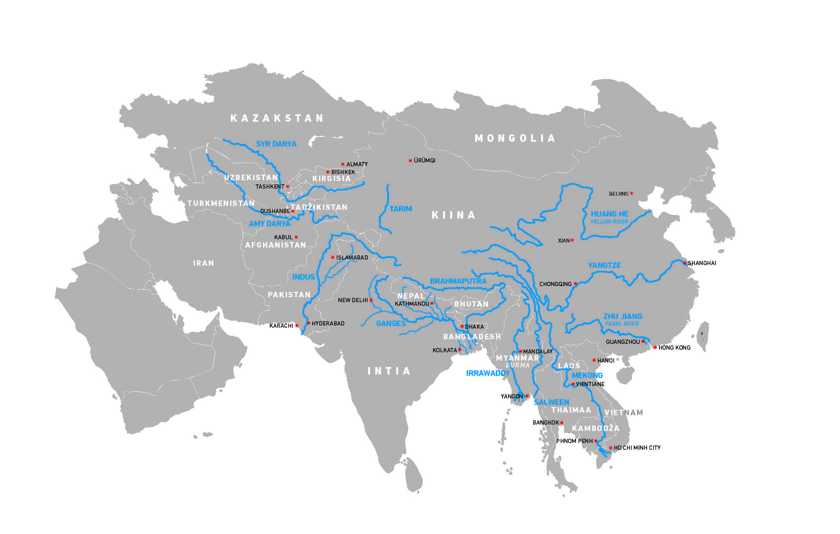
The Himalayas, the Karakorum
and the Tibetan Plateau
Billions
of people
depend on the
glaciers of the
Himalayan and
Karakorum
mountains and
the Tibetan
Plateau for their
water supply.
Map: Jussi Latvala, JuJu Design

Slide 24
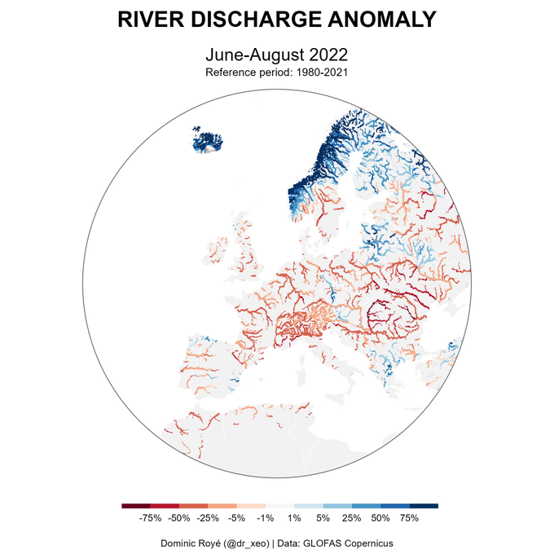
DEVIATIONS IN EUROPEAN RIVER FLOWS IN
JUNE-AUGUST 2022 COMPARATIVE INFORMATION 1980-2021
Vertaustieto 1980-2021
The worst drought
in Europe in 500 years. The review, which ran from June to August 12, 2022, found that the
river flow decreased by almost a third on average, at worst by
62 percent.

Slide 25
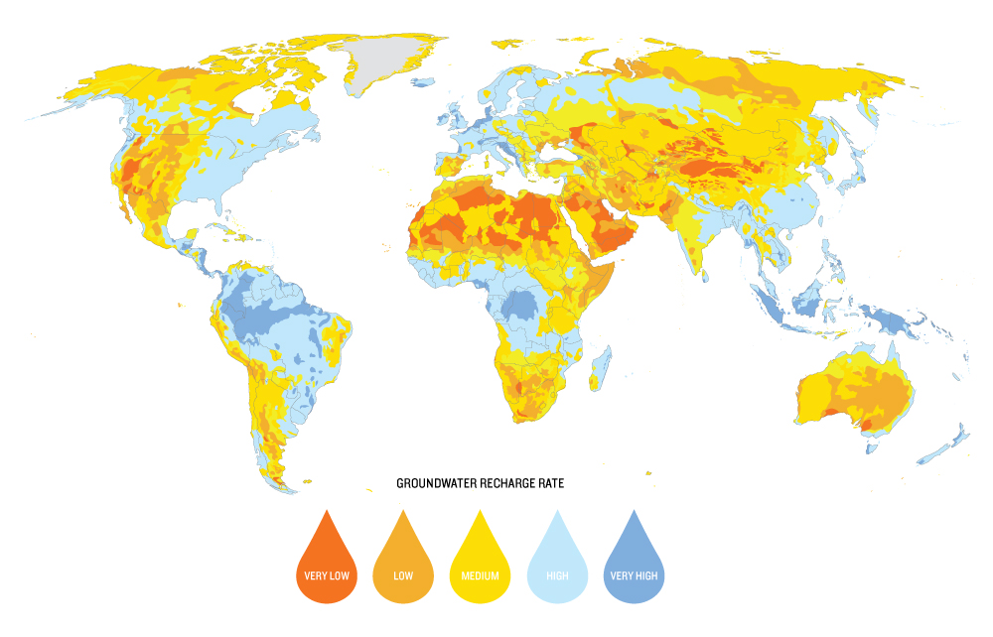
GROUNDWATERS OF THE WORLD
USED UP IN 30 YEARS
This groundwater basin
needs 6,000 years of
rainfall to fill up again
Regeneration capacity of groundwater basins
Very
low
Low
Medium
High
Very
high

Slide 26
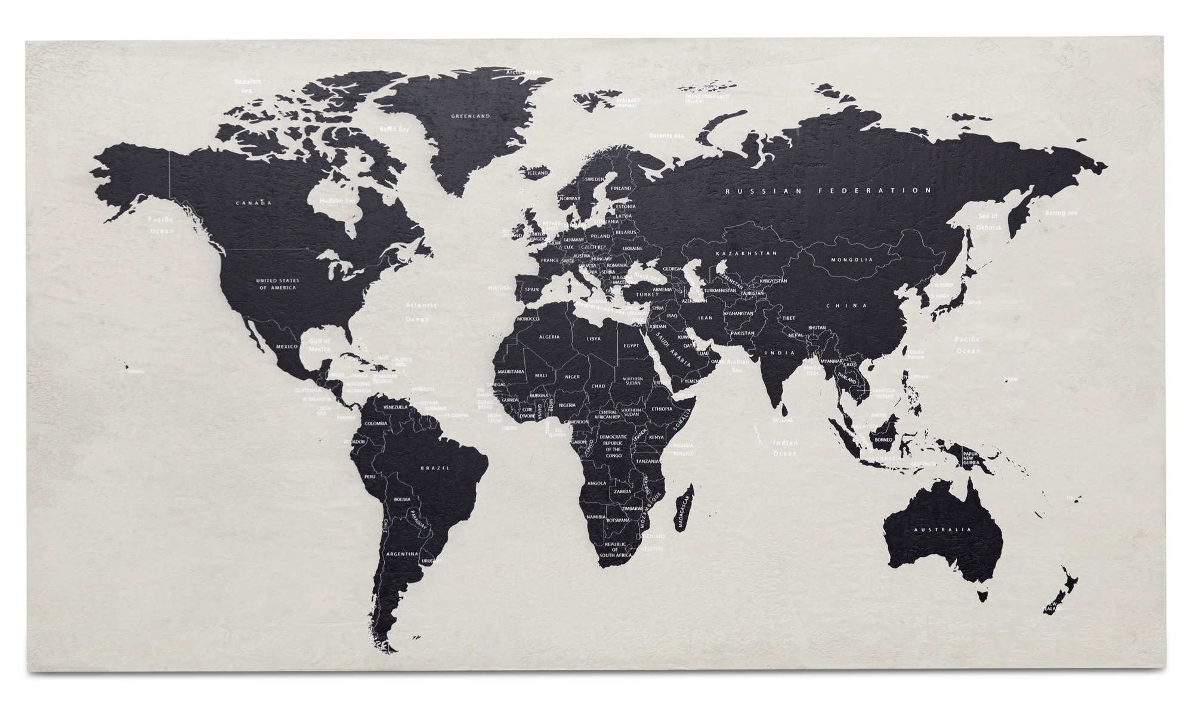
MORTALITY-INCREASING HEAT
ANNUALLY IN 2100
47,6%
RCP2,6
Based on the IPCC forecast
2100
of the world’s population
will live in an area
where the risk of death
has increased due to heat
and humidity
Source: Mora, C., Dousset, B., Caldwell, Powell, Geronimo, Bielecki, Counsell, Dietrich, Johnston, Louis, Lucas, McKenzie, Shea, Tseng, Giambelluca, Leon, Hawkins, Trauernicht (Global Risk of Deadly Heat. Nature Climate Change, 7 (7) 2017 .

Slide 27
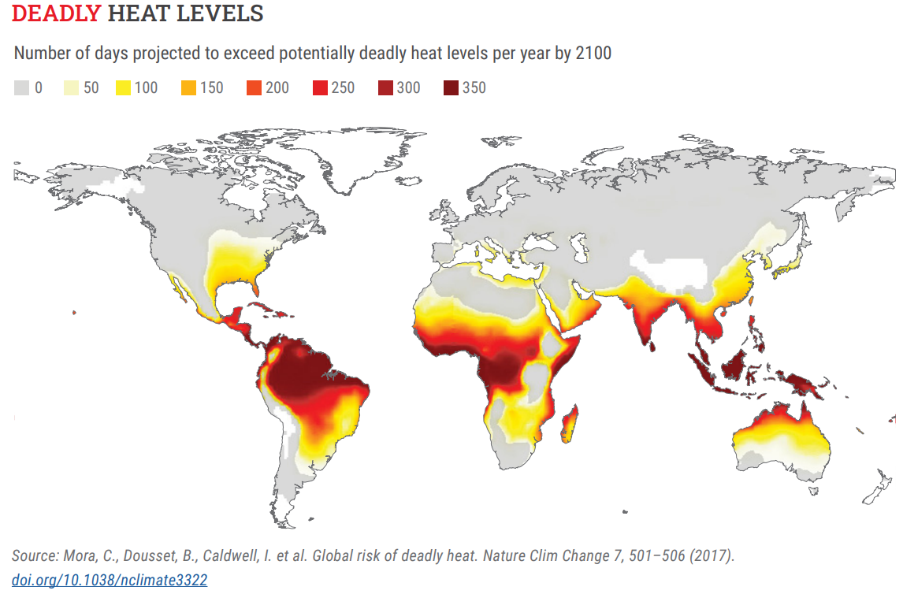
MORTALITY-INCREASING HEAT
The number of days per year when the limit of heat that increases mortality will be exceeded in 2100
Source: Mora, C., Dousset, B., Caldwell, Powell, Geronimo, Bielecki, Counsell, Dietrich, Johnston, Louis, Lucas, McKenzie, Shea, Tseng, Giambelluca, Leon, Hawkins, Trauernicht Global Risk of Deadly Heat. Nature Climate Change, 7 (7) 2017 .

Slide 28
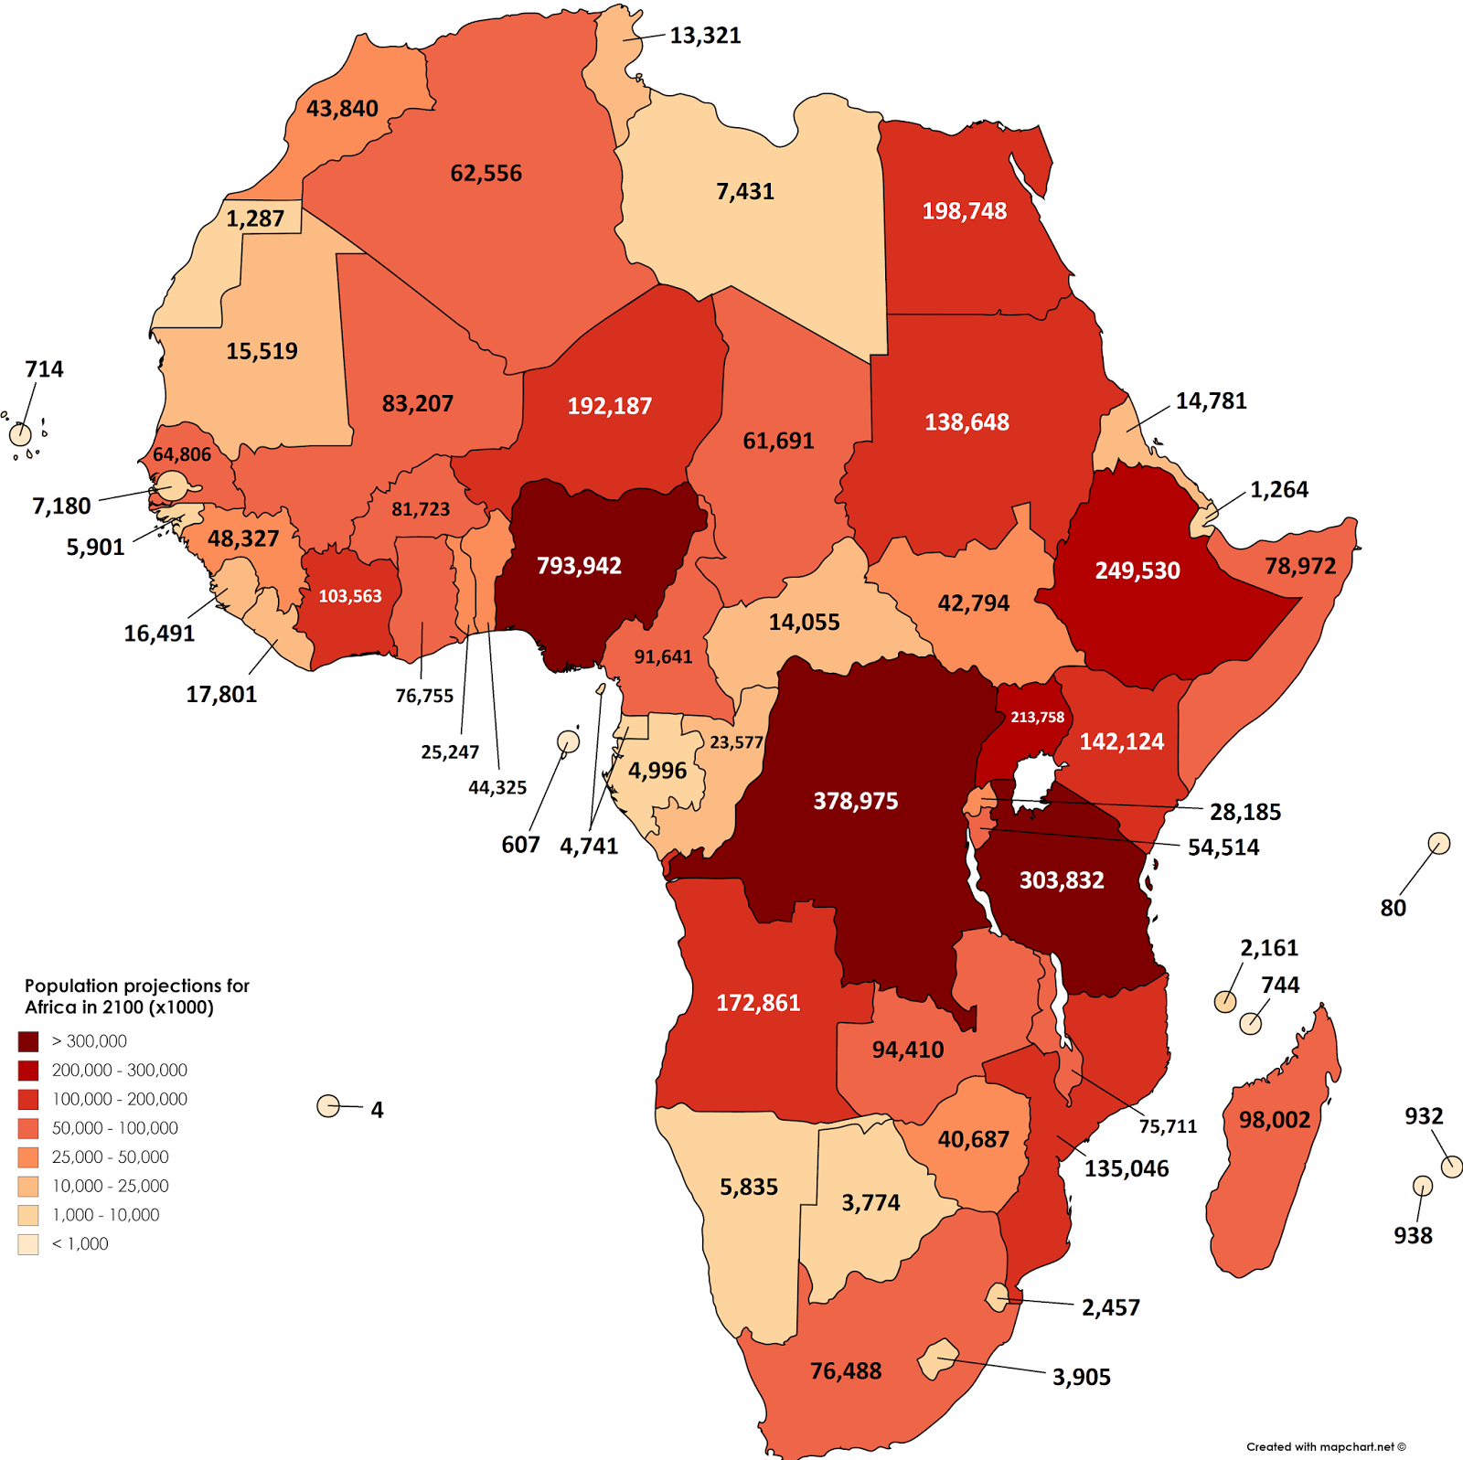
THE LAST POPULATION EXPLOSION?
Population projections for Africa in 2100 (x thousands)

Slide 29
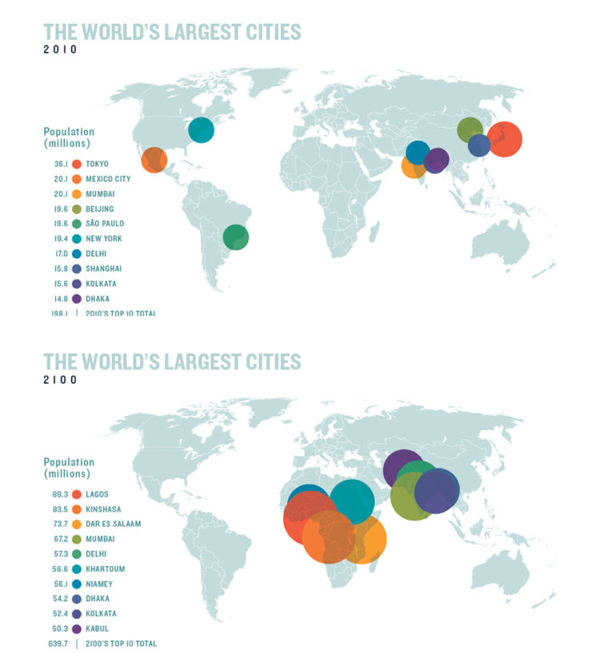
2010: 198 millions
Population
In millions
36,1
20,1
20,1
19,6
19,6
19,4
17,0
15,8
15,6
14,8
Tokyo
Mexico City
Mumbai
Beijing
Sao Paolo
New York
Delhi
Shanghai
Kolkata
Dhaka
WORLD'S LARGEST CITIES 2010/2100
2010 top ten cities with a total of 198 million inhabitants
2100: 640 millions
Population
In millions
88
83
74
67
57
57
56
54
52
50
Lagos
KiNshasa
Das es salaam
Mumbai
Delhi
Khartoum
Niamey
Dhaka
Kolkata
kabul
2100 top ten cities with a total of 640 million inhabitants

Slide 30
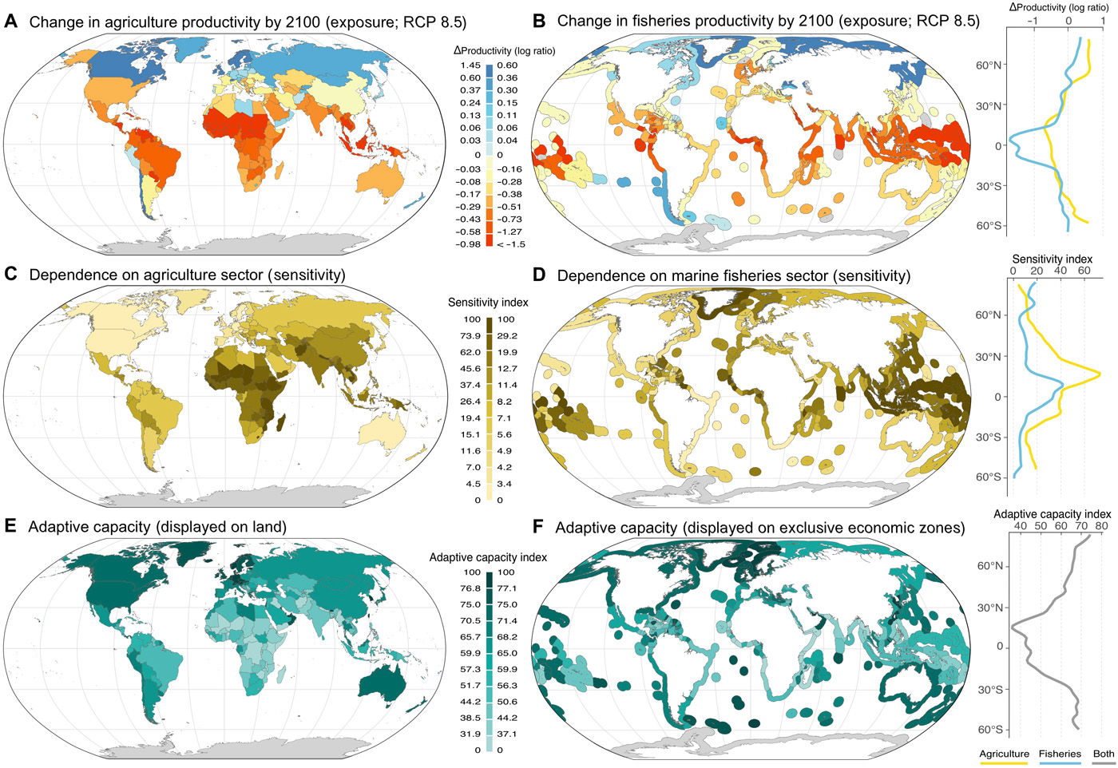
PRODUCTIVITY/SENSITIVITY/CAPACITY TO ADAPT
A Change in agriculture productivity by 2100 (RCP8.5)
B Change in fisheries productivity by 2100 (RCP8.5)
Productivity
C Dependence on agriculture sector (sensitivity)
D Dependence on fisheries sector (sensitivity)
Sensitivity
E Adaptive capacity (displayed on land)
F adaptive capacity (exclusive economic zones)
Capacity to adapt
Agriculture Fisheries Combined
Source: Lauric, Thiault, Mora, Cinner, Cheung, Graham, Januchowski-Hartley, Mouillot, Sumaila, Claudet:
Escaping the perfect storm of simultaneous climate change impacts on agriculture and marine fisheries. Science Advances 27 Nov 2019

Slide 31
Crises belt

Slide 32
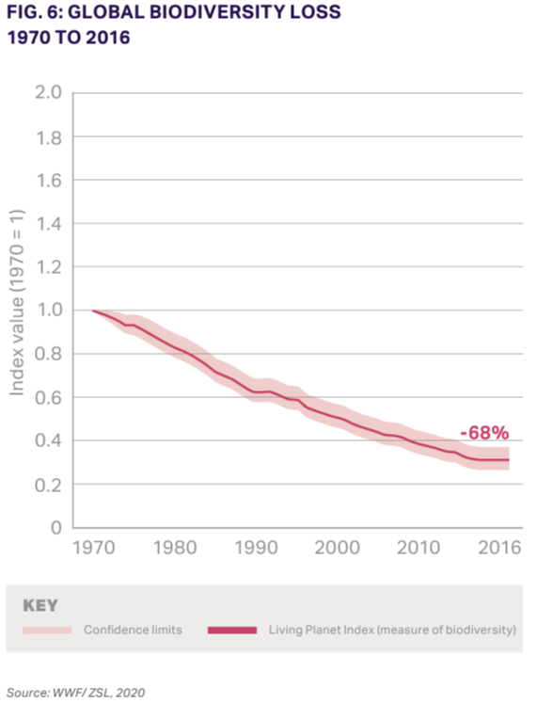
GLOBAL BIODIVERSITY LOSS
1970-2016
Variation intervall
Living Planet-index (Measures biodiversity)
Source: Vision for 2050; Time to Transform, WBCSD 2022

Slide 33
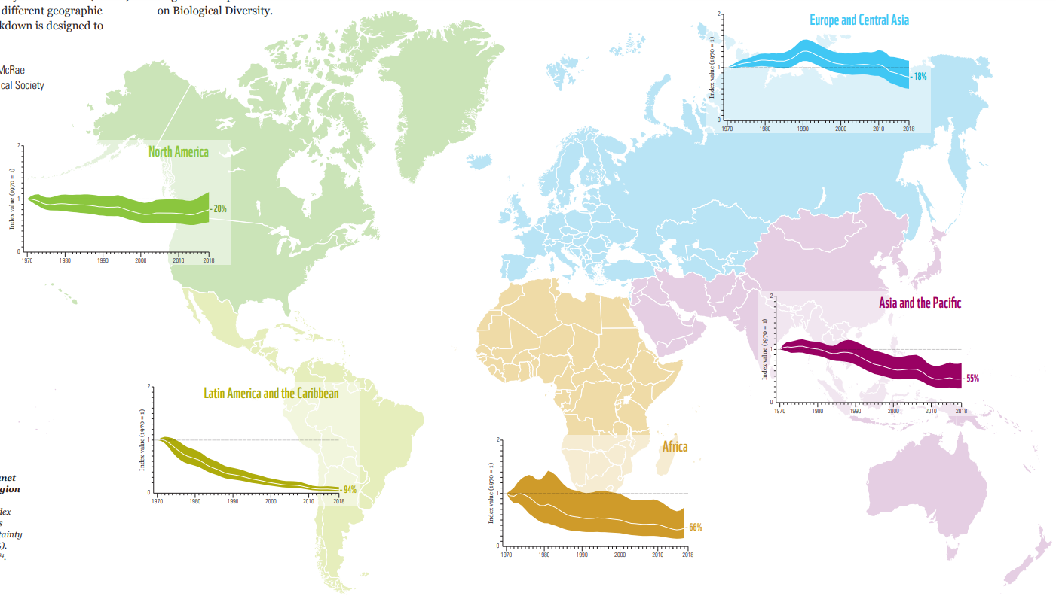
Continental LIVING PLANET INDEX 1970-2018
The white line indicates the level of indexed wildlife loss, and the shaded area the total statistical probability range at the 95% confidence level relative to the trend.
BIODIVERSITY LOSS
-18%
-20%
-55%
LUONTOKATO
-66%
-94%
Source: Living Planet Report 2022, Building a Nature-Positive Society. WWF October 2022
Illustration: WWF/ZSL (2022))

Slide 34
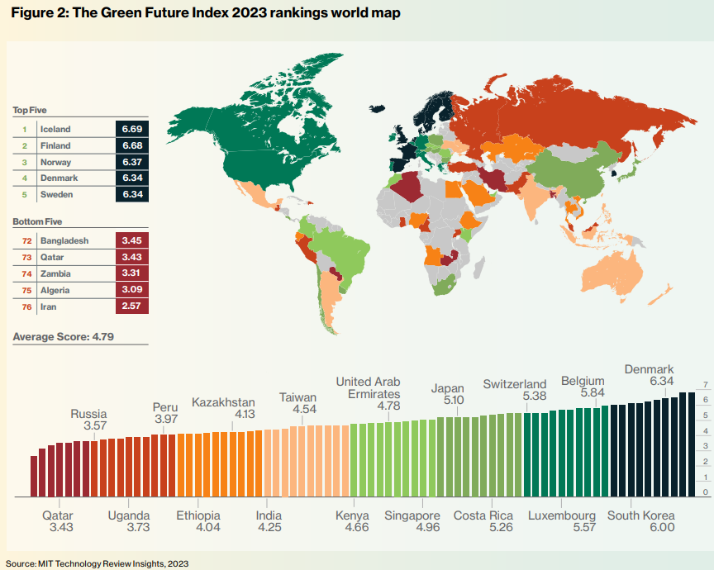
green future index 2023 rankings
Vihreä tulevaisuus –indeksi / 2023 sijoitukset
TOP 5
BOTTOM 5
Keskimääräiset pisteet 4,79
Source: Massachusetts Institute of Technology MIT Technology Review Insights, 2023

Slide 35
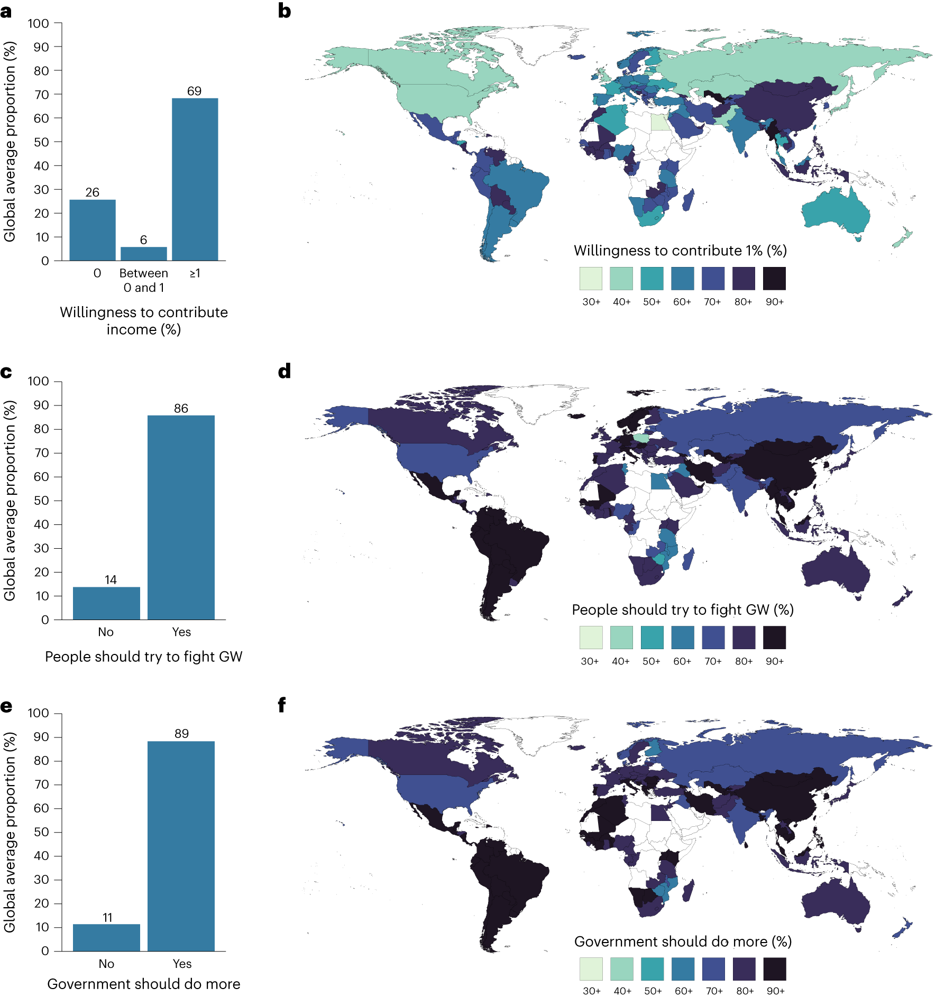
69 percent
willing to
contrubute
1% of income
a,c,e, The global average proportions of respondents willing to contribute income (a), approving of pro-climate social norms (c) and demanding political action (e). Population-adjusted weights are used to ensure representativeness at the global level. GW = global warming.
Source: Peter Andre, Teodora Boneva, Felix Chopra & Armin Falk: Globally representative evidence on the actual and perceived support for climate action.
Nature Climate Change 9.2.2024

Slide 36
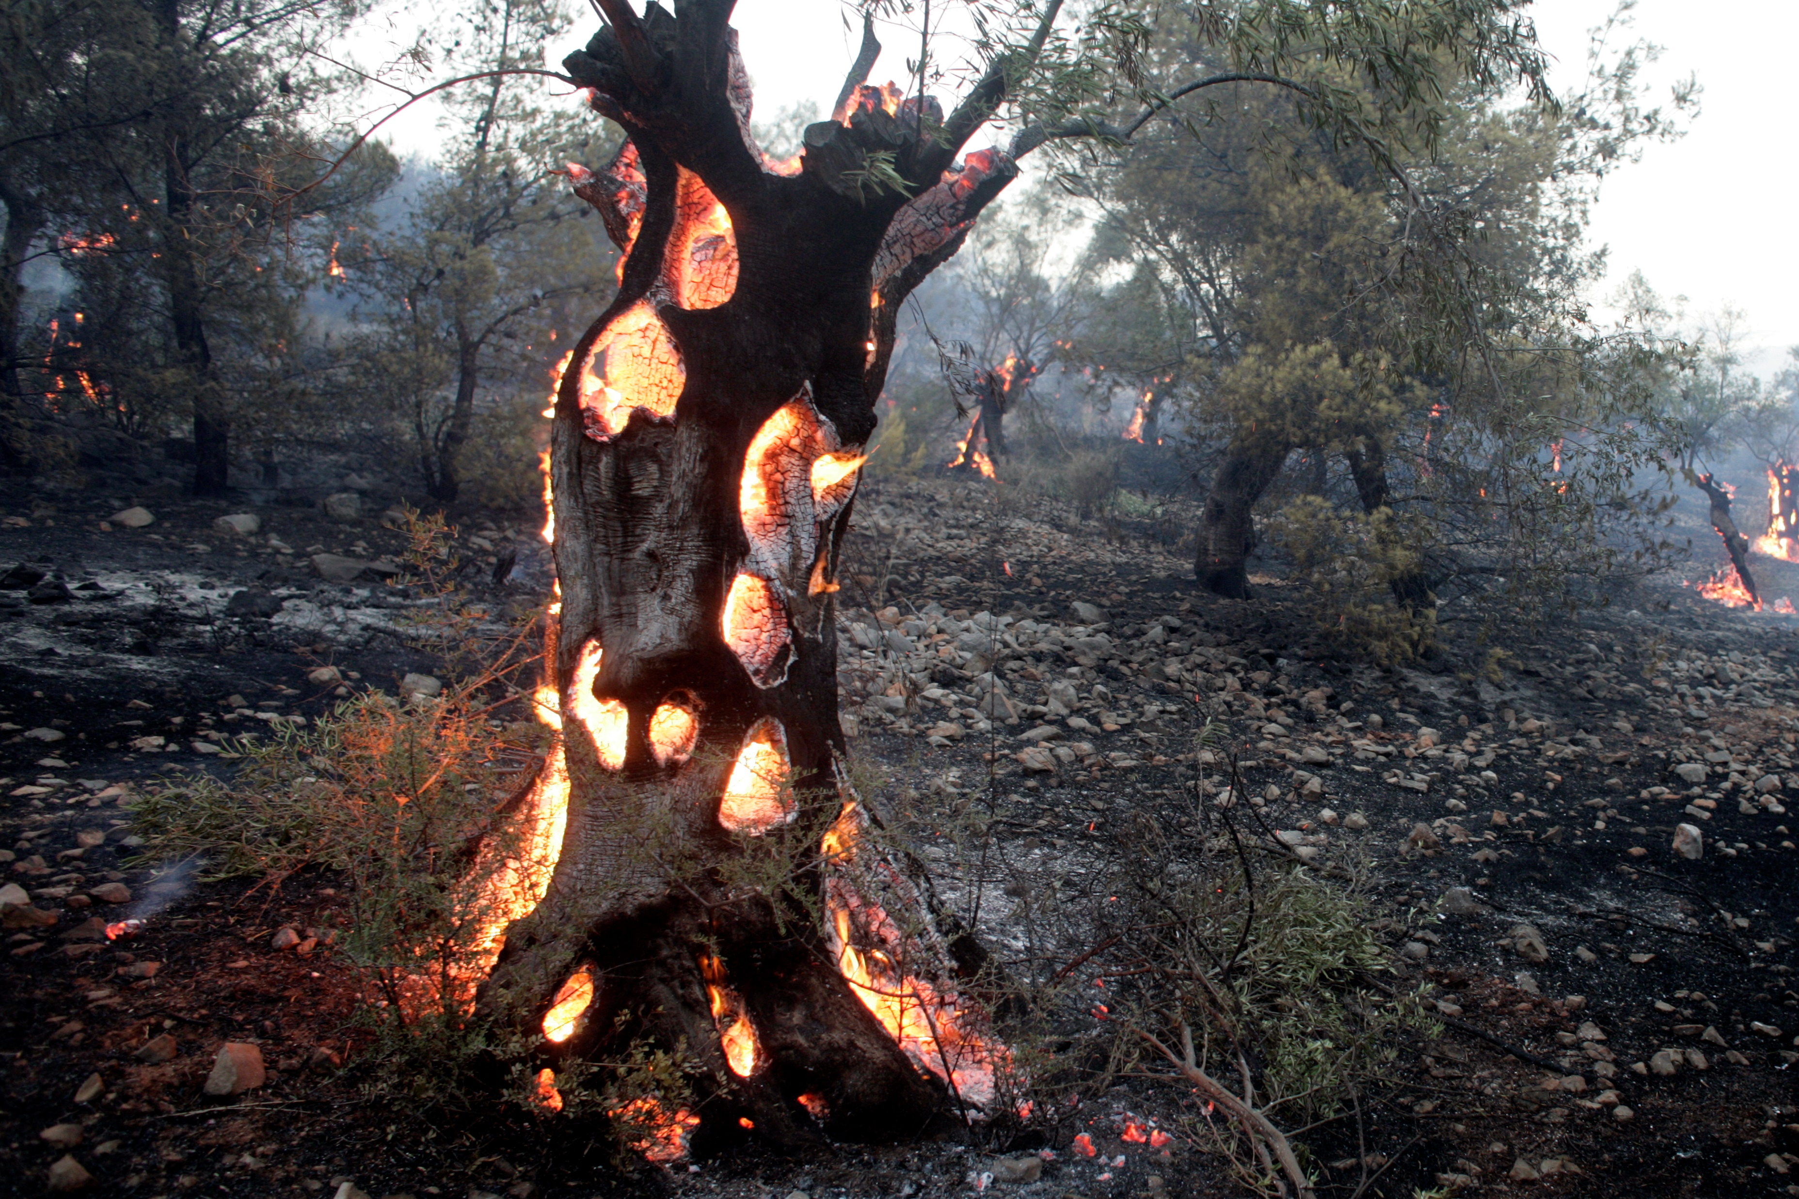
145 COUNTRIES PRODUCE THE WORLD’S CO₂ EMISSIONS
THESE COUNTRIES CAN CHANGE THEIR ENERGY PRODUCTION
FROM FOSSIL TO 100% RENEWABLE BY THE YEAR 2050
BY INVESTING 62 TRILLION USD TO BUILD
THE INFRASTRUCTURE REQUIRED TO DO THIS
CURRENTLY, IN ADDITION TO PAYING FOR THE PRODUCTION INFRASTRUCTURE,
WE PAY FOR THE SOURCES OF ENERGY: OIL, GAS, COAL.
AFTER THE TRANSITION WE NO LONGER PAY A PENNY FOR THE SOURCE:
WIND, SUN, AND WATER ARE FREE. ONLY TECHNOLOGY COSTS.
IT TAKES LESS THAN SIX YEARS TO PAY OFF THE INVESTMENT.
ONCE THE NEW TECHNOLOGY HAS BEEN PAID FOR,
THE WORLD WILL SAVE 11 TRILLION USD PER YEAR.
THEREAFTER WORLD ECENOMY WILL GET A 11 TRILLION STIMULUS INJECTION EVERY YEAR
SOURCE: Energy and Environmental Science, Journal of the Royal Society of Chemistry 9.7.2022
Department of Civil and Environmental Engineering at Stanford University:
Jacobson et al: Low-cost solutions to global warming, air pollution, and energy insecurity for 145 countries.
PHOTO: Milos Bicanski / Climate Visuals Countdown

Slide 37
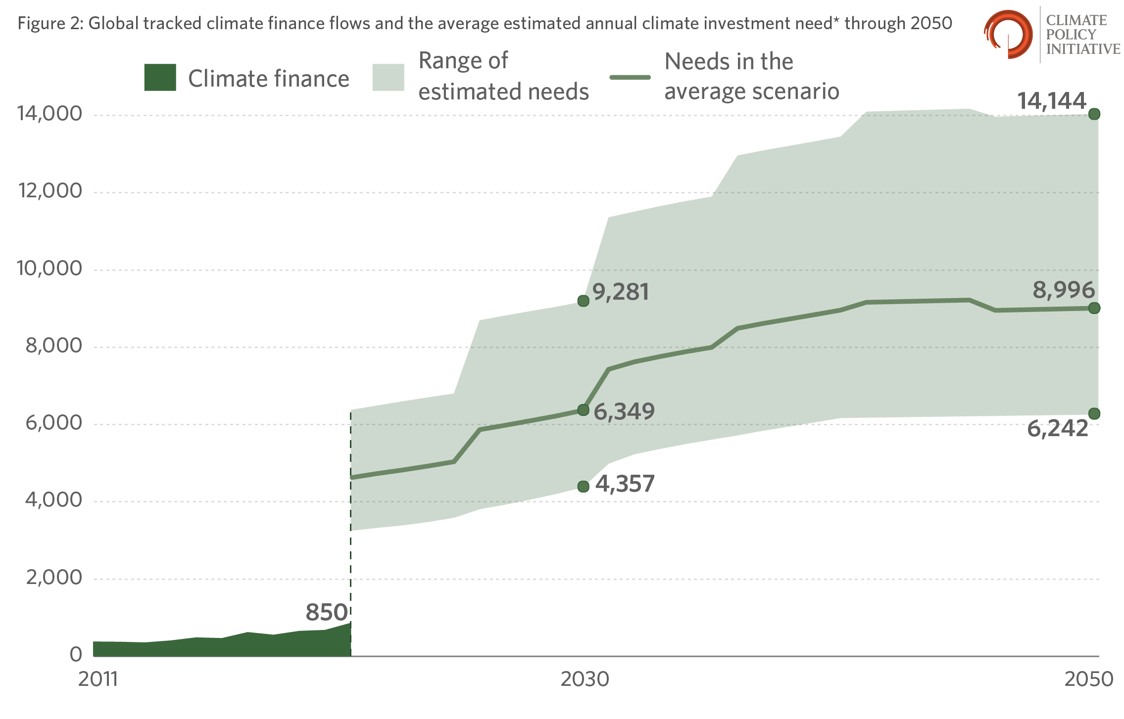
GLOBAL CLIMATE FINANCE FLOWS
AND AVERAGE CLIMATE INVESTMENT NEEDS UNTIL 2050
Realized climate finance (billions)
Tolerance of predicted values
Average level
of needs
CLIMATE
FINANCING
NEEDED
CLIMATE FUNDING 2019-2020
90,1% TO MITIGATE EMISSIONS
7,3% TO ADAPT
2,5% MULTI-TARGETED
IMPLEMENTED
CLIMATE FINANCING
Only 16% of the climate finance needed for carbon neutrality in 2050 is currently covered..
Source: Bloomberg

Slide 38
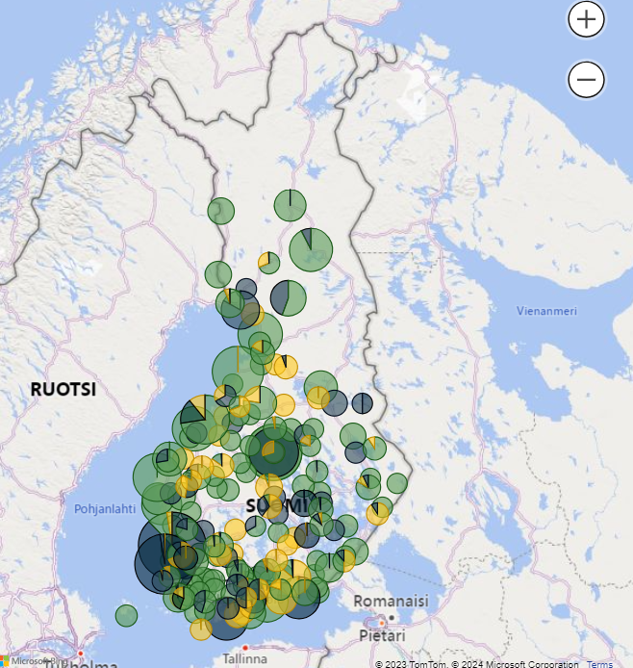
GREEN TRANSITION INVESTMENTS IN FINLAND SITUATION 8 FEBRUARY 2024
144,4 bln
14.8.2023
203,3 bln
3.10.2023
229,5 bln
8.2.2024
Involved projects
are scheduled
to be realized
by 2035
Source: Elinkeinoelämän keskusliitto 2023

Slide 39
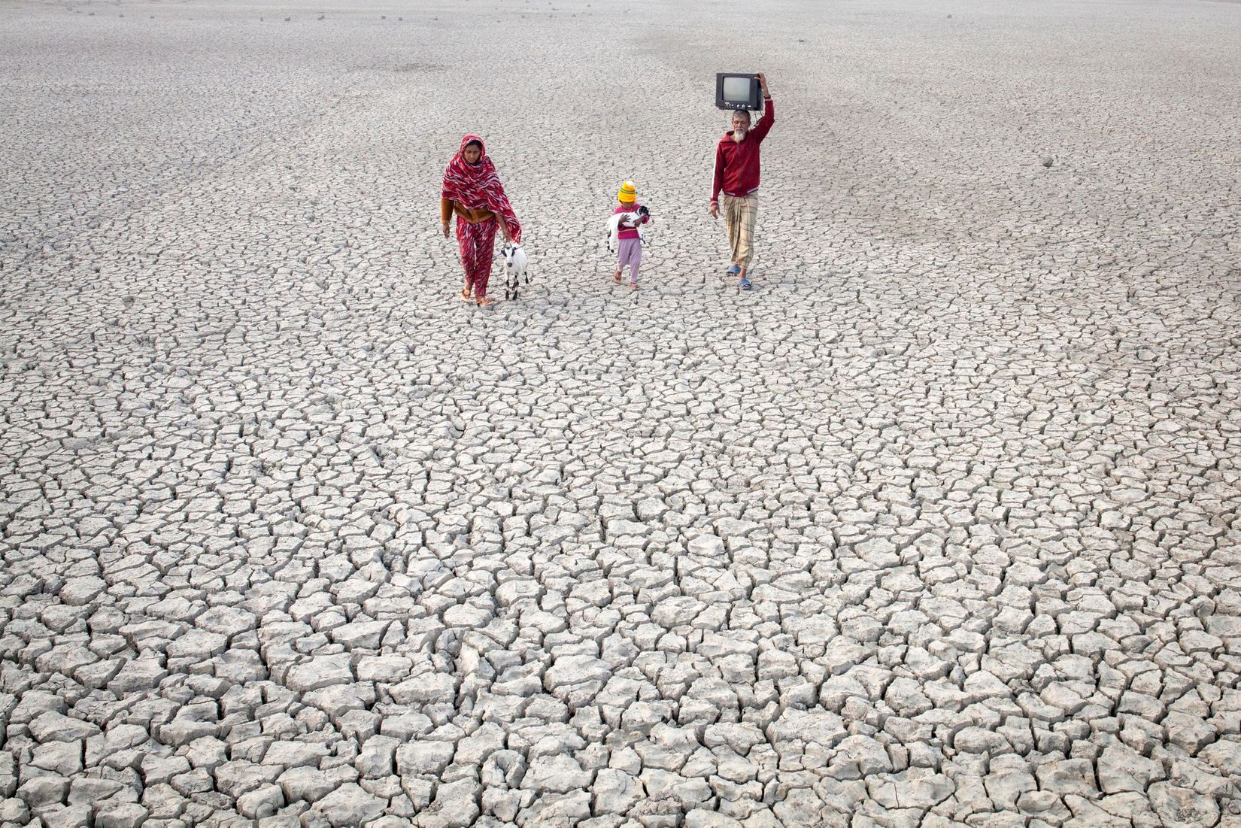
WHAT COULD ONE
SINGLE PERSON ACHIEVE?

Slide 40
SMOKING
POWER TRANSMISSION OF CARS
SUPERMARKET SHELVES
LIDL: EXPANDING PLANT BASED FOOD
NATO

Slide 41
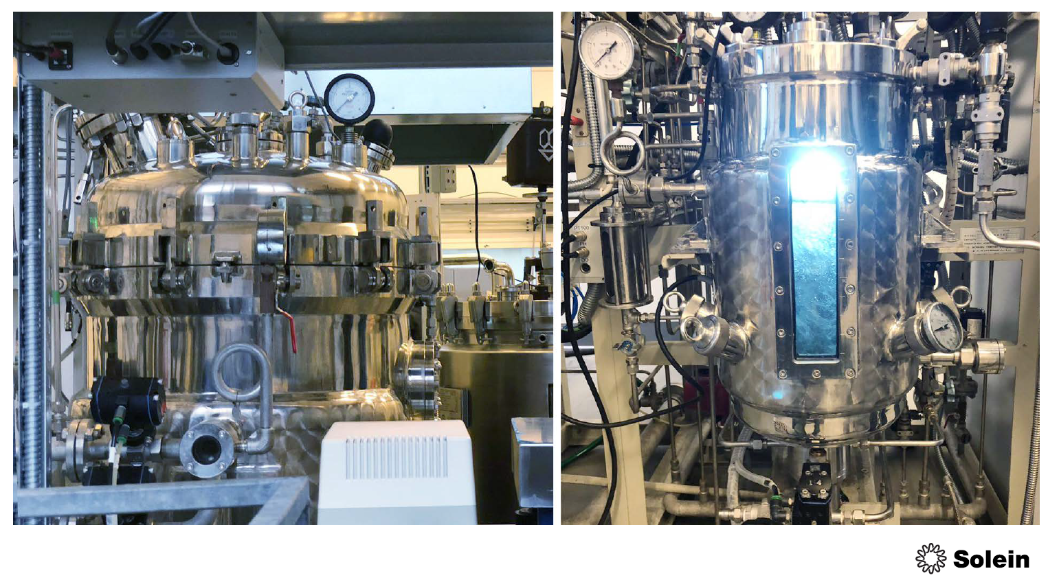
PROTEIN FROM ATMOSPHERIC
CARBON DIOXIDE – SOLAR FOODS

Slide 42
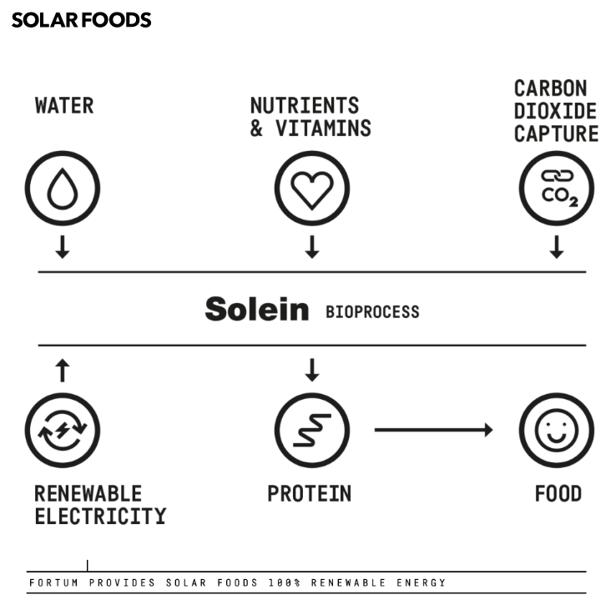
Nutrients & vitamins
HIILI-
DIOKSIDIA
ILMASTA
Carbon dioxide from the air
WATER
RAVINTEITA
& VITAMIINEJA
VETTÄ
Break free from agricultural production models: Food production is successful in the Sahara desert
BIOPROCESS
BIOPROSESSI
Green
Electricity
PROTEINS
=FOOD
SÄHKÖÄ
UUSIUTUVISTA
PROTEIINIA
RUOKAA

Slide 43
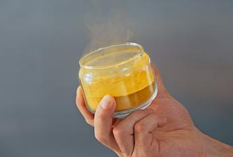
SOLEIN WON NASA'S SPACE FOOD COMPETITION

Slide 44
© Klimaburger-concepti:
Pekka Reinikainen
EU Climate Pact Ambassador
LEVEL ONE
what does the
thermometer
read?
LEVEL TWO
prevent
mitigate
adapt
CLIMA-
BURGER
1-2-3
LEVEL THREE
respond to
all kinds of
crises and
disasters
OVERSHOOT
CRITICCAL THRESHOLD
RISK: out-of-control humanitarian emergency
Graphics: JuJu Design Jussi Latvala

Slide 45
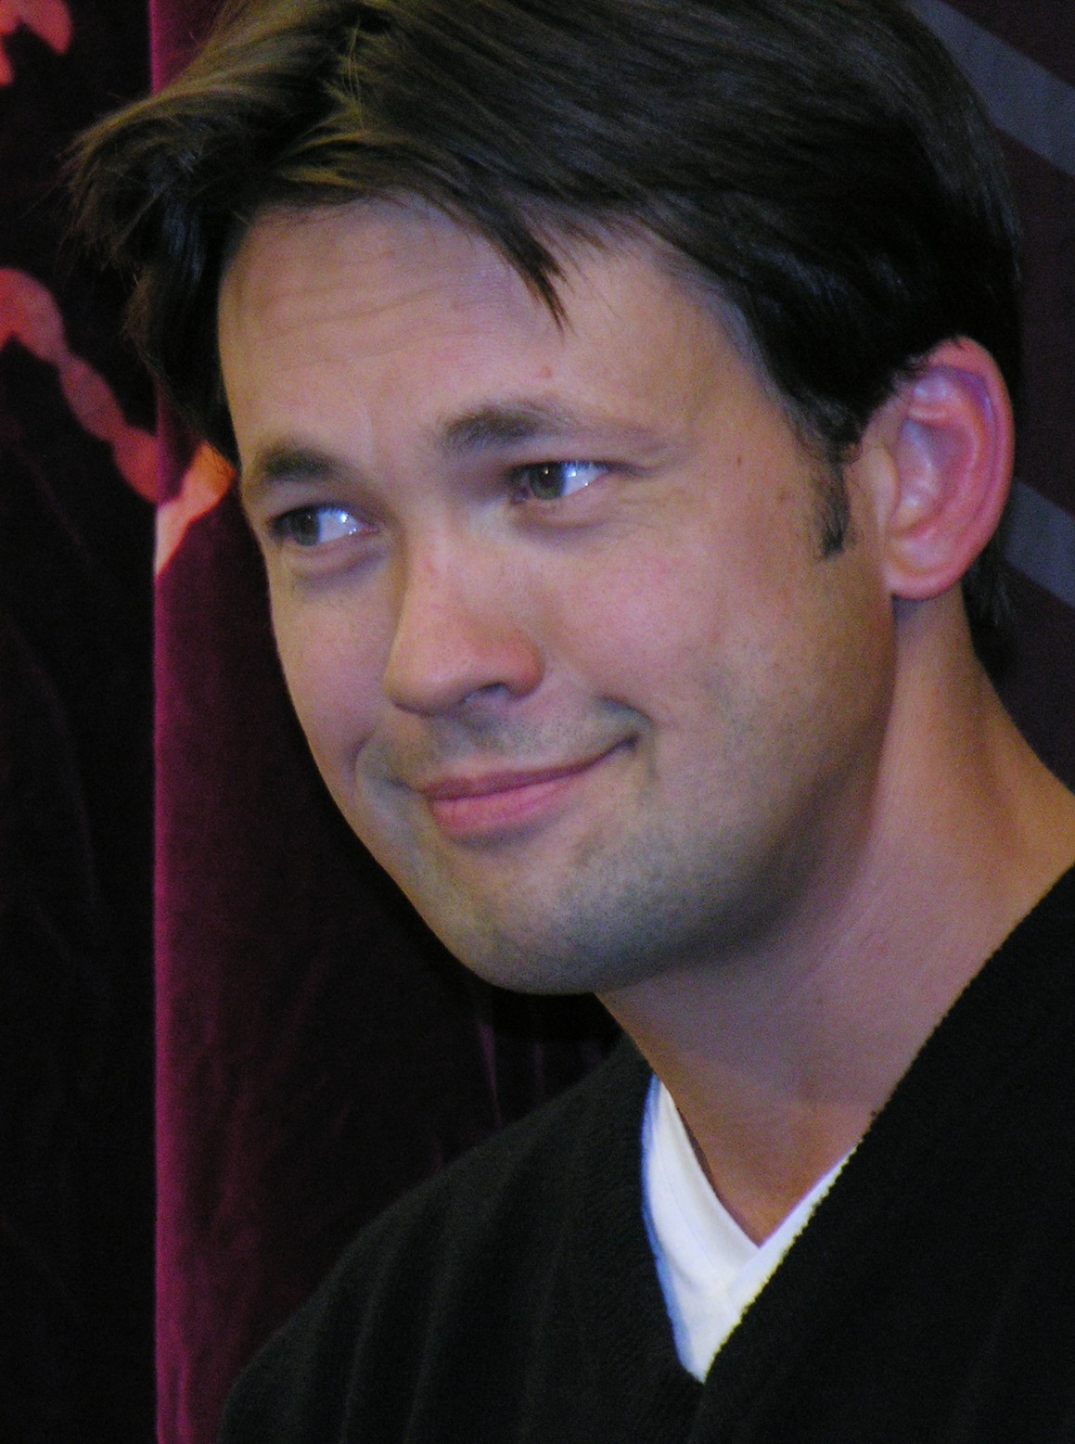
’
FOOD FOR THOUGHTS:
WE CAN, EACH OF US, PICK UP THE TORCH
WE CAN MAKE A DIFFERENCE
WE NEED TO EXTEND THE LOVE WE HAVE FOR OUR CHILDREN AND GRANDCHILDREN TO A GENERATION FURTHER, TO THE CHILDREN WE WILL NEVER MEET, TO THE WORLD WE WILL NOT SEE, AND TO THE THINGS WE WILL NOT BENEFIT FROM
Espoo-based documentarian John Webster in his climate change documentary "Tulevilla rannoilla" published in 2017

Slide 46
In 2007, the Red Cross Movement received a mandate from the 30th International Conference (also from participating governments) to respond to the humanitarian consequences of climate change, and engage in related advocacy and educational work
The Red Cross Movement is the densest humanitarian information acquisition network in the world.
It is permanently present in all four corners of the world before, during and after something happens, or threatens to happen. Therefore, it is best positioned to sound the first alarm, when needed
The work of the Red Cross Movement also produces negative climate effects. That's why the Movement’s working methods and work results are reviewed to minimize negative climate effects.
Through its disaster preparedness work, the Red Cross Movement aims to prevent the risks related to the direct consequences of climate change and their reflections from materializing.
Through its disaster preparedness work, the Red Cross Movement aims to mitigate the humanitarian effects of risks related to the direct consequences of climate change and their reflections.
D
C
A
B
E
The Red Cross Movement implements a cycle of operations: anticipation, preparation, adaptation, response, learning, reconstruction...
The Red Cross Movement responds to the humanitarian needs caused by the direct consequences of climate change and their reflections
G
F

