Slide 1

Waste4Soil
Dr. Tuomo Eskelinen
Dr. Ardita Hoxha-Jahja

Slide 2
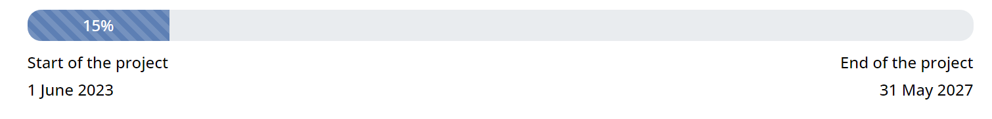

Main aim of the project
Turning food waste into sustainable soil improvers for better soil health and improved food systems

Slide 3
For a circular use of food-processing residues in the European food chain
Waste4Soil serves a double purpose: reducing the percentage of food waste in Europe by recycling food-processing residues and turning them into soil improvers to enhance soil health across Europe.
Waste4Soil aims to do so through a multi-actor approach at regional level. 7 living labs will be studied, having different cultural and geographical aspects.

Slide 4
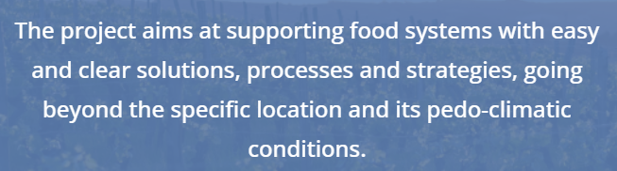
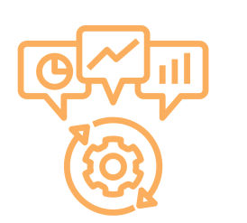
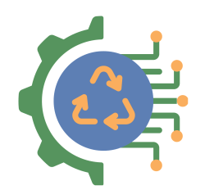
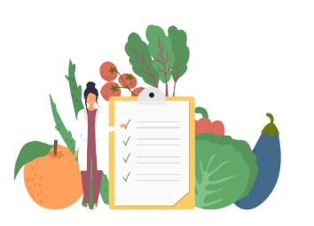
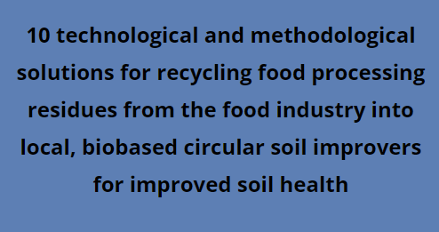
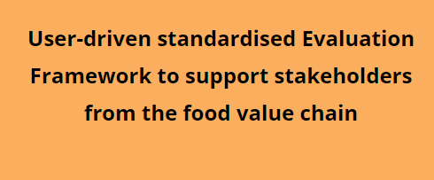
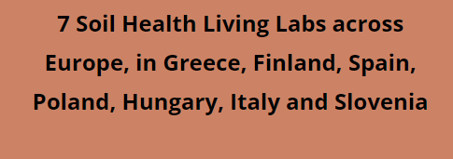
About Waste4Soil

Slide 5

THE CONCEPT
The methodology
To optimize FPR valorisation from source, the Waste4Soil project will design a waste management guideline to understand and conserve FPR’s streams, while avoiding external pollutant and deterioration.
To be relevant, the whole soil improvers production system must be in line with farmers’ needs and with food industry resources, while being environmentally sustainable, economically viable and socially acceptable. This last point implies a genuine involvement of citizens in the project implementation.
Waste4Soil project aims at developing applicable recycling technical pathways to transform FPR into soil improvers, through a circular, systemic and multi actor approach at regional level involving all food chain actors, thereby closing specific loops (nutrients, organic matter, water).

Slide 6
A locally-based strategy
The FPR's (food processing redidues)
The project will cover a great variety of FPR: fruits and vegetables, olive oil residues, wine industry, meat industry by-products, dairy products, cereals, and fish.
Covering a broad range of FPR is key, because they do not have the same impacts and potential. FPR will be characterised in terms of bulk composition, also to determine the preferred way to valorise them. The developed methodology is meant to be spread to improve FPR knowledge across Europe.
The project aims at supporting food systems with easy and clear solutions, processes and strategies, going beyond the specific location and its pedo-climatic conditions, the local waste management systems or regulation.
To do so, standards will be developed to answer practitioners needs and ease the application of the solutions.

Slide 7
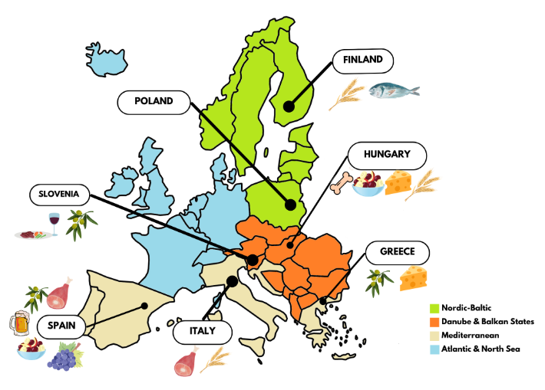
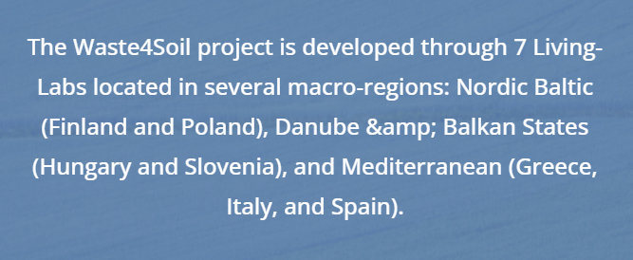
ABOUT LIVING LABS
Living Labs are user-centred, open innovation ecosystems, operating as close as possible to local stakeholders and target population groups.

Slide 8

Waste4Soil: Circular business models & results exploitation
Business background
Co-creation for CE business models
Standards development
Social Acceptance study

Slide 9
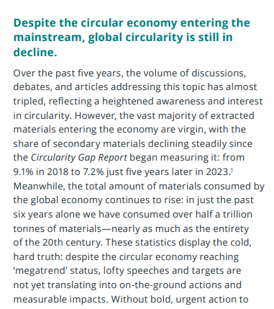
The cold truth about circularity …
Ellen McArthur Foundation, 2024

Slide 10
One-third of food produced for human consumption is lost or wasted globally, which amounts to about 1.3 billion tons per year. Food loss and waste (FLW) causes serious social, economic, and environmental issues undermining our planet’s sustainability.
Therefore actions aimed at FLW prevention and reduction must be urgently taken. The unsustainability of the current economic model, based on a linear system of production and consumption, has emerged above all in the food sector, where little is being done to upcycle residues generated along the supply chain.
https://www.sciencedirect.com/science/article/abs/pii/B978032385253100006X

Slide 11
Example from Social Acceptance study.
Would you agree to choose from the following new protein or fertilizer sources when made available?
Number of respondents: 447
Average score
4.1
3.9
4.1
3.4
3.4
3.7
4.0

Slide 12
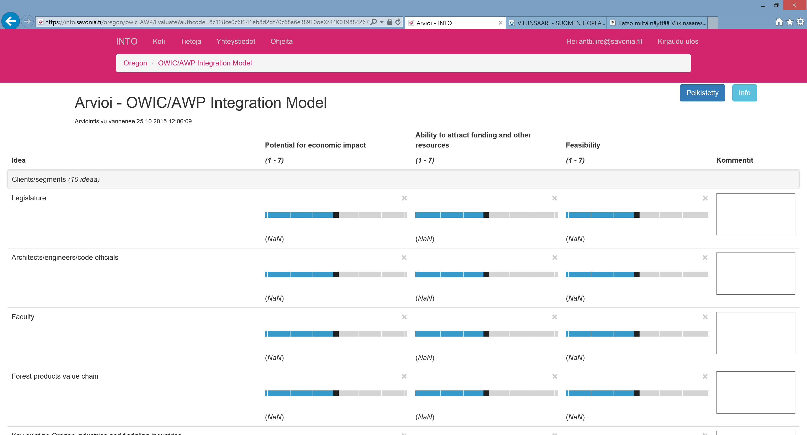
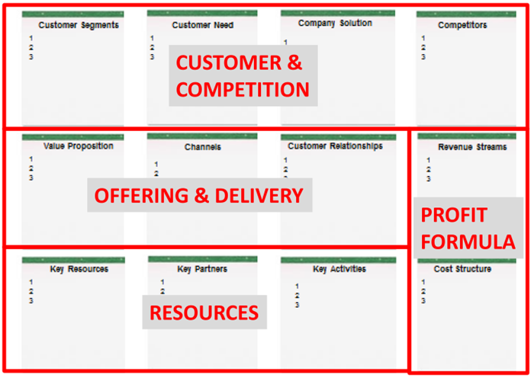
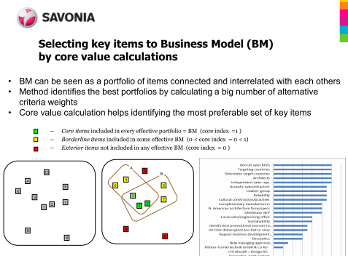
1. Setting up the Context
3. Evaluating the
identified items
Problem area pain chain & Target
Who, how and when?
Criteria setting
Sustainable & Circular Business model creation
(Eskelinen et al., 2017, Kajanus et al., 2014 & 2019)
2. Identifying ideas
Interviews
Survey
Brainstorming ds)
Input by net link
4. Core value analysis
5. Workshop
=> CE Business model

Slide 13
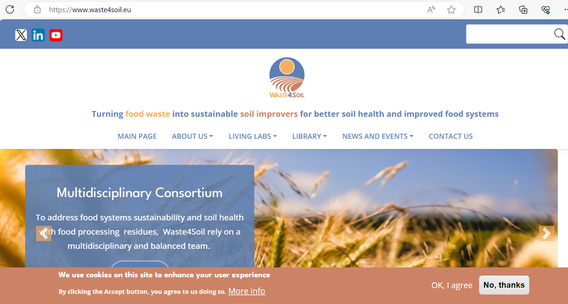

Slide 14
We would like to hear about your systemic approaches on food sidestreams
valorisation and SoilHealth issues
Do you develop SoilHealth Living Lab? Lets collaborate!
Tuomo Ardita
Tuomo.Eskelinen@savonia.fi ardita.hoxha-jahja@savonia.fi
Waste4Soil - Turning food waste into sustainable soil improvers for better soil health and improved food systems

Slide 15
Thank you!

