Slide 1
Carbon footprint and optimization of energy consumption in SME companies, EAKR (European Regional Development Fund) project
1.1.2023-30.6.2025
Project team Project Manager Jari Niemelä, Solar energy optimazing calculations Juhani Rouvali, Carbon emissions accounting Merja Tolvanen, data analytics tools Mikko Laasanen, project engineer test tools Henrik Sikanen

Slide 2
Carbon footprint and optimization of energy consumption in SME companies, EAKR project
1.1.2023-30.6.2025
Content
Situation in your own country: carbon emissions in industries and homes? Experiences
Project -Carbon footprint and optimization of energy consumption in SME companies,
Can solar energy and lower carbon emissions give competitive advantage to company ?
Develope similar EU project (or local fund) for your own UAS
* Basic idea, process, legal ESG reporting, competitive advantage

Slide 3
2. Carbon footprint and optimization of energy consumption in SME companies, EAKR project
In this project, carbon footprint and optimization of energy consumption in SME companies and
other organizations is studied. Savonia UAS will develop methods and tools for the evaluation
of carbon footprint and optimization of solar energy systems. Local SME companies and other
relevant organizations are offering pilot cases for the project implementer (Savonia) and for
the ongoing development process. The project contributes significantly to the know-how of
low-carbon operations in the region and, for example, the introduction of solar electricity in
companies after the project can immediately reduce the carbon footprint. The results are
distributed e.g. with workshop-type arrangements. And after the project, the results will be
distributed in the region with the help of Savonia's teaching activities and RDI projects of the
future.
One key factor behind the project is that larger companies can demand a carbon footprint report
from SMEs, and the companies themselves do not have the expertise to do this. Furthermore,
in order to generate a reasonable payback period, the optimization of a suitable solar power
system requires information about the energy consumption of the object. This is usually not
taken into account by companies selling solar power systems. These are one of the key
challenges identified during the preparation phase of the project in order to reduce the carbon
footprint of SMEs

Slide 4
2. Carbon footprint and optimization of energy consumption in SME companies, EAKR project
Target: develope a process concept how to optimize solar energy system and lower carbon emissions at the same time
Developing process
10 pilot companies
Develope a data bace for a todays electricity consumption (whole year, 1 hour)
Use PVGIS databace to gather solar energy information in one unique place and building
Analyce: potential solar energy for m2 and electricity concumption, > result the size of optimal solar energy solution for a company
Develope service concept and online course for Savonia! Very important part of project!

Slide 5
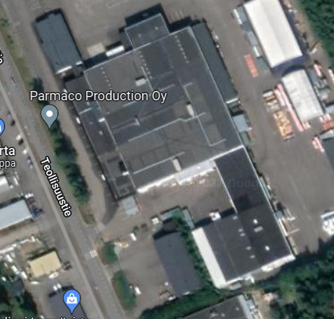
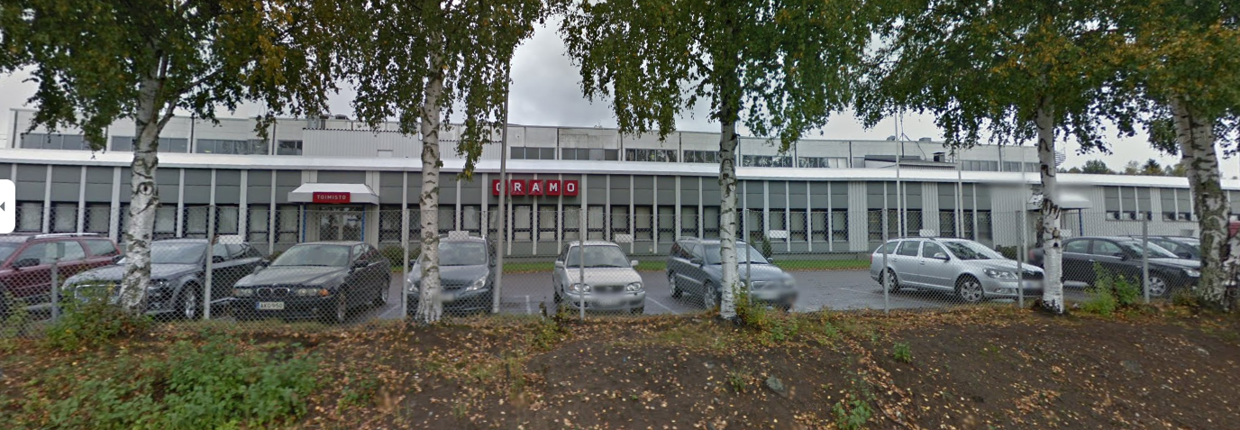
Case
Parmaco
Teollisuustie 13
Leppävirta
Google Maps

Slide 6
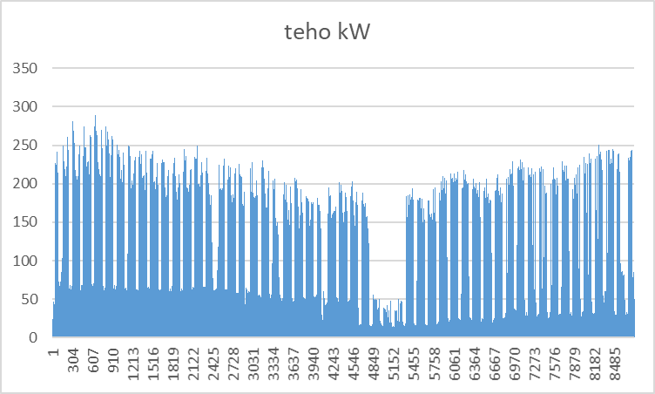
Parmaco, Teollisuustie 13, Leppävirta
Electricity consumtion 841,2 MWh (year 2020)
Average per hour 96 kW
How consumption range 2020

Slide 7
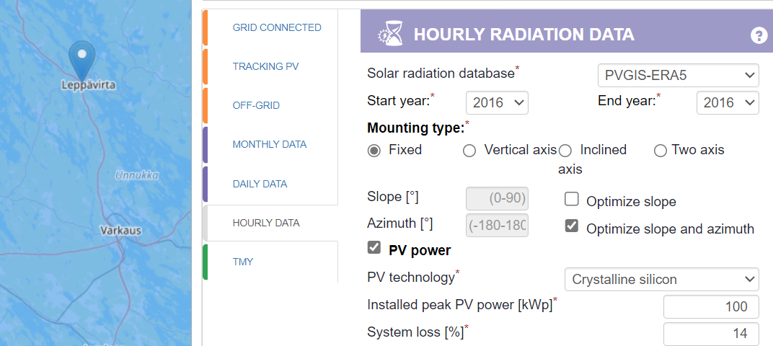
PVGIS

Slide 8
Solar panels estimate electricity production, PVGIS
https://ec.europa.eu/jrc/en/pvgis
260 peaces 385 Wp solar panel, = 100,1 kWp
Optimizing installationg angle and projection (azimuth)
PVGIS gives estimated electircity production for an hour

Slide 9
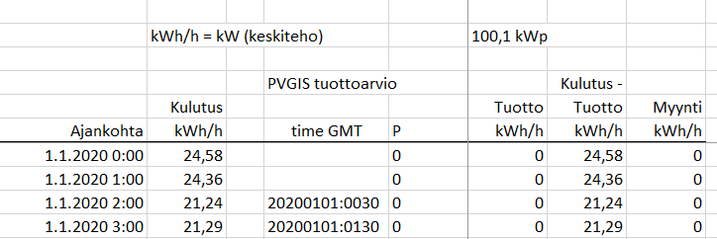
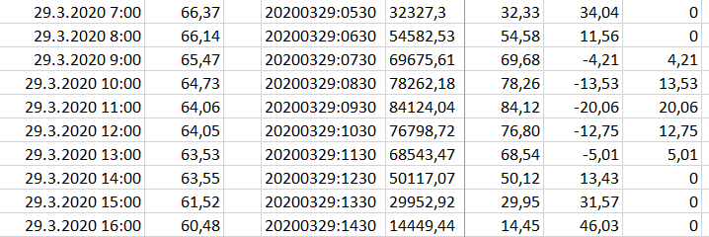
Solar panel system production estimate, PVGIS
260 peaces 385 Wp solar panel , = 100,1 kWp
Concumption data/hour Parmaco, production PVGIS ➔ EXCEL ➔

Slide 10
Solar panel system production estimate, PVGIS
260 peaces 385 Wp solar panel , = 100,1 kWp
Concumption data/hour Parmaco, production PVGIS ➔ EXCEL ➔
Weekend production is good, but no > need to sell stock market (low prices in a real life in Finland)

Slide 11
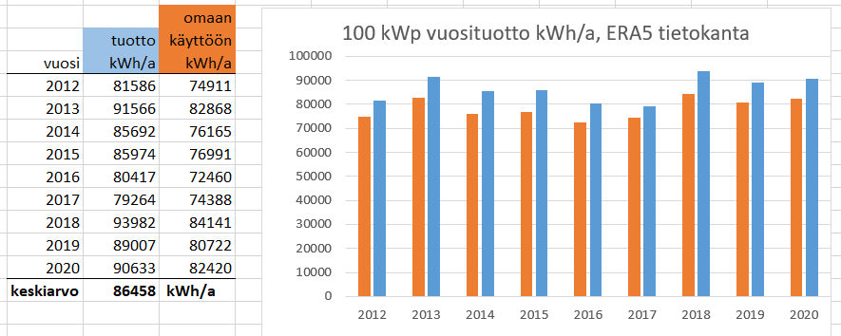
Solar panel system production estimate, PVGIS
260 peaces 385 Wp solar panel , = 100,1 kWp
- each panel position optimized ( 43° - 49°)
- satellite databace 2012 – 2020, (databace ERA5)
- electricity comcumption 841,2 MWh (year 2020)
- panel production 79 – 94 MWh/a, average 86,5 MWh/a
- from production to own usage 72 – 84 MWh/a

Slide 12
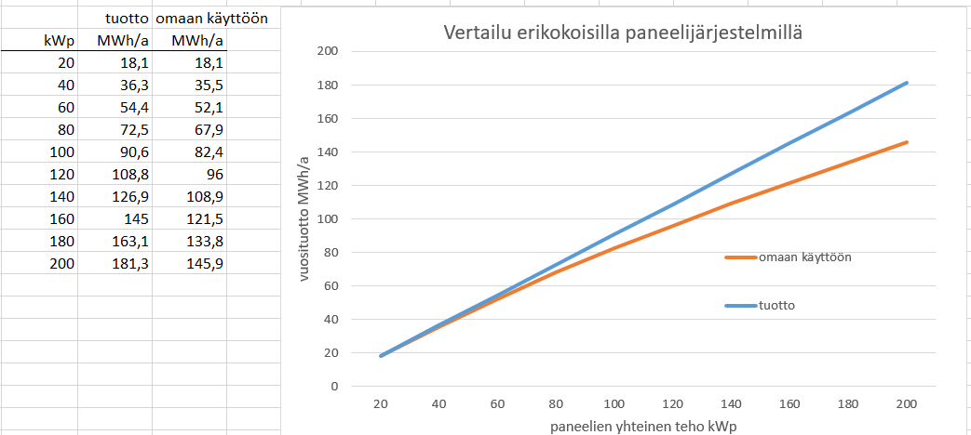
Aurinkopaneelien tuottoarvio, PVGIS
Eri määrä aurinkopaneeleita
- paneelit optimiasennossa
- vertailuvuosi 2020 (tietokanta ERA5)
- vertailukulutus 841,2 MWh (vuosi 2020)
Omakäyttöaste noin 91 %, kun järjestelmän koko 100 kWp

Slide 13
3. Solar energy and lower carbon emissions give a competitive advantage to company ? How, what kind of, ideas, examples?

Slide 14
4. Develope EU project (or local fund) for your own UAS
Target: solar energy system optimization, lower emissions, competitive advantage
* Basic idea, process, legal ESG reporting, competitive advantage

Slide 15
Thank You!

