Slide 1
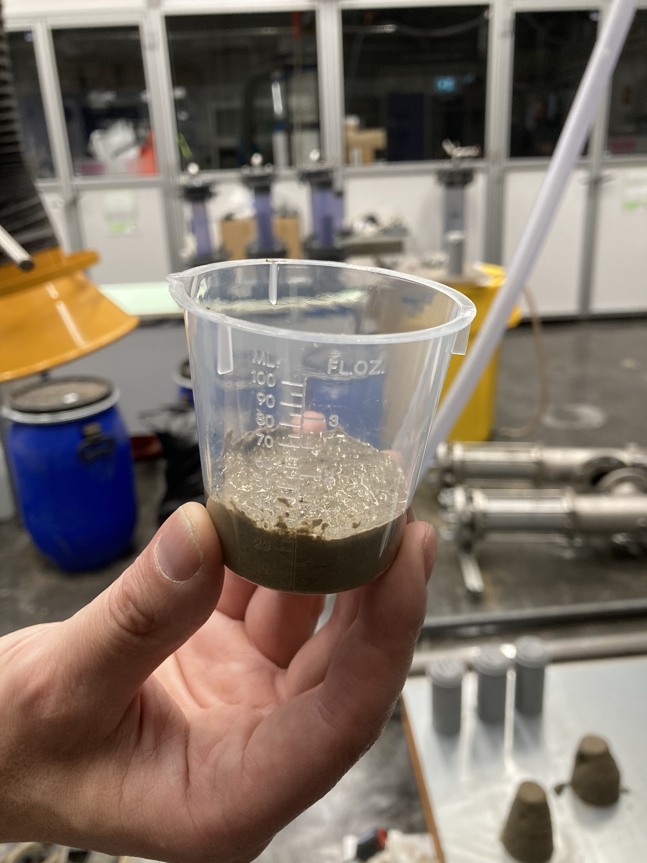
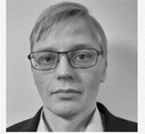
SETELIT Secondary waste streams, added value and productization in mining industry
Petri Juntunen, MSc (Tech.)
Senior Specialist
Savonia University of Applied Sciences
Department of Environmental Engineering
Contact:
E: petri.juntunen@savonia.fi
M: +358 44 785 6045

Slide 2
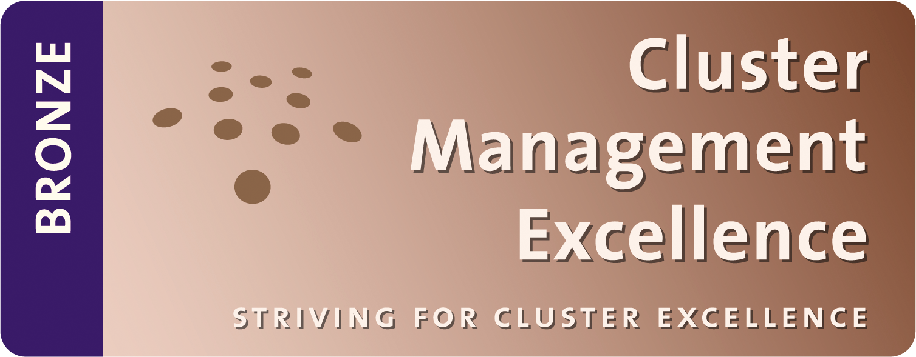
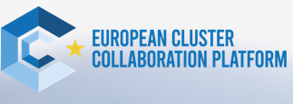
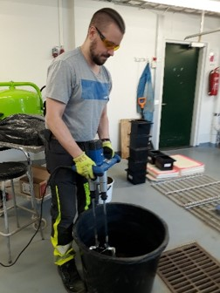

Slide 3
SETELIT Secondary waste streams, added value and productization
1.3.2023 - 30.11.2025
ERDF A renewing and competent Finland 2021-2027
Funding authority: The regional council of Pohjois-Savo
Company partners: Agnico Eagle Finland Oy, Alva Oy, Fatec Oy, Fescon Oy, LKAB Minerals Oy, Sibelco Nordic Oy, Sika Finland Oy and Yara Suomi Oy
Total budget approx. 776 000 €
Lead partner GTK, Co-partner Savonia

Slide 4
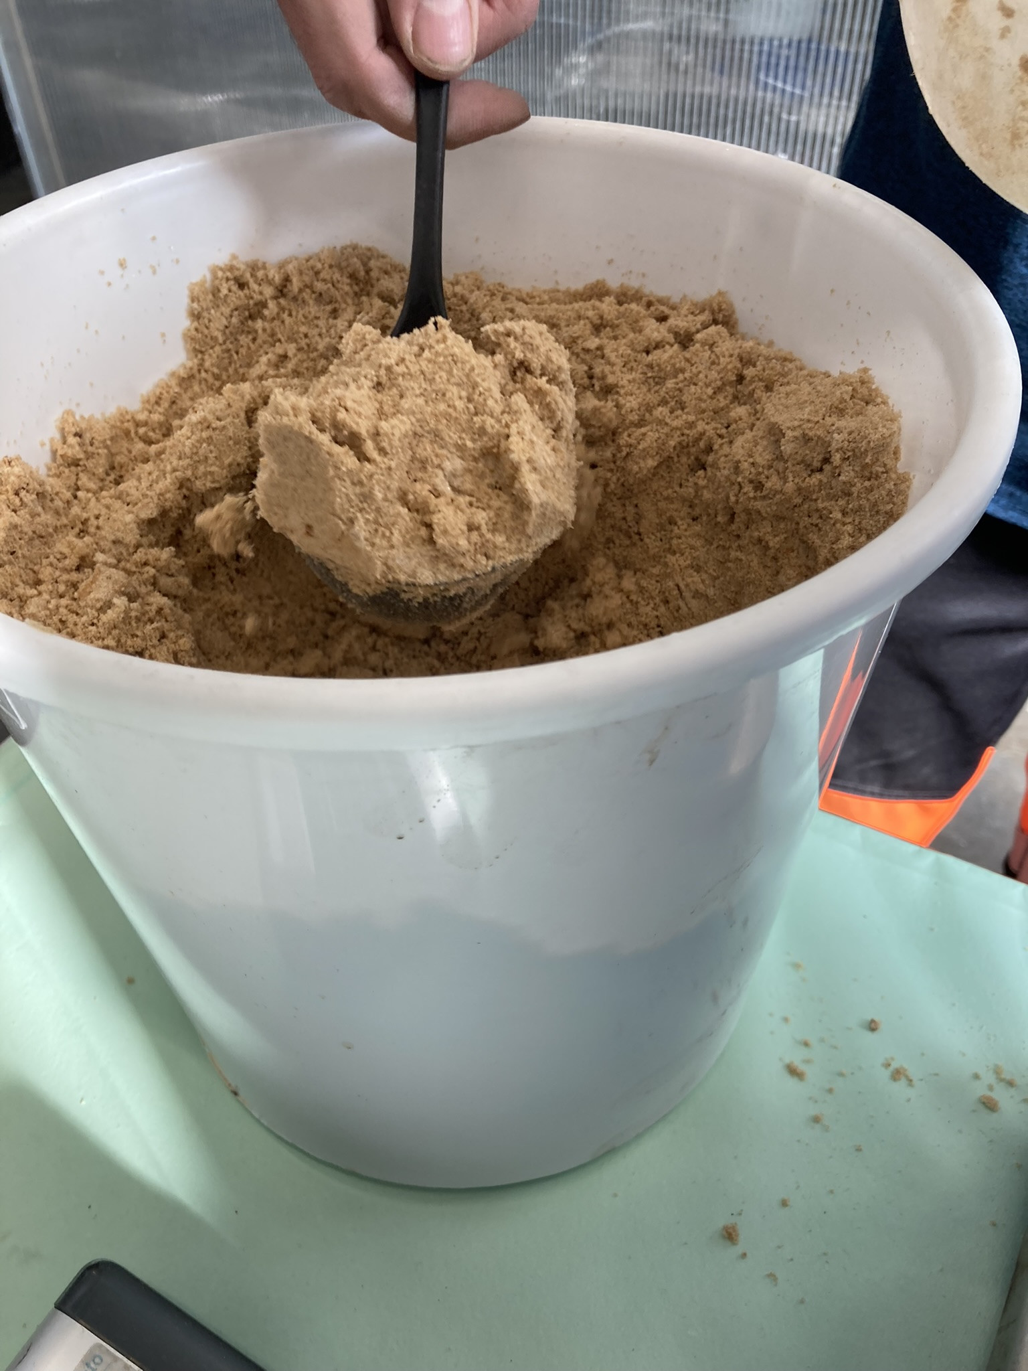
Background
up to 96% of the processed ore ( 46 Mt, 2017) ends up in large impoundments as extractive waste i.e. mine tailings.
This mode of operation is inefficient in terms of energy and material efficiency, environmental protection, and the economy.
Need for end-of waste guidance
GOALS
Supporting the carbon-neutral Finland goal by promoting the low-carbon operations of the mining industry
Promotion of the circular economy
Increasing material and energy efficiency ​
Reducing the amount of waste and reducing emissions
Increasing digitization to support the circular economy ​

Slide 5
In this project the main focus is in the concrete like materials
promote research services
create guidebook for end-of-waste process
Digital recipe tool

Slide 7
Selection of the materials
The materials
Tailings
Binders
Water
Fillers
Additives

Slide 8
Characterization of the raw materials

Slide 9
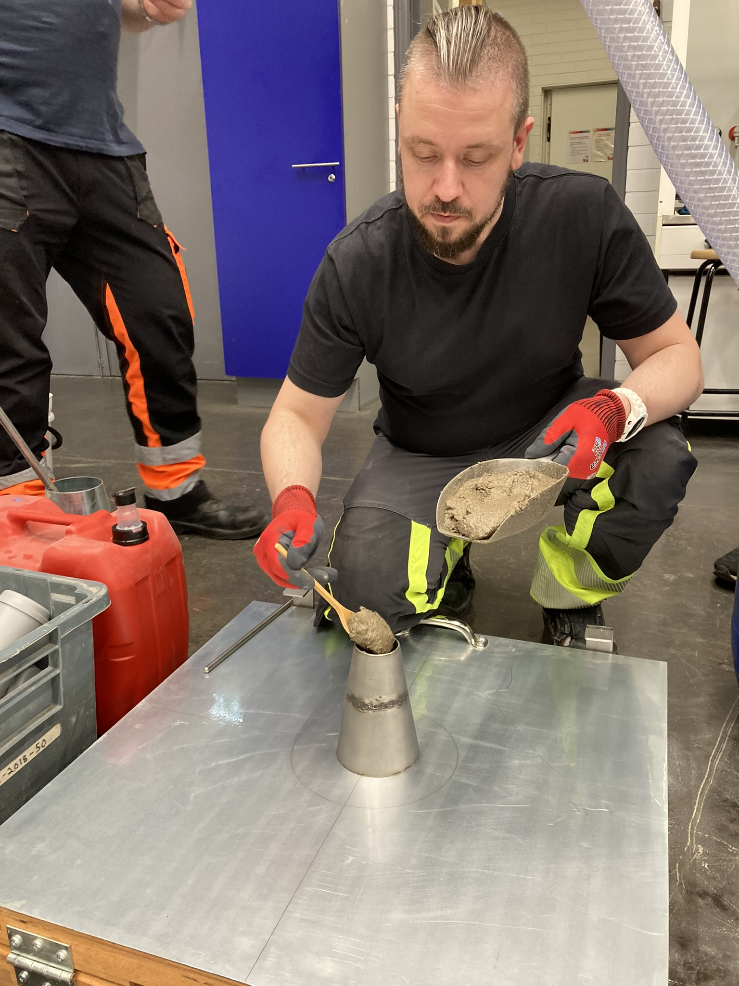
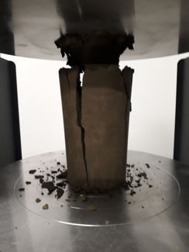
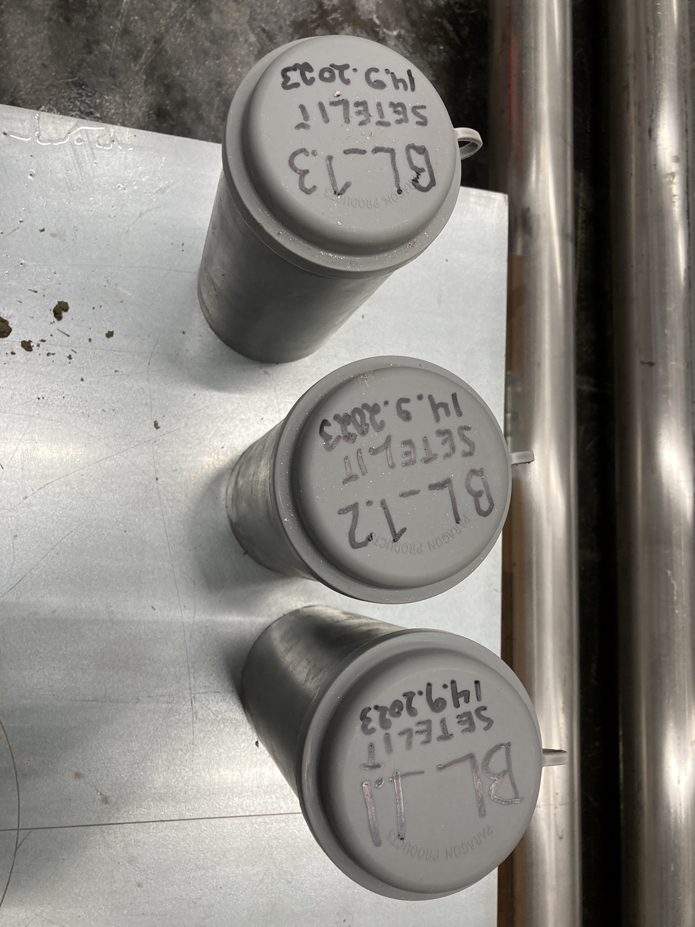
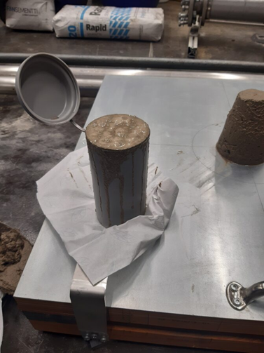
Recipe design & Making the test samples & characterize

Slide 10
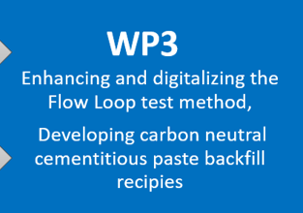
The flowloop

Slide 11
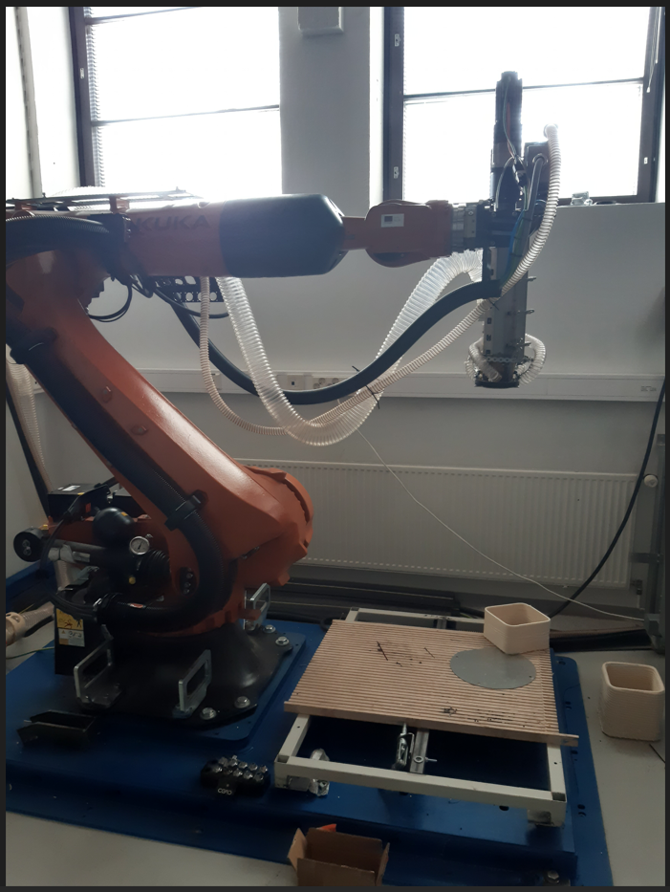
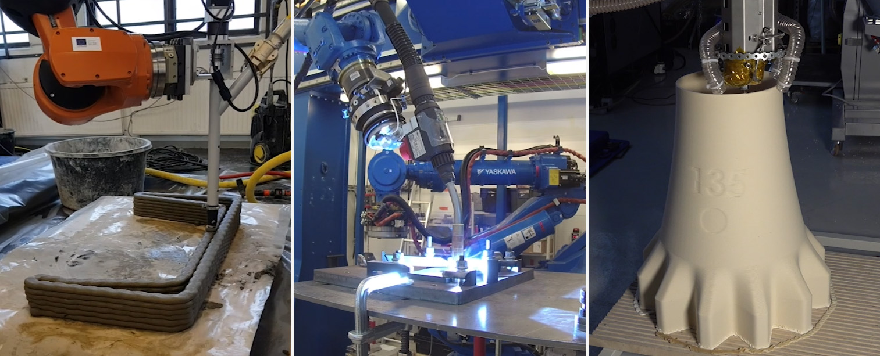
The product:
Case 3D printing

Slide 12
create guidebook for end-of-waste process
Education pack for students
End of waste manual
New learning module about circular economy in mining (Merja Tolvanen)
Banchelor studies (carbon footprint calculations)

Slide 14
Thank You! Questions?
neea.heino@gtk.fi
petri.juntunen@savonia.fi
Setelit (gtk.fi)

