Slide 1
Welcome International Staff Week 2024 - Moving towards Greener Economy

Slide 2
Monday 19 Feb 2024
Musical performance by Savonia students LUSH Cover Duo
Welcoming words Rector Mervi Vidgrén
Introduction to the week, Director of Internationality Virpi Laukkanen
Keynote: Where is the world going? Mr. Pekka Reinikainen, Finnish Red Cross, European Union Climate Pact Ambassador at EU Climate Pact Secretariat
Get-together event

Slide 3
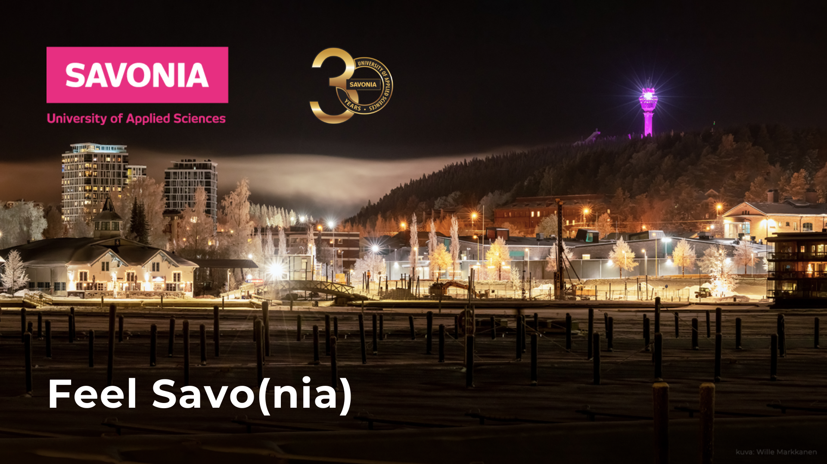

Slide 4
Savonia: This is the way to change the world
Three
campuses
STUDENTS +8000
ALUMNI 30000
BUSINESS PARTNERS 2300
STUDENT EMPLOYMENT 90%
IISALMI
KUOPIO VARKAUS
Employees +600
RDI Volume 14M€
Turnover 59M€
Students remaining in the region 60%

Slide 6
Introduction to the International Staff Week 2024
Virpi Laukkanen
Director of Internationality, Savonia UAS
Academic Director, EU4DUAL

Slide 7
Welcome our visitors from:
This week is:
Austria
China
Costa Rica
Croatia
Czech Republic
France
Germany
Hungary
Ireland
Kosovo
Lithuania
Malta
Poland
Spain
Sweden
Ukraine
EU4DUAL European University Alliance’s Staff Week
Kick-off for EU4DUAL Grand Challenge; Green Economy
Meeting point for Savonia’s partners
Discussion forum for very current topics related to Green Economy

Slide 8
Moving towards greener economy together!
Climate change mitigation
Bio and circular economy
Water safety
Carbon neutrality and optimization of energy consumption
Ethical food production
Sustainability in
Agriculture and forestry
Tourism
Design and product development
Social sustainability
Etc.

Slide 9
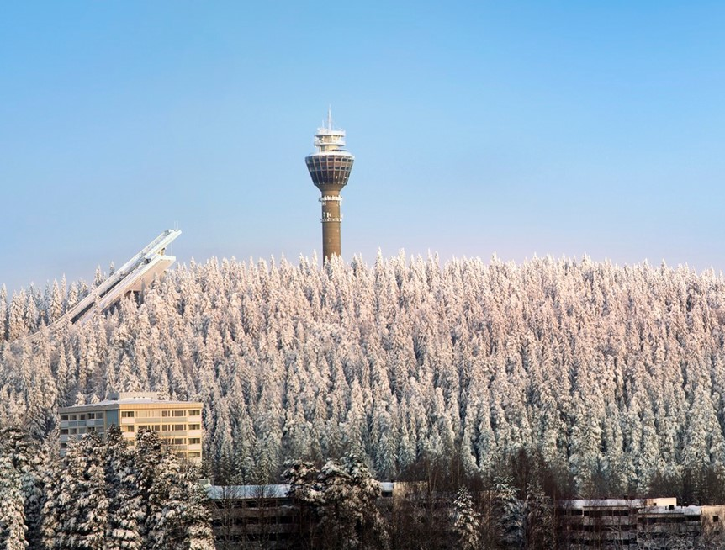
Thank you! Kiitos! Enjoy your stay in Kuopio, the best winter city in Finland!

