Slide 1
Funding Green Economy International Cooperation
Emma Incze, PhD
Senior Researcher
Savonia University of Applied Sciences

Slide 3
Who manages European Funds

Slide 4
Funding programmes
1 HORIZON EUROPE (HE) –PROGRAMME FOR RESEARCH AND INNOVATION
2 COST (EUROPEAN COOPERATION IN SCIENCE AND TECHNOLOGY)
3 SINGLE MARKET –PROGRAMME FOR THE COMPETITIVITY AND SUSTAINABILITY OF COMPANIES
4 LIFE –PROGRAMME FOR THE ENVIRONMENT AND CLIMATE ACTION
5 DIGITAL EUROPE –PROGRAMME FOR DIGITALIZATION
6 INTERREGIONAL INNOVATION INVESTMENTS (I3)
7 CREATIVE EUROPE - PROGRAMME FOR CULTURE AND CREATIVE SECTORS.
8 CONNECTING EUROPE FACILITY
9 EU4HEALTH
10 INNOVATION FUND
11 GLOBAL EUROPE- NEIGHBOURHOOD, DEVELOPMENT AND INTERNATIONAL COOPERATION INSTRUMENT
12 EU SPACE PROGRAMME
13 EUROPEAN DEFENCE FUND
14 CITIZENS, EQUALITY, RIGHTS AND VALUES PROGRAMME (CERV)
15 BREAKTHROUGH ENERGY CATALYST PARTNERSHIP
16 EUROPEAN SOCIAL FUND PLUS (ESF+)
17 ERASMUS +
18 ASYLUM, MIGRATION AND INTEGRATION FUND (AMIF)
19 INTERREG BALTIC SEA REGION
20 INTERREG NORTHERN PERIPHERY AND ARCTIC PROGRAMME (NPA)
21 INTERREG EUROPE
22 Business Finland

Slide 5
SPECIFIC THEMES

Slide 6
Sustainable Development & Green Transition
Where to look first?
Horizon Europe
LIFE
New European Bauhaus
Interreg Family
JTF

Slide 7
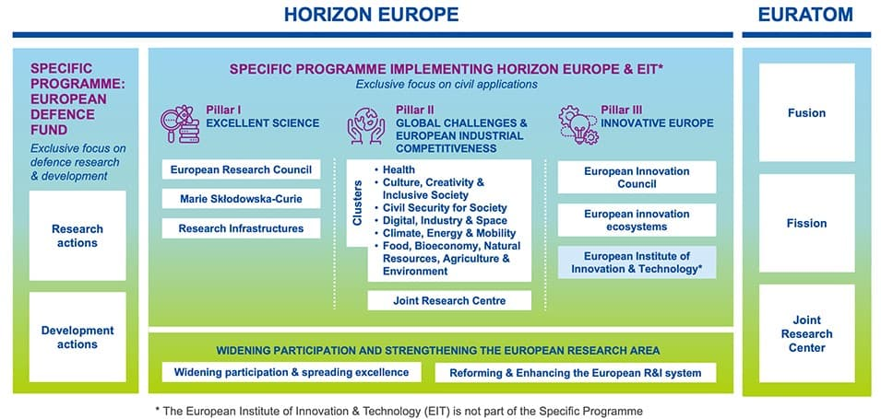
Co-financing rate: 70% to 100%.

Slide 8
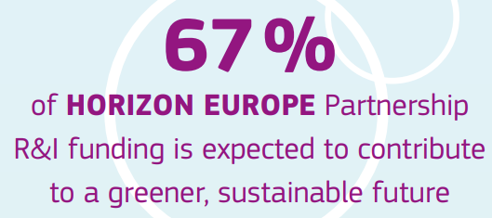
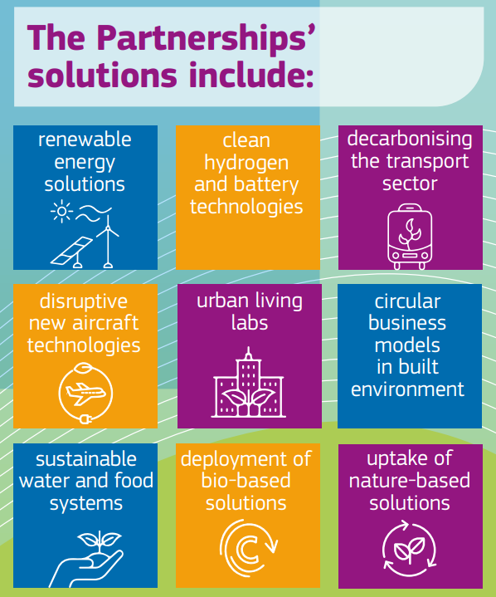
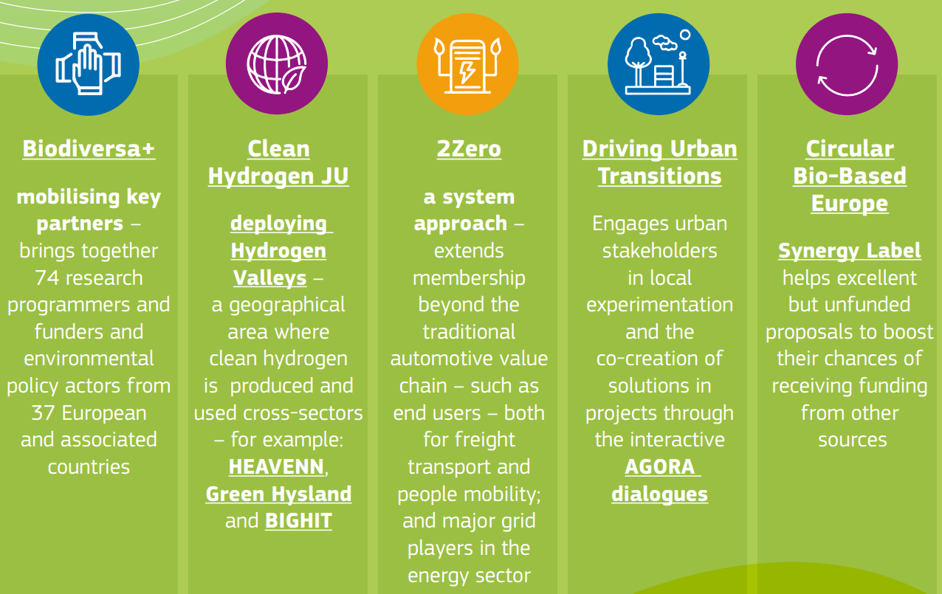

Slide 9
The EU’s programme for tackling climate change and protecting the environment. Supports green innovations and cleantech solutions

Slide 10
The New European Bauhaus (NEB) is all about living spaces and experiences; it seeks to facilitate and steer the transformation of our societies along three inseparable values:
• Sustainability, from climate goals, to circularity, zero pollution, and biodiversity
• Aesthetics, quality of experience and style, beyond functionality
• Inclusion, from valorising diversity, to securing accessibility and affordability
The delivery of the NEB crystallises in several
EU financing instruments dedicating calls to
support pilot projects such as Horizon
Europe, ERDF, Erasmus+, Interreg Europe etc.

Slide 11
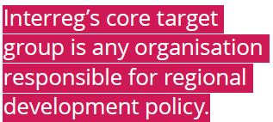
The programme also targets other types of organisations provided that their relevance and competence in regional development policy can be demonstrated
Co-financing rate: 65% to 85%.

Slide 12
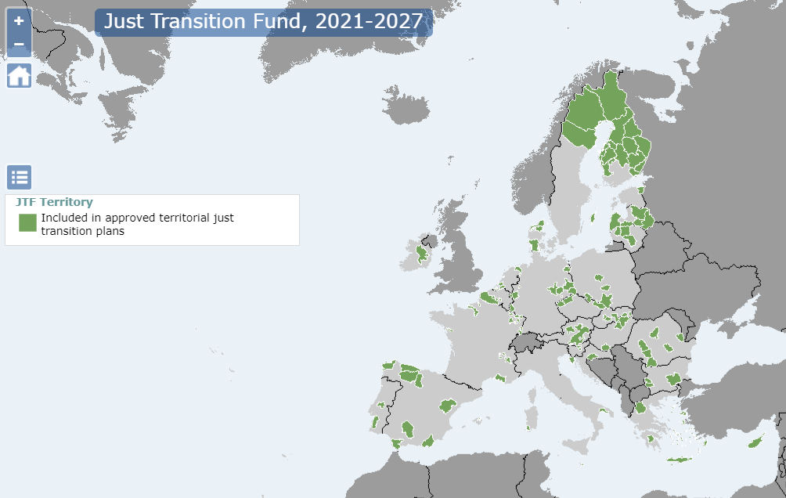
Territories most affected by the transition towards climate neutrality to avoid regional inequalities growing.

Slide 13
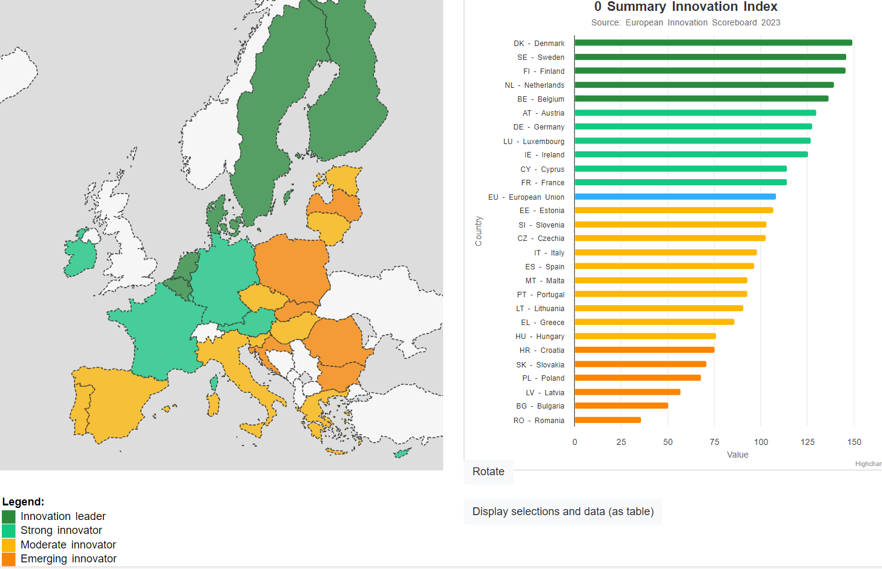

Slide 14
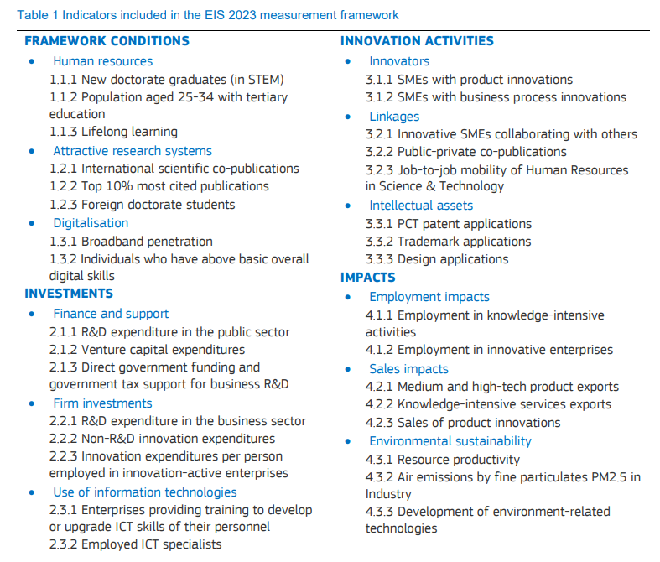

Slide 15
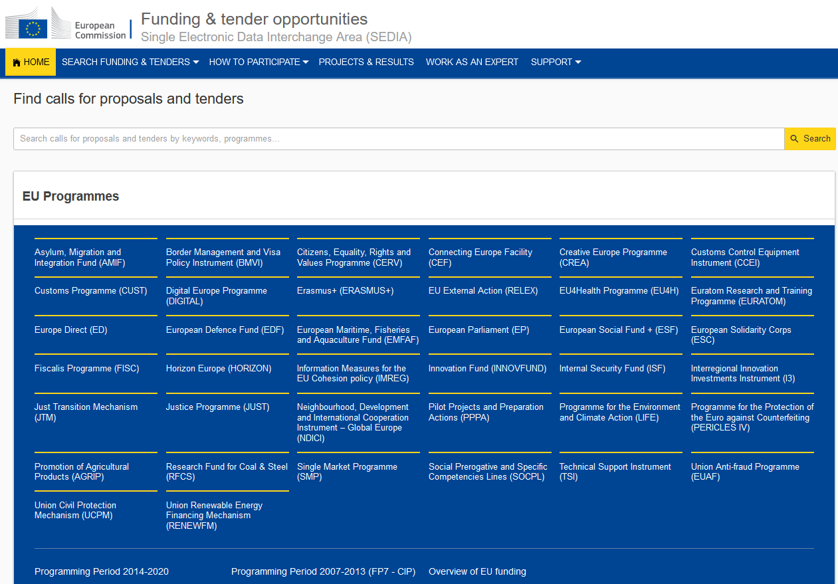
EU Calls Database

Slide 16
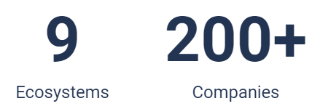
RESEARCH & INNOVATION
Social Sciences, Business, Creative Industries
Water security
Agri-Food business
1. INTEGRATION at SCALE
2. Prototype / Test / PoC
Technologies
Products
Business models
3. Testing laboratories & co-creation platforms
Wellbeing technology
Machine & energy technology
Bio & circular economy
Notes:
Savonia has six R&I focus areas and we host and coordinate three platforms that connect R&I with education and the business world: Business Center, Digi Center and SuperEcosystem.

Slide 18
Backups

Slide 20
Your estimate TIME needed for a Horizon Europe proposal

