Slide 1
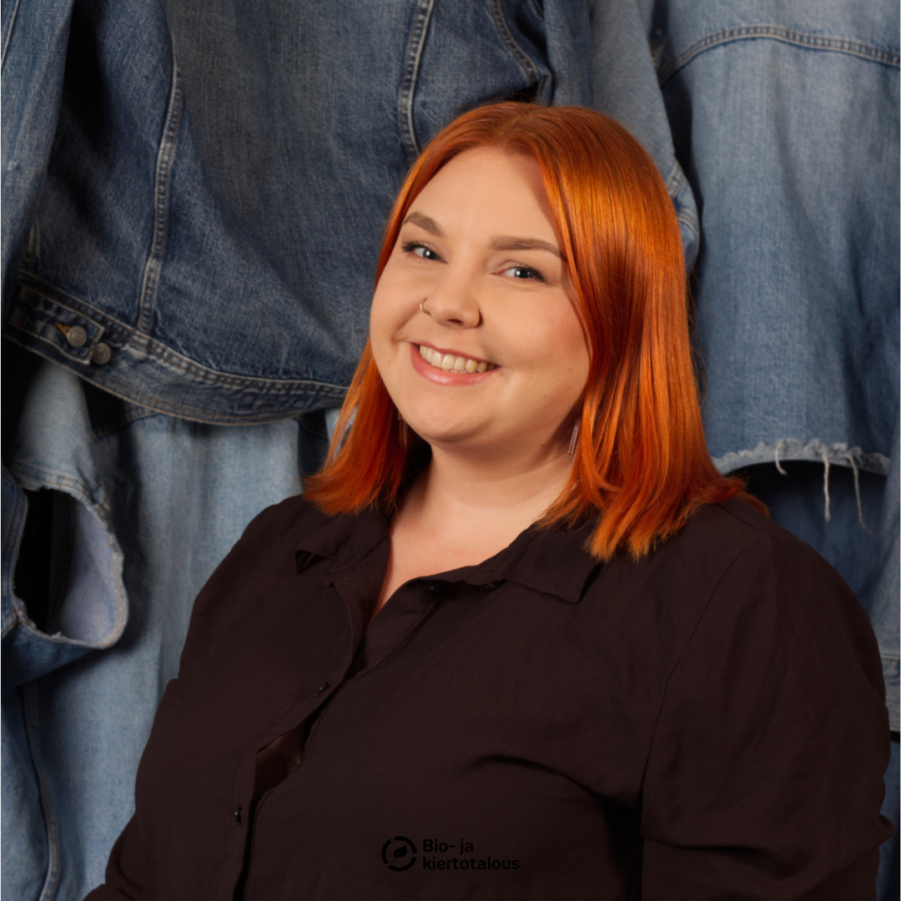
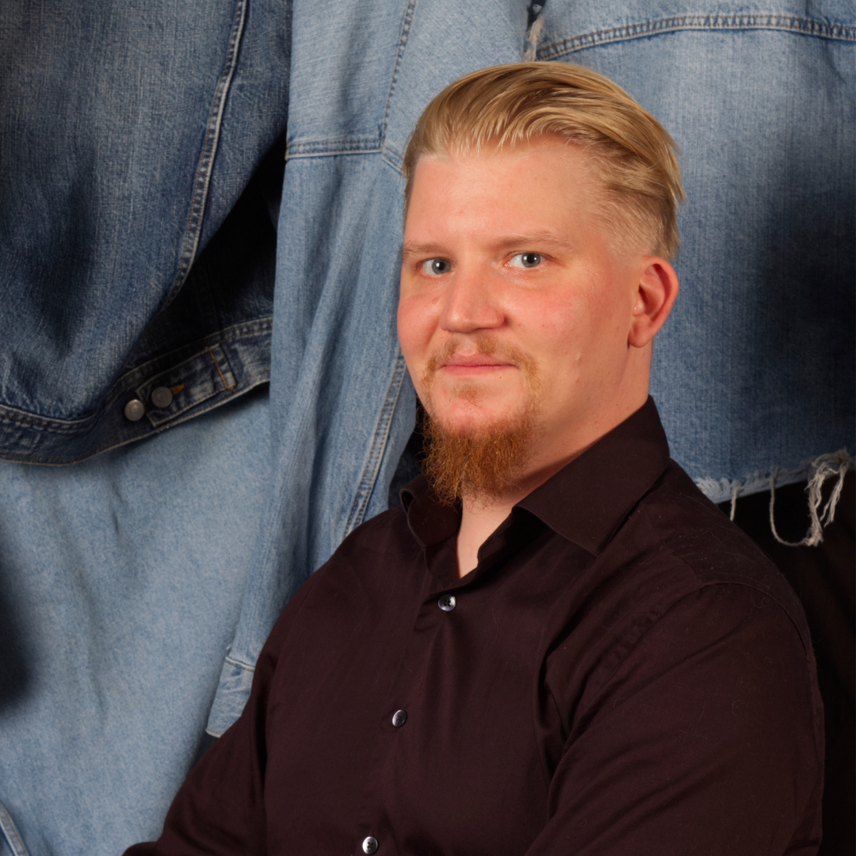
Product innovation workshop: Textile Fiber Mass 12.15-13.45 B5015
Eeva Käärmekallio
RDI Specialist
Mikko Vidgren
RDI Service Designer

Slide 2
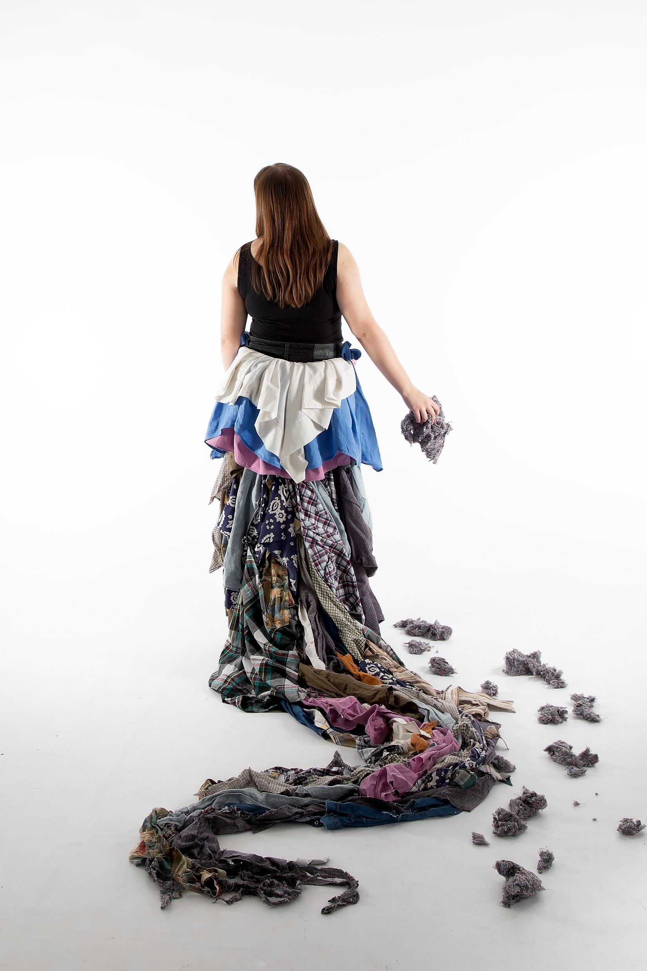
In EU, 22 % of textile waste is collected for reuse or recycling. In 2021, in Finland 85,77 million kilos of textile waste was collected. That’s 11,3 kg per Finn. And only 1 % of it is reused into new products.
Separate collection of textile waste started in 2023 in Finland. EU requires it from its members by 2025. There are only few companies utilizing recycled textile fibers in the use of new products. For example wool yarn if made from recycled wool textiles, partly replacing virgin materials. Hardest fibers to reuse are synthetic and mixed materials.
What can be produced from textile fiber mass? Come and innovate that with us in Product innovation workshop: Textile Fiber Mass. In Savonia UAS we have almost 400 kg of textile fiber mass from Rester in Paimio. More about Rester: https://rester.fi/en/
In this workshop we utilize service design methods to innovate how this material could be used in future product development.
Anniina Saanila, Sustainable fashion course, Savonia-UAS, 2023

Slide 3
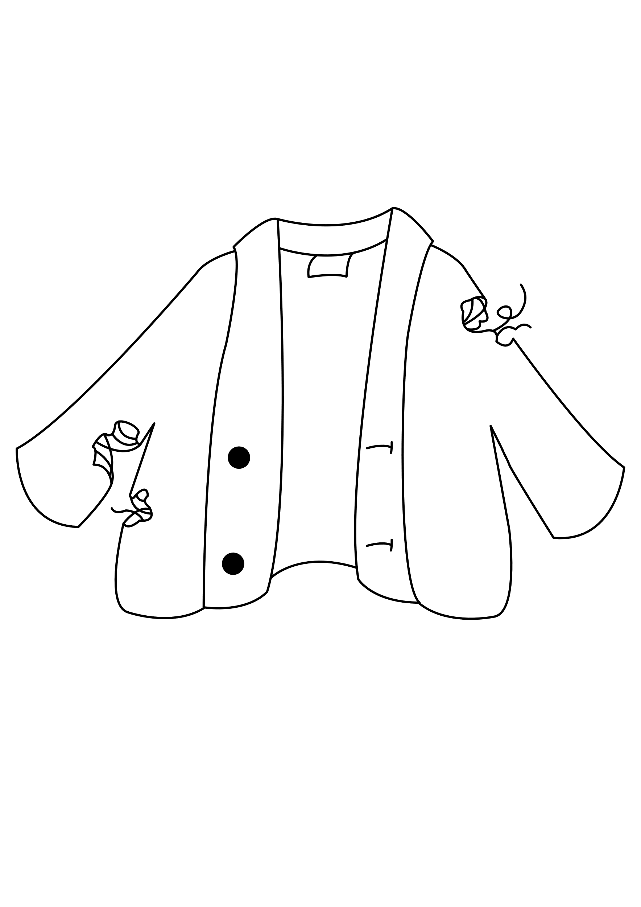
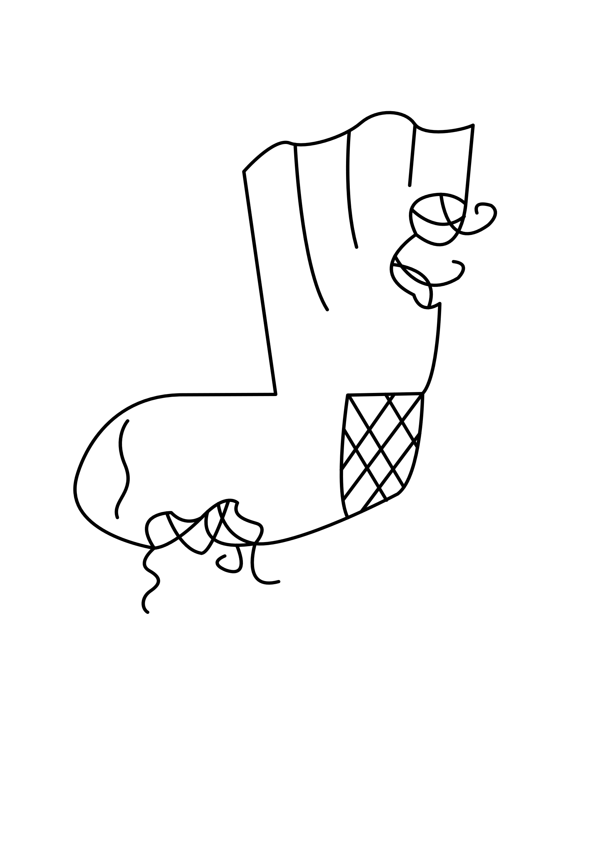
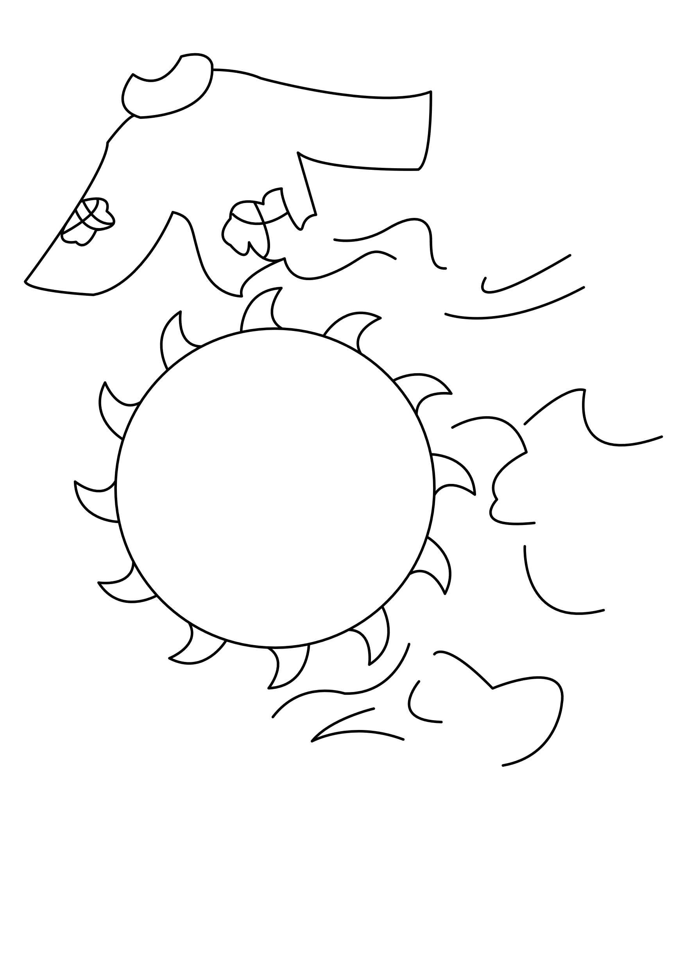
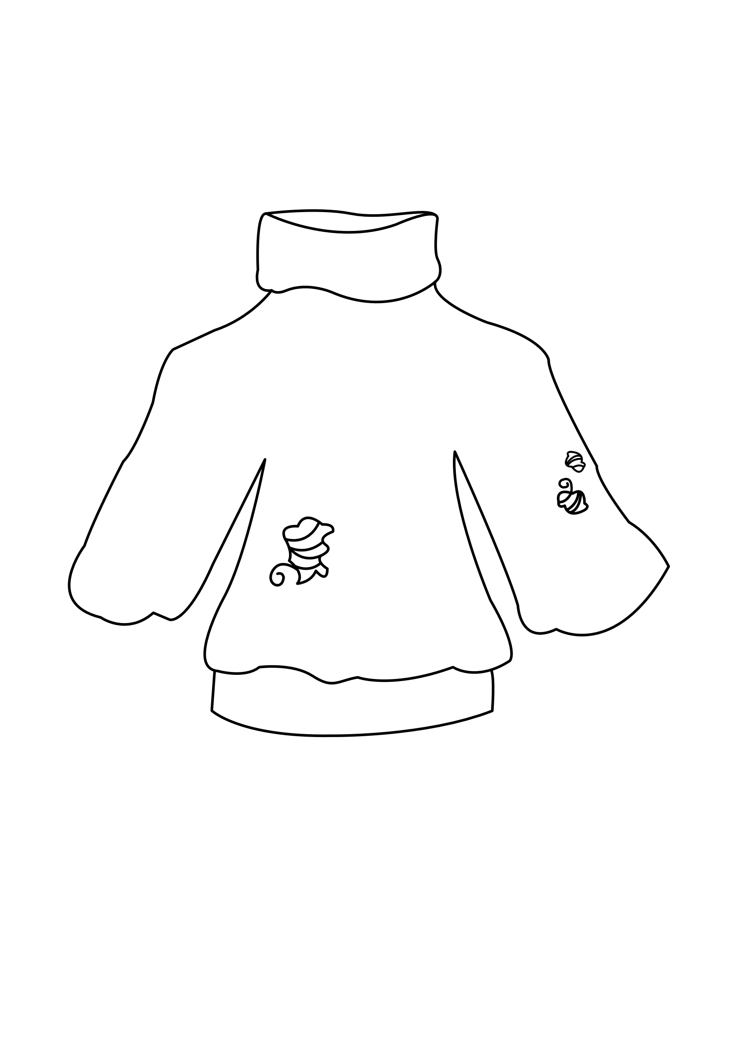
End-of-life consumer textile
Textile fiber mass
Savonia & Elävä
We collected from September to October 2023 200kg of wool products containing at least:
70% wool
30 % other materials e.g. cotton, acrylic, viscose
Rester Oy
Is a company that processes end-of-life textiles to fiber.
Natural fibers (e.g. cotton and wool) are used to reproduce new materials.

Slide 4
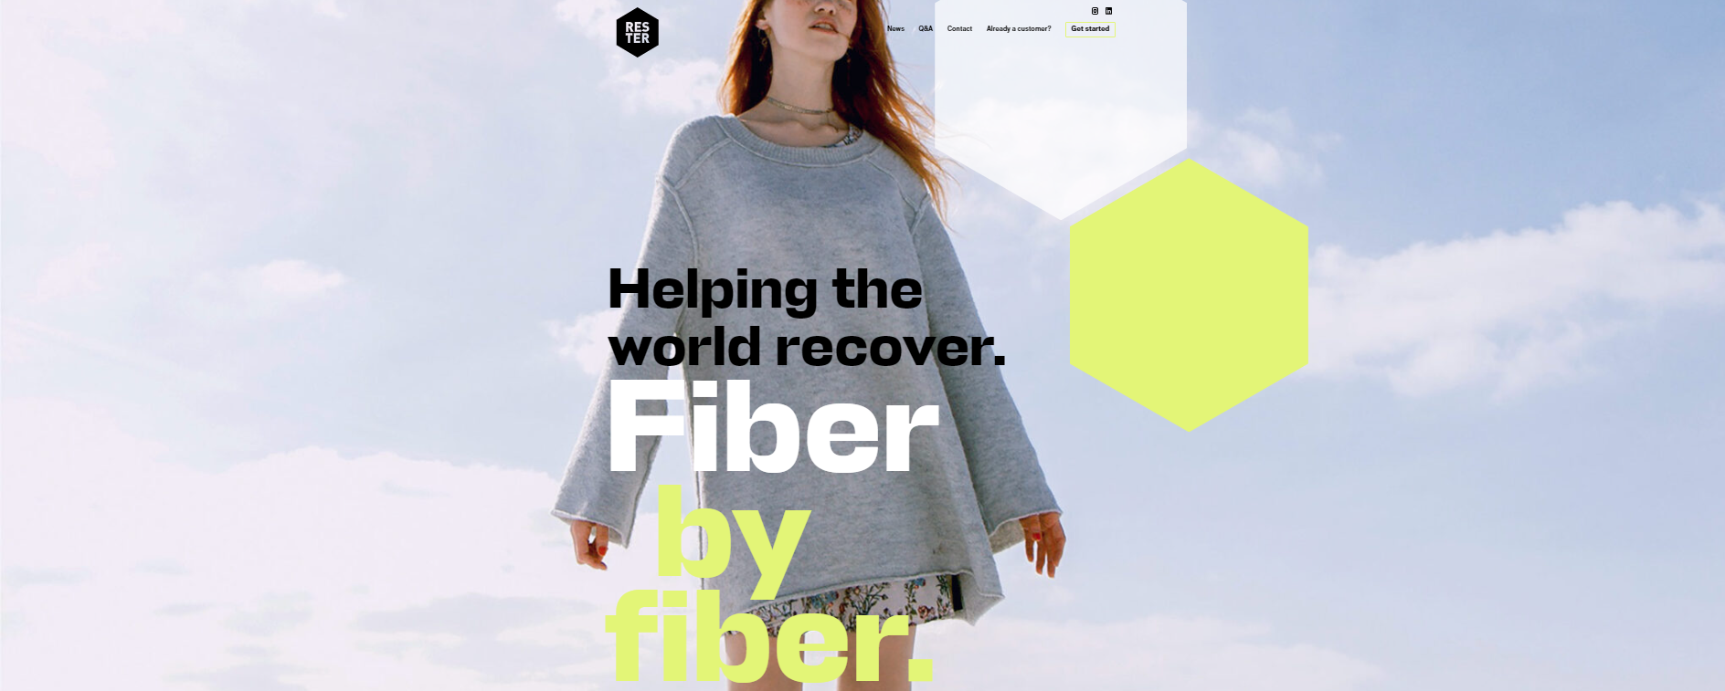
We accept clean, dry and sorted end-of-life textiles from companies and sideflows of production. Received material fractions are at the moment cotton, polyester, cotton-polyester, wool, polypropylene and mixed materials.
As a co-operation with Tekstiilien sivuvirta / Textile sidestream –project we acquired a mixed fiber unit of 200 kg:s for innovation and research.

Slide 5
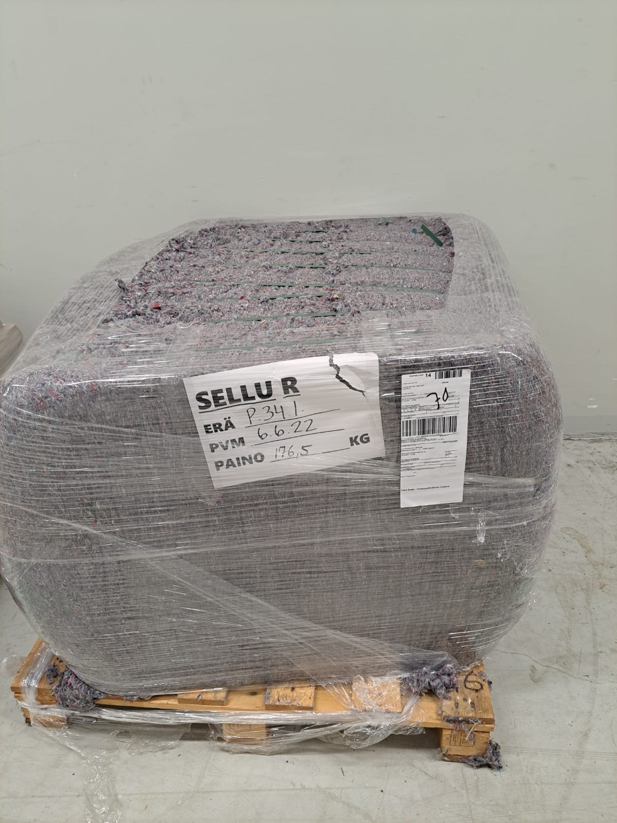
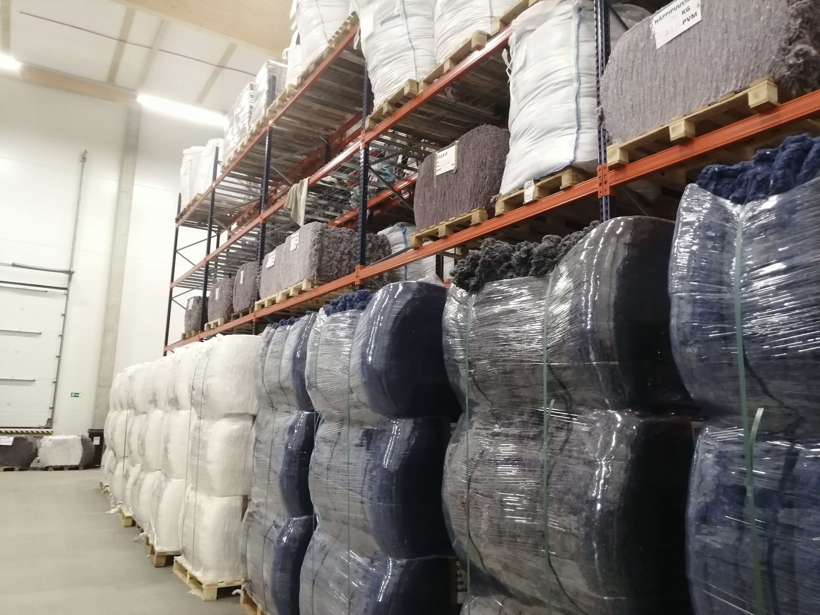
70 % wool
30 % other materials
70 % cotton
30 % mixed materials

Slide 6
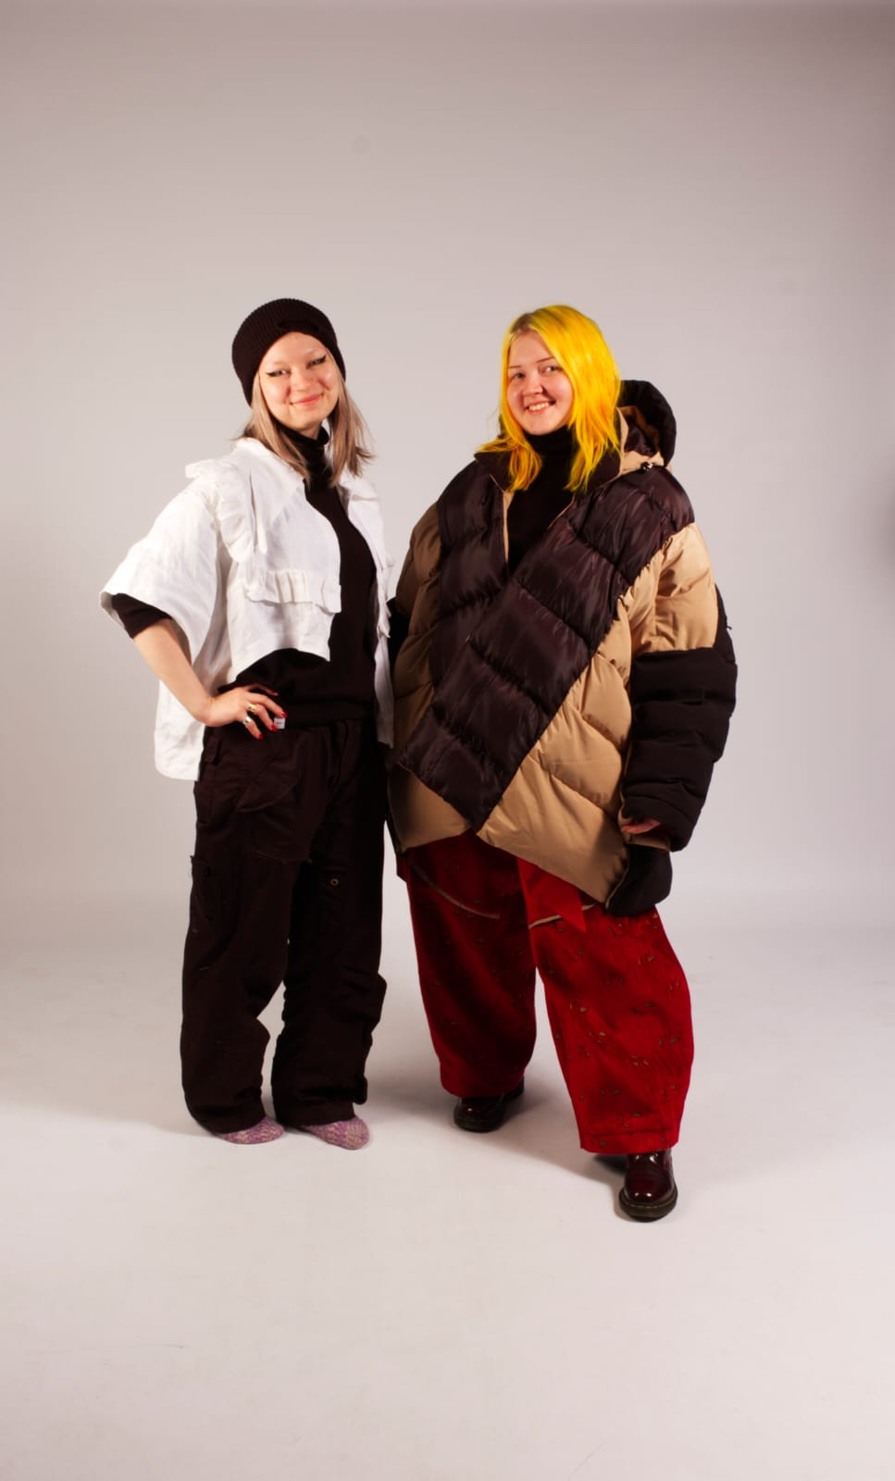
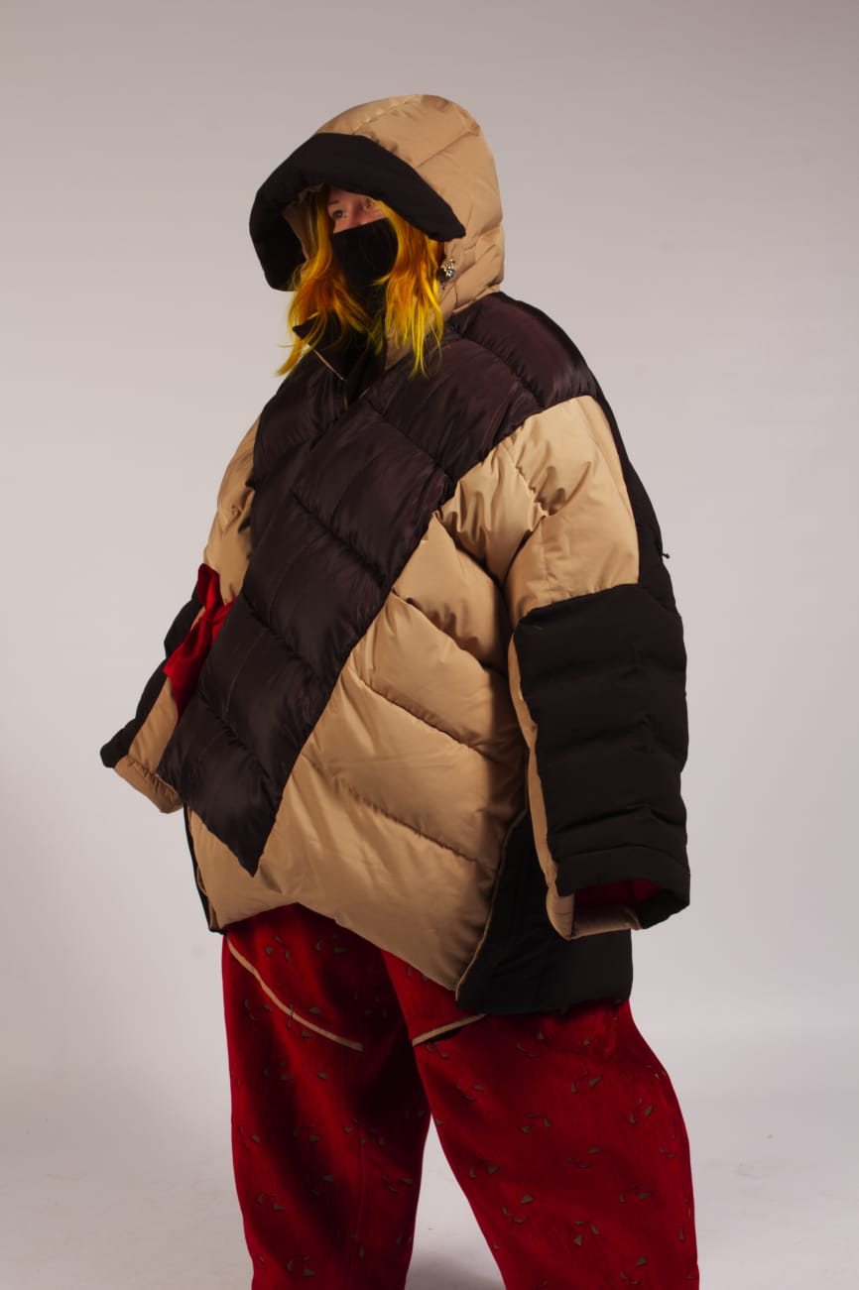
Old to Gold Masterclass by Nora Kühner
Meri Tynkkynen & Katariina Weeman,
Students of Savonia-UAS, design
Fiber was used as filling for outwear jacket and pants designed for a cold future.

Slide 7
Observation period
Observate the fiber materials:
Hapticly – how do they feel?
Moldability – does it stay in shape?
Visual – how does it look like?
Emotions – do the trigger any emotion?
Other?
Please keep in mind the differences of wool and mixed materals.

Slide 8
Observation period, in groups
On post-it notes, please write the following attributes / answer following questions:
Hapticly – how do they feel?
Moldability – does it stay in shape?
Visual – how does it look like?
Emotions – do the trigger any emotion?
Other?
Please keep in mind the differences of wool and mixed materals.

Slide 9
Everyday solutions
From your unique point of view. Your life and experiences.
Is the material solution for an everyday problem? E.g. in your hobbies, home, work.
Write solutions to post-it notes.

Slide 10
Connect the observation and solution
Organize your post-its as follows:
Solution
Solution
Solution
Solution
Observation
Observation
Solution
Solution
Solution
Solution

Slide 11
Final innovation
In groups: choose the most innovative observation-solution –group, and present it to the workshop.
Insulation
Filter
The material looks and feels disgusting
Filling
Cleaning rag

