Slide 1


WP3
February 2024
Minna Kaarakainen, Savonia
Miroslaw Wesolowski, KUT

Slide 2






Grand innovation challenges
 | Grand challenge 1: Future of work | Grand challenge 2: Green economy | Grand challenge 3: Healthy living
Challenge statements | Support economic growth and competitiveness via the sustainable transition of industry to a new model of digitally-based production, while increasing quality of life for all employees. | We must give our society the capability to support the transition to economies that are low carbon, resource efficient and socially inclusive. | The challenge is to harness innovation, research and social outreach to increase quality of life, extend lifespans and increase happiness.
Subtopics | Twin transition │ Smart Industry Skills for future │ Collaborative intelligenc │ LLL │ Flexiblilty of workplace │ Human-Centric manufacturing | Climate security │ Sustanable energy engineering │ Green data │ Bio- and circular economy │ Green transition in agriculture and food production │ Sustanable tourism │ Sustainable design | Health promotion │ Disease prevention │ Personalised nutrition │Health apps │ Workplace design
Leading insitution | FH Joanneum Koszalin University of Technology | Savonia MCAST | DHBW PAR
 | Grand challenge 1: Future of work | Grand challenge 2: Green economy | Grand challenge 3: Healthy living
Challenge statements | Support economic growth and competitiveness via the sustainable transition of industry to a new model of digitally-based production, while increasing quality of life for all employees. | We must give our society the capability to support the transition to economies that are low carbon, resource efficient and socially inclusive. | The challenge is to harness innovation, research and social outreach to increase quality of life, extend lifespans and increase happiness.
Subtopics | Twin transition │ Smart Industry Skills for future │ Collaborative intelligenc │ LLL │ Flexiblilty of workplace │ Human-Centric manufacturing | Climate security │ Sustanable energy engineering │ Green data │ Bio- and circular economy │ Green transition in agriculture and food production │ Sustanable tourism │ Sustainable design | Health promotion │ Disease prevention │ Personalised nutrition │Health apps │ Workplace design
Leading insitution | FH Joanneum Koszalin University of Technology | Savonia MCAST | DHBW PAR

Slide 3
WP3 coreteam (1/2024)
GC 1
Future of Work
GC 2
Green
Economy
GC 3
Healthy
Living
Chair: Minna Kaarakainen
(WP3 Leader) (SAVONIA)
GC1 Leader:
Maja Dragan (FHJ)
Chair: Minna Kaarakainen
(WP3 Leader) (SAVONIA)
GC1 Leader: Jyri Wuorisalo (SAVONIA)
Chair: Minna Kaarakainen
(WP3 Leader) (SAVONIA)
GC1 Leader: Kathrin Friedrichs (DHBW)
WP3 Co-Leader: Miroslaw Wesolowski (KTU)
GC1: Co-leader Krzysztof Wasilewski (KUT)
WP3 Co-Leader: Miroslaw Wesolowski (KUT)
GC1 Co-Leade: Louis Aquilina (MCAST)
WP3 Co-Leader: Miroslaw Wesolowski (KUT)
GC1 Co-Leader: Andrea Milić
(PAR)
Local WP3 heads + Coordinators of the GC activities from each organisation
Local WP3 heads + Coordinators of the GC activities from each organisation
Local WP3 heads + Coordinators of the GC activities from each organisation

Slide 4
GC1 team
Academic secretariat of a joint dual master in GC1:
KUT, MU, DHBW, FHJ, JNU, MCAST, PAR, ESTIA, SAVONIA
GC 1
Future of Work
Coordinators of a joint dual master in GC1:
KUT, MU, DHBW, FHJ, JNU, MCAST, PAR, ESTIA, SAVONIA
Coordinators for GC1 activities:
KUT, MU, DHBW, FHJ, JNU, MCAST, PAR, ESTIA, SAVONIA
Chair: Minna Kaarakainen
(WP3 Leader) (SAVONIA)
GC1 Leader:
Maja Dragan (FHJ)
WP3 Co-Leader: Miroslaw Wesolowski (KTU)
GC1: Co-leader Krzysztof Wasilewski (KUT)
Experts
KUT, MU, DHBW, FHJ, JNU, MCAST, PAR, ESTIA, SAVONIA
Stakeholders

Slide 5
GC2 team
Academic secretariat of a joint dual master in GC2:
KUT, MU, DHBW, FHJ, JNU, MCAST, PAR, ESTIA, SAVONIA
GC 2
Green economy
Coordinators of a joint dual master in GC2:
KUT, MU, DHBW, FHJ, JNU, MCAST, PAR, ESTIA, SAVONIA
Coordinators for GC2 activities:
KUT, MU, DHBW, FHJ, JNU, MCAST, PAR, ESTIA, SAVONIA
Chair: Minna Kaarakainen
(WP3 Leader) (SAVONIA)
GC2 Leader: Jyri Wuorisalo (SAVONIA)
WP3 Co-Leader: Miroslaw Wesolowski (KUT)
GC2 Co-Leader: Louis Aquilina (MCAST)
Experts
KUT, MU, DHBW, FHJ, JNU, MCAST, PAR, ESTIA, SAVONIA
Stakeholders
Names are from the alliance directory: this will be updated

Slide 6
GC3 team
Academic secretariat of a joint dual master in GC3:
KUT, MU, DHBW, FHJ, JNU, MCAST, PAR, ESTIA, SAVONIA
GC 3
Healthy living
Coordinators of a joint dual master in GC3:
KUT, MU, DHBW, FHJ, JNU, MCAST, PAR, ESTIA, SAVONIA
Coordinators for GC3: activities:
KUT, MU, DHBW, FHJ, JNU, MCAST, PAR, ESTIA, SAVONIA
Chair: Minna Kaarakainen
(WP3 Leader) (SAVONIA)
GC3 Leader: Kathrin Friedrichs (DHBW)
WP3 Co-Leader: Miroslaw Wesolowski (KUT)
GC3 Co-Leader: Andrea Milić
(PAR)
Experts
KUT, MU, DHBW, FHJ, JNU, MCAST, PAR, ESTIA, SAVONIA
Stakeholders
Names are from the alliance directory: this will be updated

Slide 7
Task overview

Slide 8
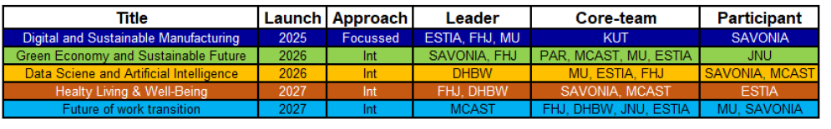
Joint-master programs

Slide 9
Research
Lighthouse research initiatives:
Business & Management for Green Transition – Leader Savonia
Engineering for Sustainable and Digital Industry – Leader ESTIA
Health and Welfare Transition – Leader FHJ
Interdisciplinarity in Social Sciences: A European way of life – Leader KUT

Slide 10
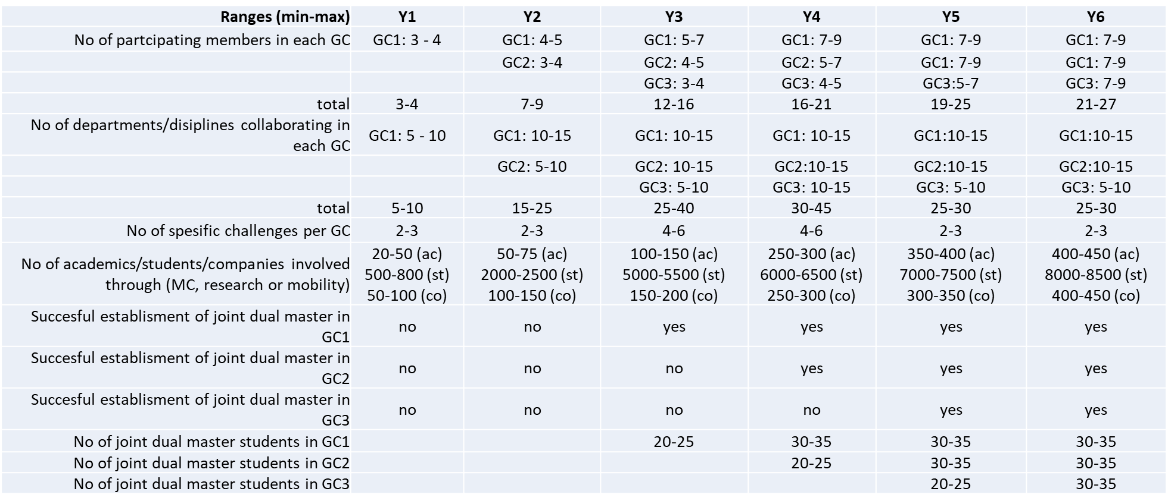
Indicators

Slide 11
Thank you

