Slide 1
Savonia International Week ILCA Project
Miika Kajanus, Jyri Wuorisalo, Bailey Lähdesmäki
Savonia UAS
Tuesday 20 February, 2024
Kuopio, Finland

Slide 2
Agenda 13:30-15:00 (B5015)
13:30-13:35 Welcome and introductions
13:35-13:45 About ILCA and Climate Roadmaps
13:45-13:55 Climate Crisis & Ukrainian international activities
13:55-14:05 ILCA Lab Concept – involving ecosystem actors
14:05-14:20 Coffee break
14:20-15:00 Breakout sessions
What have been your experiences with climate action-related systemic change? What good practices have you discovered? What still needs to be done?
How would you like to collaborate?

Slide 3
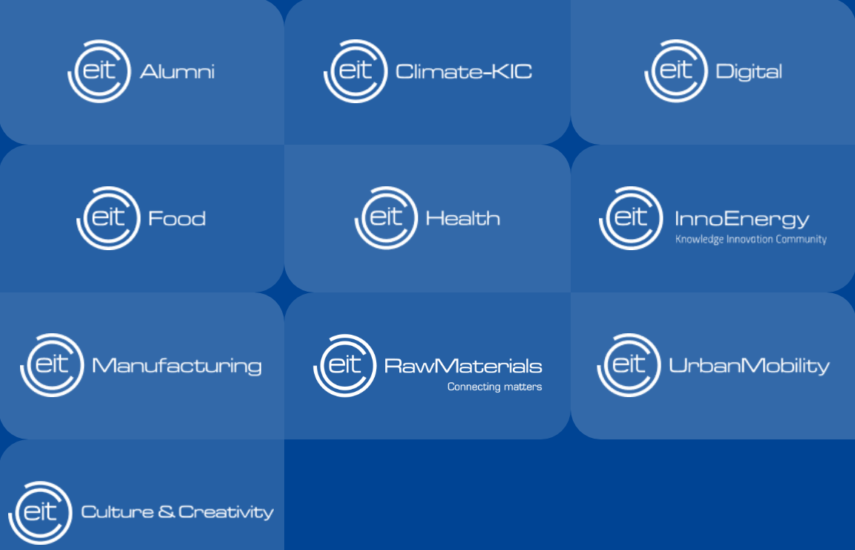
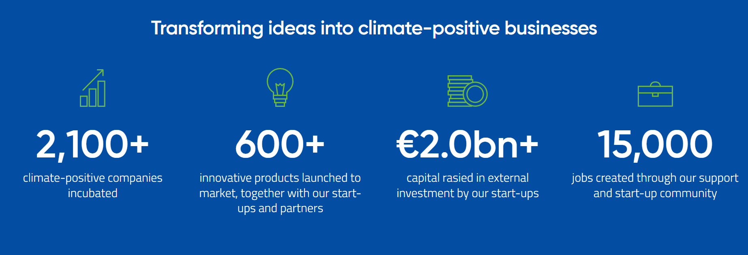
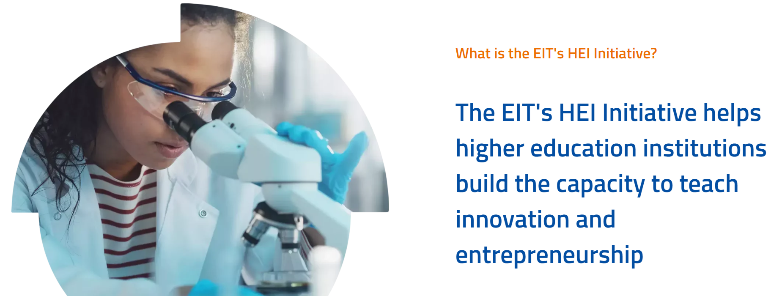
The European Institute of Innovation and Technology (EIT) is an EU body created in 2008 to strengthen Europe’s ability to innovate.
WHAT IS EIT CLIMATE-KIC?
We are Europe’s leading climate innovation initiative applying systemic approach for climate actions

Slide 4
Objectives & Work packages
https://ilca-project.eu/
https://eit-hei.eu/projects/ilca/
https://www.linkedin.com/in/innovation-laboratories-for-climate-actions-ilca-5712b3289/

Slide 5
Climate Roadmap Actions
Develop the system of sorting and separate collection of household waste; 7)
1) Advanced complex monitoring of militarily transformed agrolandscapes;
Municipality
2) The model of development of organic agriculture within the framework of the European Green deal;
Agriculture
Create a strategy for sustainable urban transport mobility; 8)
Increase the ecological culture of producers and consumers; 9)
3) Stabilization of the grain production in Ukraine based on innovative technologies and varietal resources;
Development of a set of measures to adapt the Chernivtsi economy to global climate change; 10)
4) Climate-smart agriculture to sustain economic crop productivity;
Carbon neutrality
Adaptation
Synergy
Tradeoff
Unintended consequences
Connections
5) Carbon farming on the irrigated soils as an instrument for implementation of European policy Green Deal;
Elimination of existing spontaneous landfills and prevention of the formation of new ones. 11)
Joint (Ukrainian-Romanian) strategy for sustainable development and response to hydrological hazards; 12)
6) Development of climate-oriented crop fertilization systems in post-war Ukraine;
Restoration of damaged network infrastructure; 13)
16) Development of hydrogen production;
Determination of steps to improve the sustainability of the energy system in the long term; 14)
17) Development of low-carbon and highly maneuverable generation;
Reducing dependence on energy imports; 15)
18) Increasing the efficiency of the use of energy resources;
Energy
Case Ukraine 2023 - 2024

Slide 6
"A portfolio decision analysis approach for selecting a subset of interdependent actions: The case of a regional climate roadmap in Finland" Science of The Total Environment 2024
https://www.sciencedirect.com/science/article/pii/S0048969723081780

Slide 7
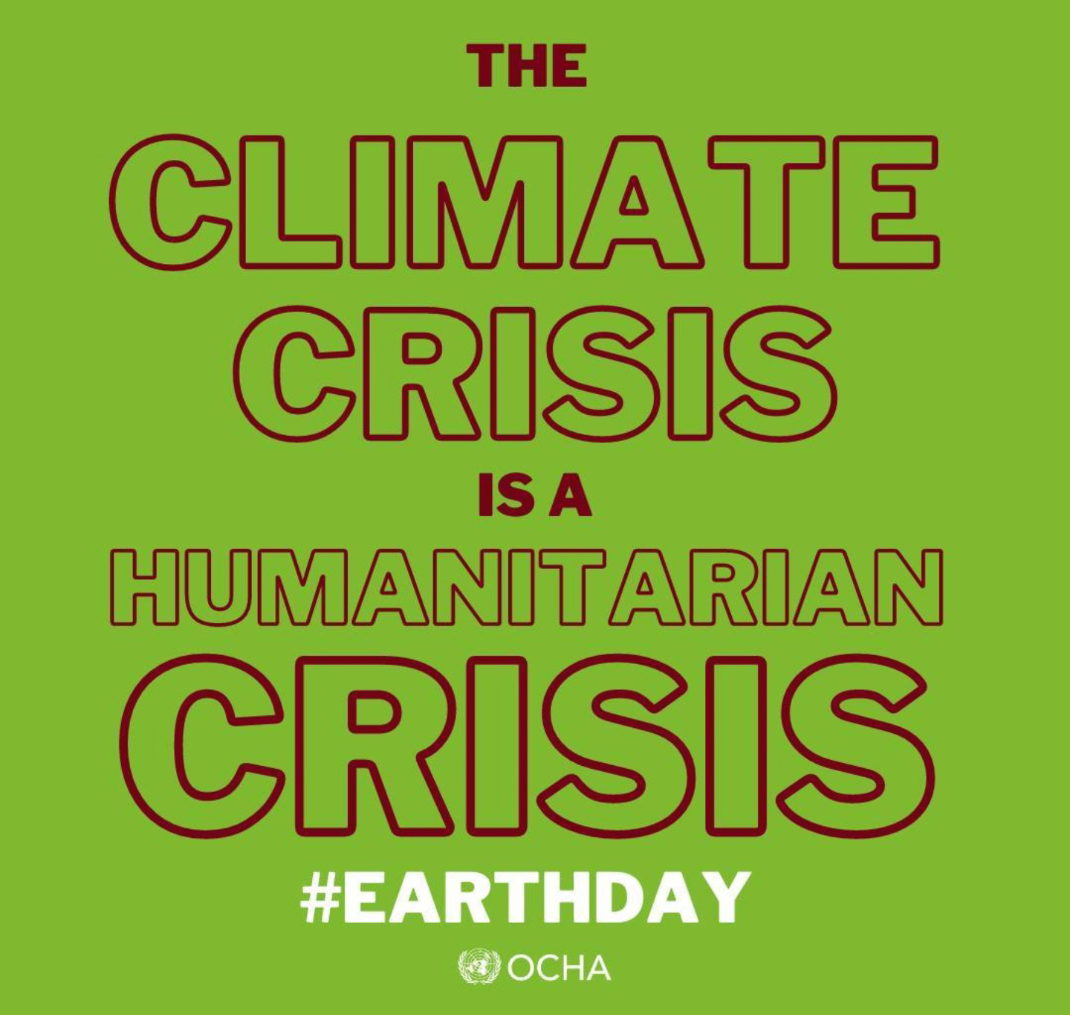
Climate Security - Leave no one behind

Slide 8
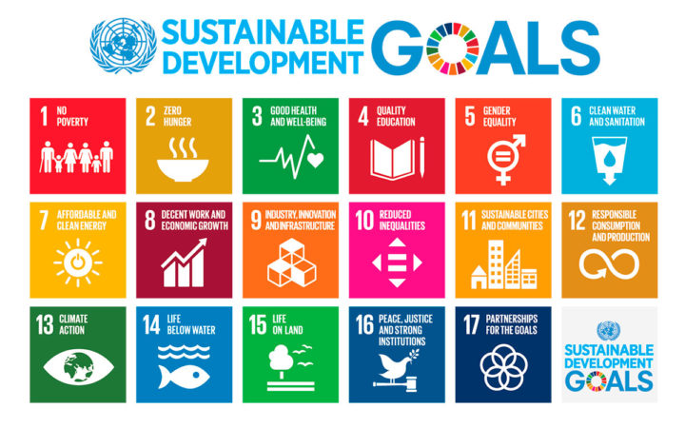
Climate Security - Leave no one behind
Human Security

Slide 9
Climate Security - Leave no one behind
Leave no one behind
Do no harm

Slide 10
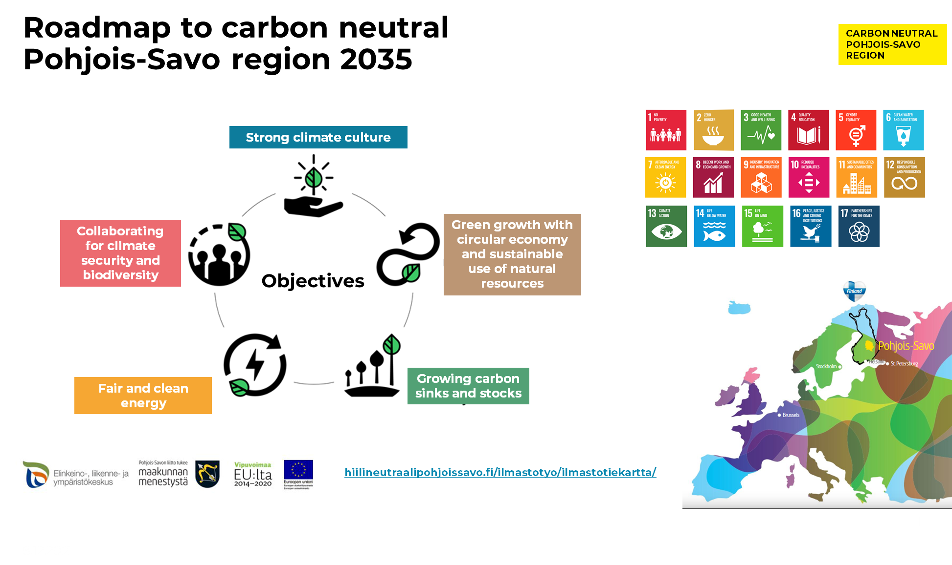
Climate Security - Leave no one behind
Collaborating for climate security and biodiversity
Ensuring climate security and adapting to and preparing for climate change are essential in order to keep the negative effects of climate change as small as possible.
Climate security work is a key part of the implementation of the UN Agenda 2030 and Human Security goals.

Slide 11
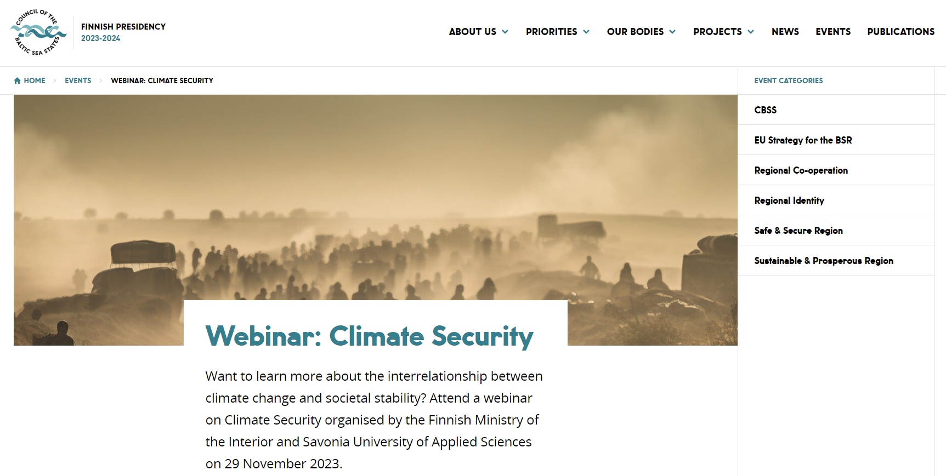
Climate Security - Leave no one behind

Slide 12
Climate Security - Leave no one behind

Slide 13
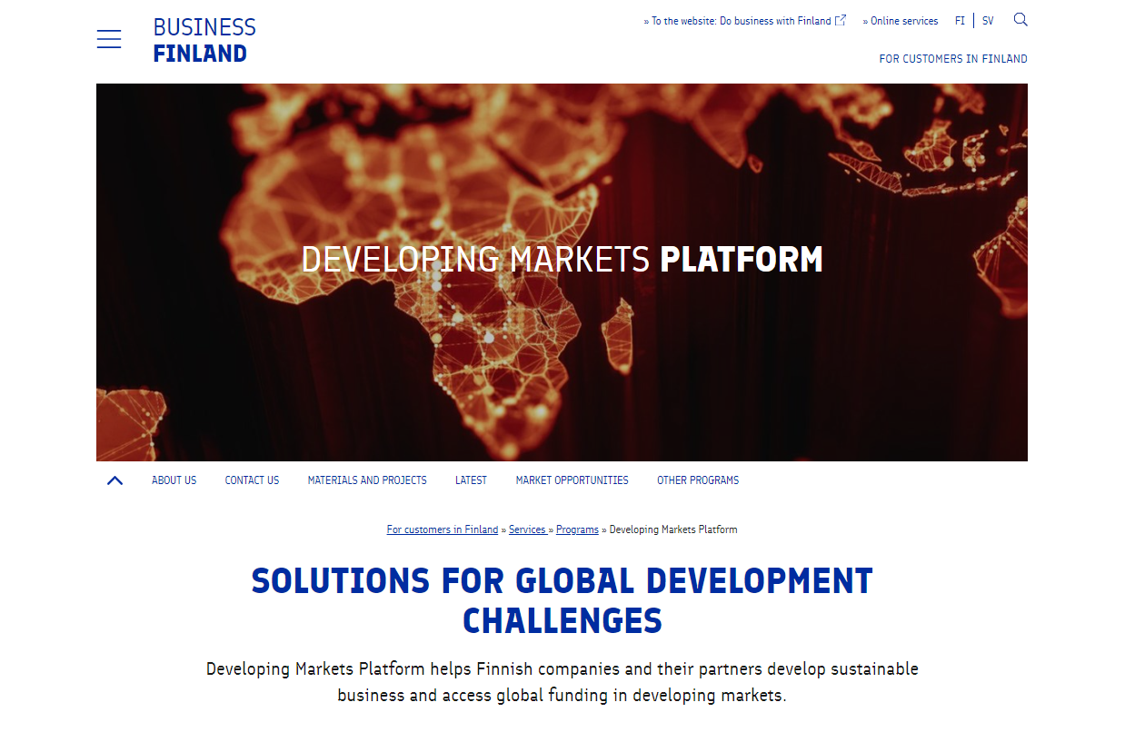
Climate Security - Leave no one behind

Slide 14
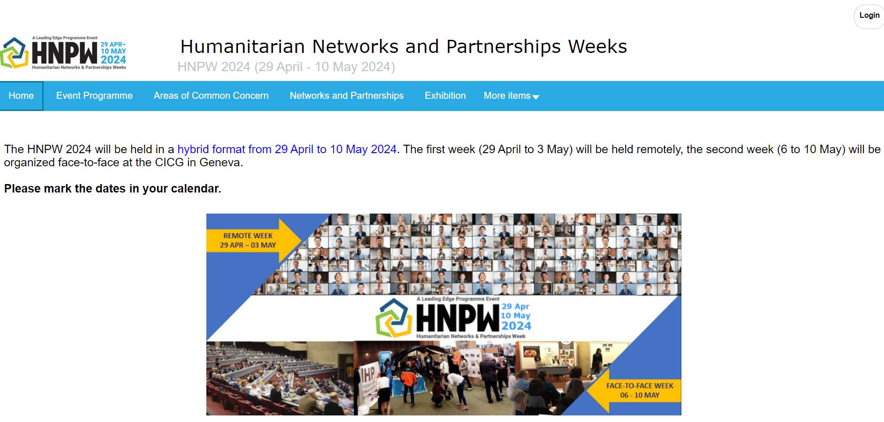
Climate Security - Leave no one behind

Slide 15
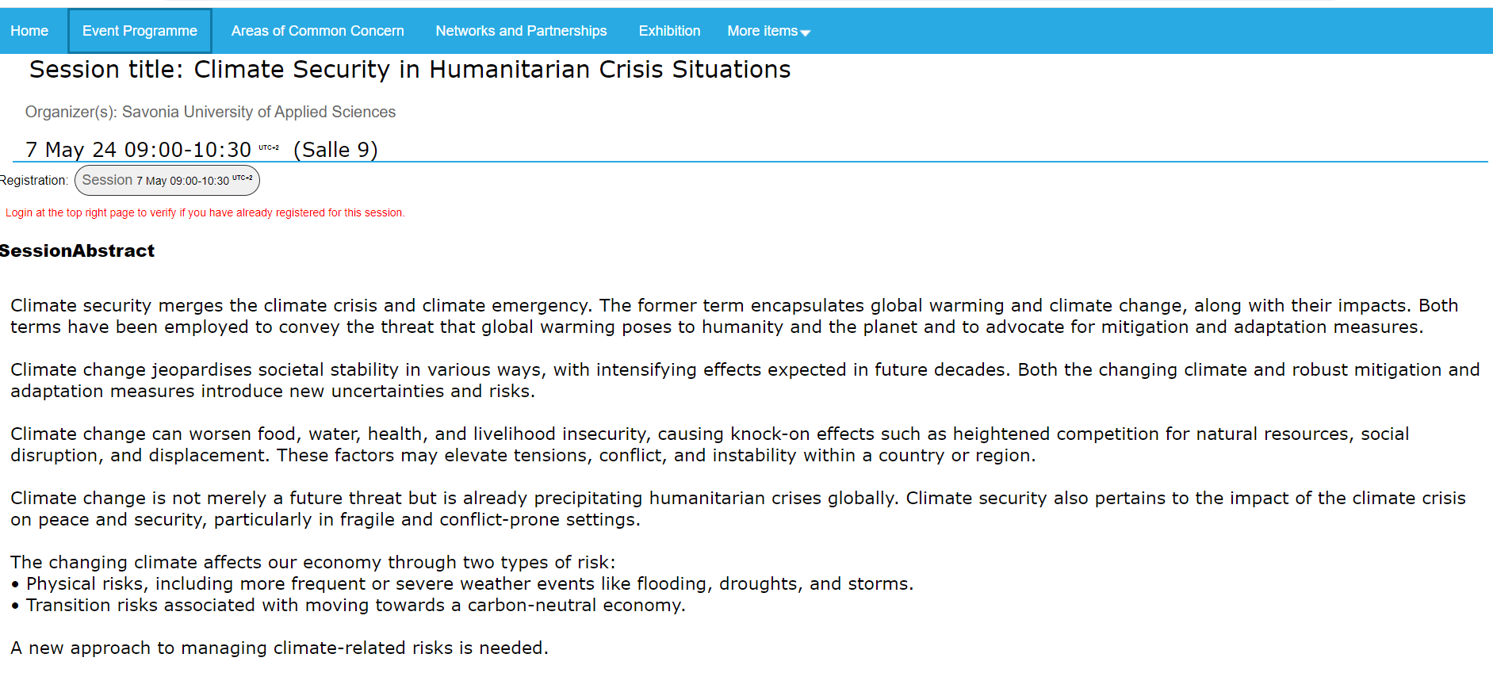
Climate Security - Leave no one behind

Slide 16
Climate Security - Leave no one behind

Slide 17
ILCA Lab Concept
Co-creative processes deeply involving ecosystem actors
Train-the-trainer mentality
Institutional capacity building to drive long-term impact
Need and capability understanding
What do we already have? What do we know? What can we already do?
What do we need in the future? What do we need to learn? What should we do together?
Stakeholder mapping – regional and national – positioning
Integration with business support services and education

Slide 18
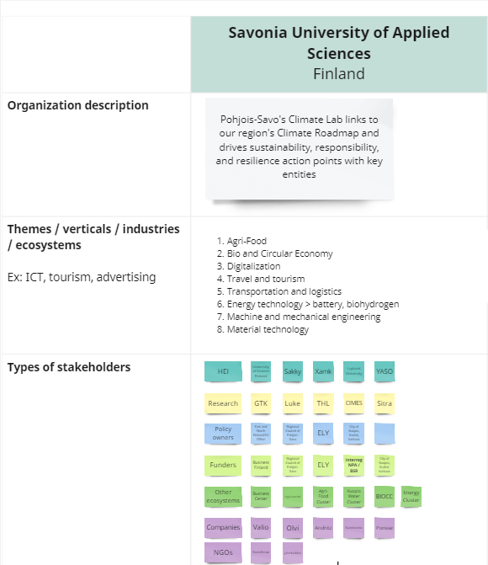
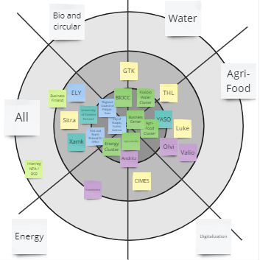
ILCA Lab Concept

Slide 19
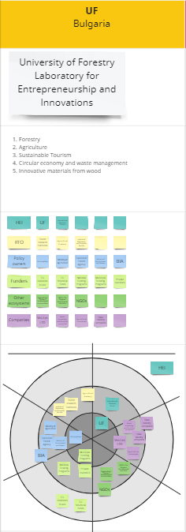

Slide 20
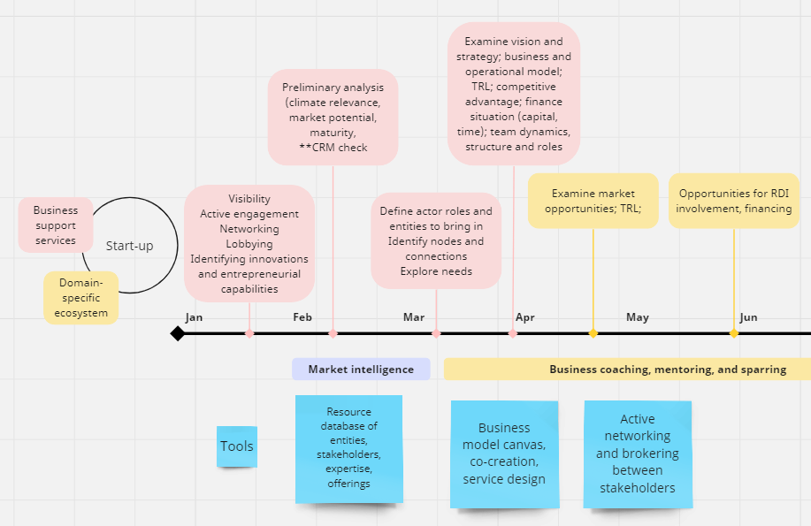
ILCA Lab Concept - Integration

Slide 21
ILCA Lab Concept - Structure

Slide 22
ILCA Lab Cooperation - RDI
Actively scanned suitable RDI instruments and calls (regional, national and international)
Evaluated suitability and built consortia
Negotiated with decision-makers and consultants
Facilitated proposal preparation
Contributed to proposal writing and budgeting
Administrated proposal platforms and systems

Slide 23
COFFEE BREAK Meet someone new ☺

Slide 24
Breakout sessions
Discuss in small groups (max 5 people)
What have been your experiences with climate action-related systemic change?
What good practices have you discovered?
What still needs to be done?
How would you like to collaborate?

Slide 25
Thank you! Miika.Kajanus@savonia.fi Jyri.Wuorisalo@savonia.fi Bailey.Lahdesmaki@savonia.fi

