Slide 1
Digital routes of Northern Savo –project Ideation workshop 22.2.2024 www.digireitit.savonia.fi

Slide 2
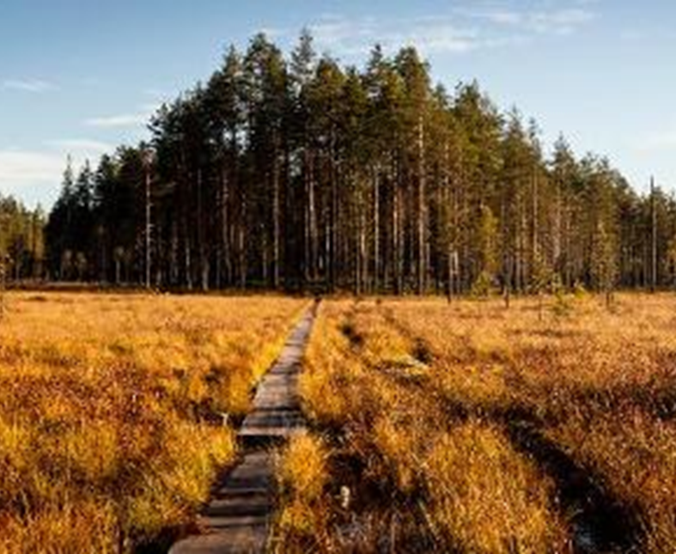
Digital routes of northern Savo –project team
Katariina Moilanen, project manager
Kalle Sievänen, RDI specialist / immersive technologies & gamification
Miia Heiskanen, RDI specialist / technical implementations
Petra Laakso, RDI specialist / tourism
Alina Ankudovich, Trainee / tourism

Slide 3
Producing virtual content
In this project virtual nature travel content made for international markets is being created and tested. We plan to produce at least three routes to be virtually experienced.
One of the routes will also have gamified, interactive elements. A livestream experience with a guide will also be produced.
The objective is also to encourage the collaboration of nature tourism operators and content creators and develop new remotely experienced virtual nature tourism products.
Virtual content offers also a sustainable and inclusive way of experiencing the nature.

Slide 4
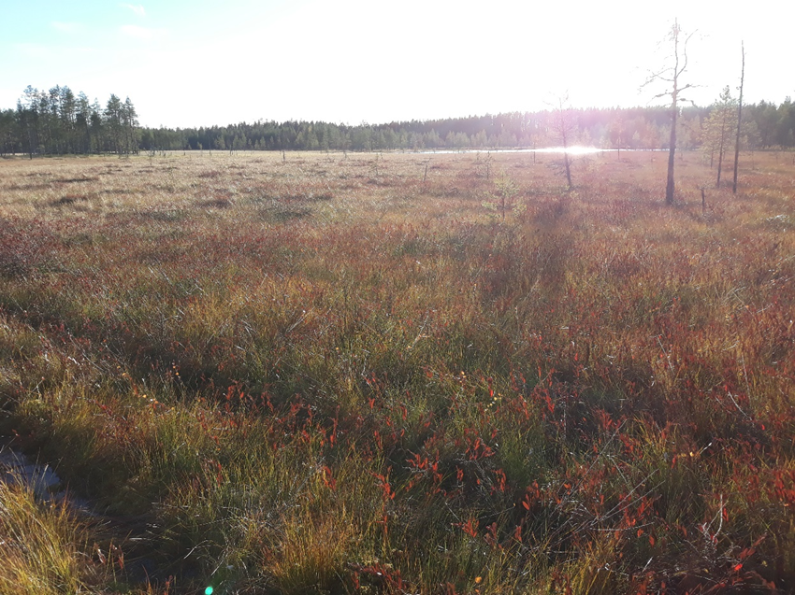
Tiilikkajärvi National Park
One of the chosen routes is Uiton Kierto in Tiilikkajärvi National Park, Rautavaara. The national park is located about 120 km northeast from Kuopio.
In this beautiful and remote area you can admire the ridges, marsh sceneries and wilderness lakes.
Video

Slide 5
Now we would love to hear your thoughts!
For example...
Do you think that nature can be experienced remotely, using virtual content and equipments?
What kind of experiences would you be interested to try out?
For who or for which puproses do you think remote virtual nature experiences might be suitable?
What should be taken into consideration when producing virtual nature experiences?
What else comes to your mind?

Slide 6
Find a space with your own paper and a color pen.
When the music starts, you can start writing or drawing your thoughts or ideas.
When the music stops, please move to the left to the next paper with your own color pen.
Based on previous comments add your own thoughts on the paper.
After a full round present briefly the last paper that you wrote on.
One round is 2 minutes!

